Slide 1
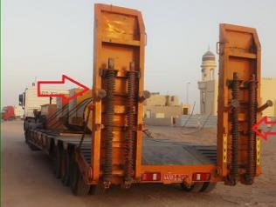
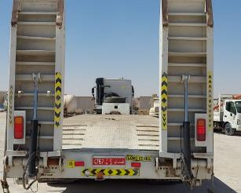
PDO Second Alert
Date: 20.02.2022 Incident title: LTI#04 Pattern: Struck By Potential severity: C4P
Target Audience: Drilling, Workover, Construction, Logistics
What happened?
On 20.02.2022 the hoist move was in progress. The Heavy Vehicle Driver (HV Driver) and the Floorman were at the old location in order to load the Cherry Picker on a low bed trailer. They tried to lower the rear spring-loaded ramps of the low-bed trailer. While doing so, they noticed that one of the spring-loaded ramps was broken. The issue was communicated to the Night Toolpusher (NTP) via WhatsApp. Meanwhile the HV Driver brought a crowbar and was attempting to adjust the spring while the Floorman was pushing the ramp in order to release the tension. The spring got released suddenly causing the ramp to spring back and lower at a much faster speed than expected. In the result, the Floorman sustained an injury and was shifted to Salalah hospital for further medical treatment.
Why it happened/Finding :
The damaged ramp was identified and the NTP was informed prior to starting the job
The Floorman and the HV Driver failed to wait for the further instructions from the NTP and proceeded with the task
The Floorman was standing in the line of fire
No risk assessment was performed, no intervention was made to stop the unsafe practices
No direct supervision at the time of the incident (hoist move, out of sight)
The receiving inspection of the trailer had not been done to identify the issue with the ramp before the hoist move
Your learning from this incident..
Always have adequate supervision and manage out of sight accordingly
Always stay away from Line of Fire hazards
Always perform the in-coming goods/equipment inspection and report the non-conformities
Always intervene and stop unsafe practices
Always perform risk assessment and “step back” prior to the task
Never proceed with the task if there is no work instruction or JHA available for it
Ramps spring operated
Ramps hydraulic operated
Never try to fix a broken piece of equipment if you are not competent to do it
Notes:
Ensure all dates and titles are input
A short description should be provided without mentioning names of contractors or individuals. You should include, what happened, to who (by job title) and what injuries this resulted in. Nothing more!
Four to five bullet points highlighting the main findings from the investigation. Remember the target audience is the front line staff so this should be written in simple terms in a way that everyone can understand.
The strap line should be the main point you want to get across
The images should be self explanatory, what went wrong (if you create a reconstruction please ensure you do not put people at risk) and below how it should be done.

Slide 2
Management self audit
Date: 20.02.2022 Incident title: LTI#04 Pattern: Struck By Potential severity: C4P
As a learning from this incident and ensure continual improvement all contract managers must review their HSE risk management against the questions asked below
Confirm the following:
Do you ensure that the workforce understand the importance of Supervision at both locations?
Do you ensure that there is adequate supervision provided during day and night?
Do you ensure that the equipment that is being brought to the site is being inspected prior to use?
Do you ensure that you have work instructions covering the High and Medium risk activities?
Do you ensure there is sufficient self-verifications and audits being performed by the management to identify the gaps?
* If the answer is NO to any of the above questions please ensure you take action to correct this finding
Notes:
Ensure all dates and titles are input
Make a list of closed questions (only ‘yes’ or ‘no’ as an answer) to ask others if they have the same issues based on the management or HSE-MS failings or shortfalls identified in the investigation.
Imagine you have to audit other companies to see if they could have the same issues.
These questions should start with: Do you ensure…………………?

