Slide 1
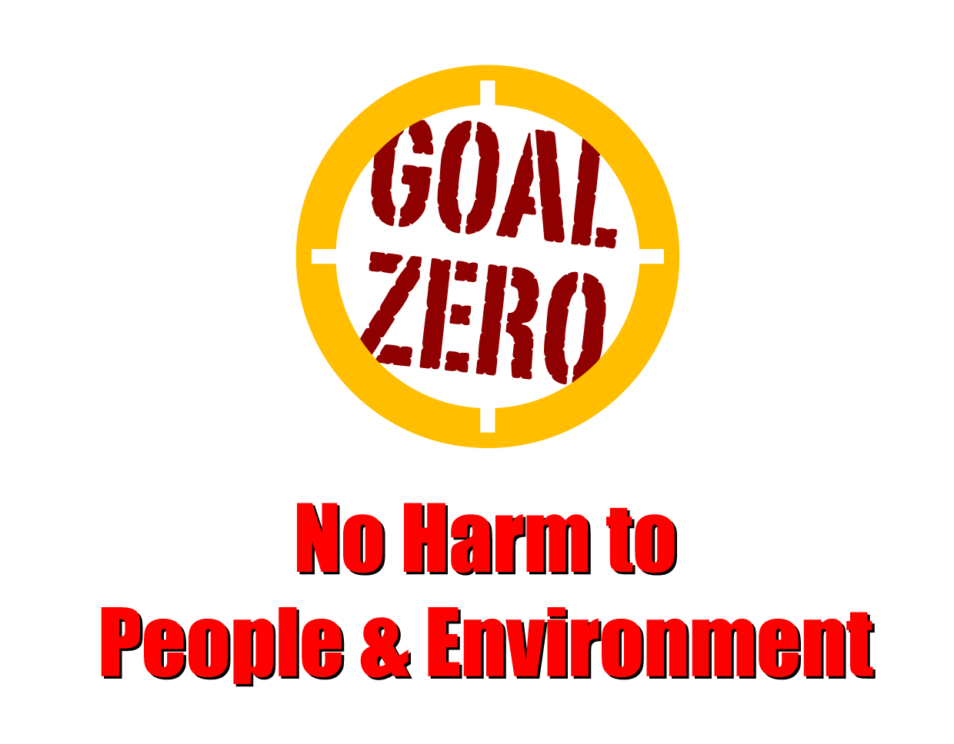
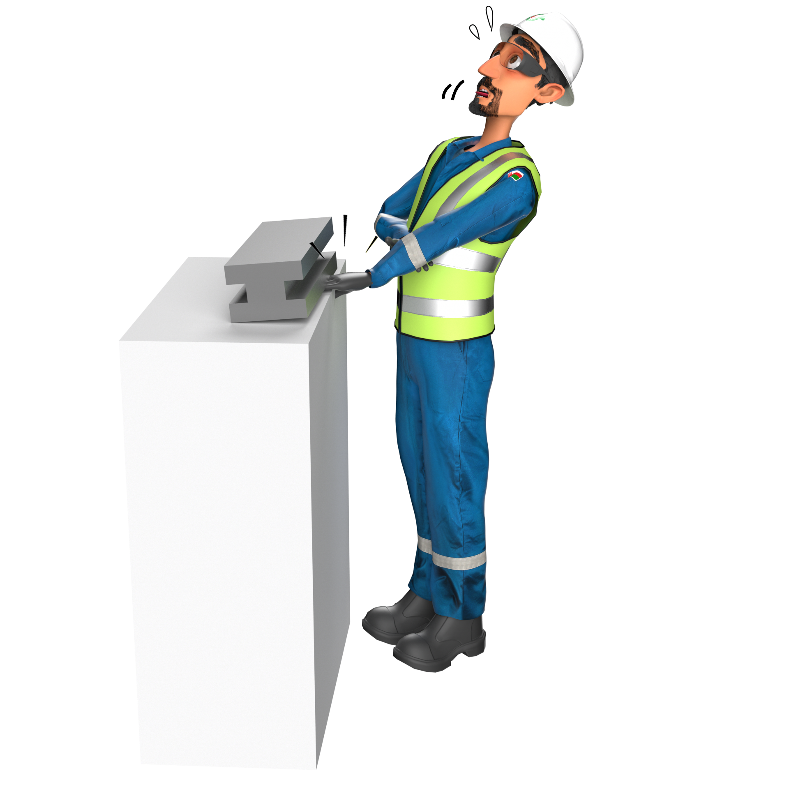
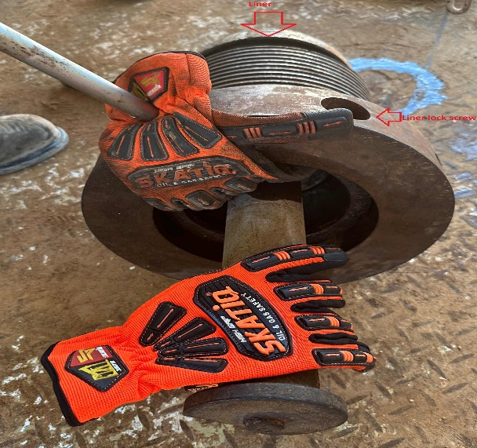
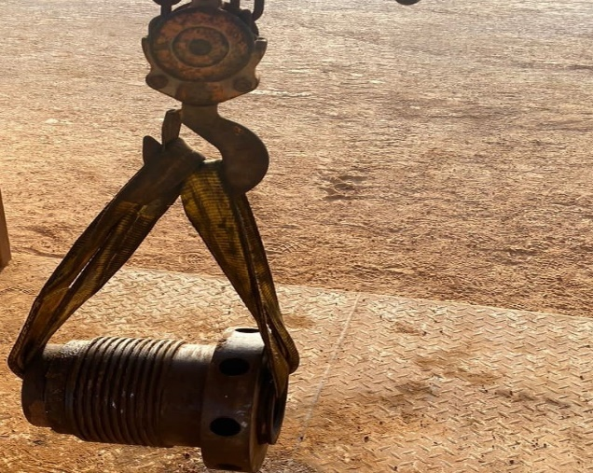
Learning From Incident - First Alert
Prevent
PIM # | 1154149 | Date | 14.05.2023 | Direct / Depart
Incident Type | LTI#04 | Time | 19:10 hrs | Location | Rig-81, Nimr
Pattern | Hands & Fingers | Contractor |  | Activity | Changing mud pump liner
Target Audience: All
What happened
During the activity of changing the mud pump liner and while the Derrickman was attempting to lift the liner cap from the liner, his right-hand index finger got trapped between the cap and the liner resulting in a fracture.
Initial Findings
The Standard Operating Practice (SOP) was available but not Followed.
Supervisor failed to intervene when the job was not performed as planned.
The Pinch Point Hazard was not identified.
Learnings
Do you follow the SOP steps when performing manual handling activities ?
How do you identify all Pinch Point Hazards prior starting the task?
Do you intervene during unsafe acts while performing the task?
How do you ensure effective supervision while carrying out a task?
Always follow the Safe Work Practices while performing any task
In case of an emergency please call PDO Emergency Number (Toll Free): 2467-5555
Notes:
Mr Musleh image on the top right will change according to incident pattern, MSE3 will provide you with the image as per the pattern
What happened: A short description should be provided without mentioning names of contractors or individuals. You should include, what happened, to who (by job title) and what injuries this resulted in. Nothing more!
Initial Finding: Four to five bullet points highlighting the initial main findings from the investigation. Remember the target audience is the front-line staff so this should be written in simple terms in a way that everyone can understand.
Learnings: Four to five learning message in the form of questionnaires linked with initial findings
The strap line should be the main learning point you want to get across
The images should be self explanatory, what went wrong (if you create a reconstruction please ensure you do not put people at risk) and below how it should be done.

