Slide 1
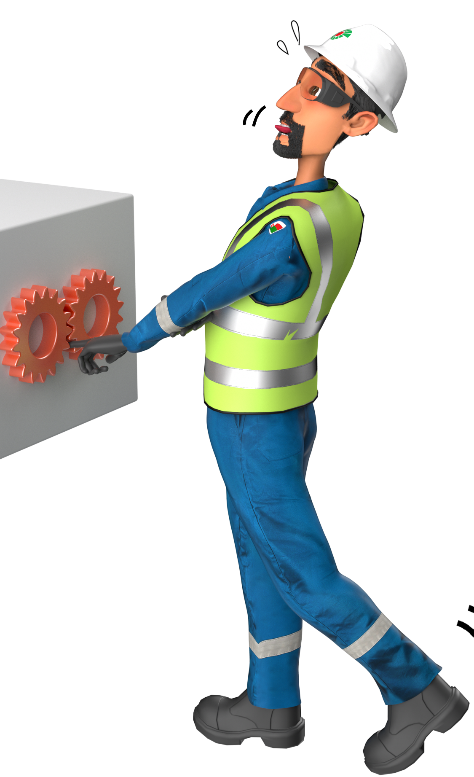
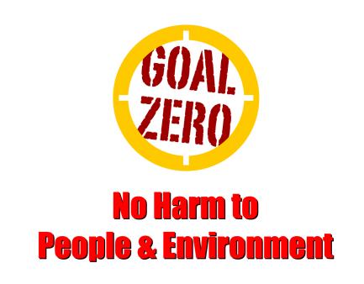
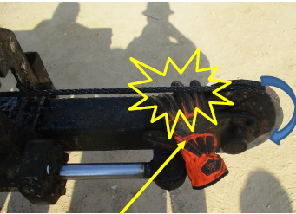
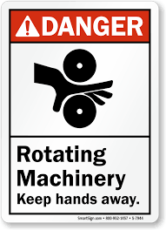
Learning From Incident - First Alert
Prevent
PIM # | 1162439 | Date | 29.01.2024 | Direct / Dept.
Incident Type | LTI#05 | Time | 08:20 AM | Location | Marmul
Category | Hands & Fingers | Contractor |  | Activity | Hydraulic Catwalk function test
Target Audience: All
What happened
At around 08:20 hrs, function test of powered catwalk was in progress. The hoist electrician who was supporting the function test activities accidently placed his right hand in between rotating pulley and skate sling which resulted in multiple fractures to his right-hand fingers.
Initial Findings
There was no guard in place for the skate sling pulley during the function test.
The process of preventing people from line of fire hazards was not adhered to.
The hazards of unguarded rotating parts were not identified.
Engagement Questions:
How do you ensure all hazards are identified and communicated before starting and during the task?
How do you ensure all the rotating equipment have adequate safety guards?
How do you ensure that employees are away from (LOF) line of fire?
How do you ensure the work is effectively supervised?
Never place your hands in the rotating equipment (LOF)
In case of an emergency please call PDO Emergency Number (Toll Free): 2467-5555
Notes:
Mr Musleh image on the top right will change according to incident pattern, MSE3 will provide you with the image as per the pattern
What happened: A short description should be provided without mentioning names of contractors or individuals. You should include, what happened, to who (by job title) and what injuries this resulted in. Nothing more!
Initial Finding: Four to five bullet points highlighting the initial main findings from the investigation. Remember the target audience is the front-line staff so this should be written in simple terms in a way that everyone can understand.
Learnings: Four to five learning message in the form of questionnaires linked with initial findings
The strap line should be the main learning point you want to get across
The images should be self explanatory, what went wrong (if you create a reconstruction please ensure you do not put people at risk) and below how it should be done.

