Slide 1
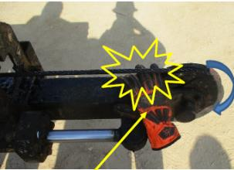
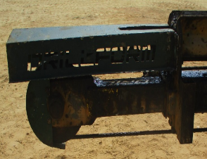
PDO Second Alert
Date: Time: | 29/01/2024 08:20 AM | Incident title: PIM# | LTI#05 1162439 | Risk Category: Injury / Asset Damaged: | Crash Between Finger Injury | Actual Severity: Potential severity: | C3P C4P | Activity: Location: | Function test of power catwalk MARMUL
Target Audience: RM, NTP, Driller, AD, derrick man, floor man, roustabout.
What happened?
At around 08:20 hrs, function test powered catwalk was in progress. Rig electrician who was standing in proximity of catwalk accidently placed his right hand in between rotating pulley and skate sling causing injury on his fingers.
Immediately first aid was given and taken to Marmul clinic and later transferred to Salalah for further evaluation.
Why it happened/Finding :
1. Planning was in adequate as roles and responsibilities was not defined, unwanted employee was involved in operation and roustabout was assigned to operate catwalk during function test.
2. Rotating pulley and Skate sling guard was not installed during function test.
3. Zone management as hard barrier was in place but not followed.
4. Electrician was not involved on TBT & PTW prior to start operation.
5. Supervisor failed to ensure all rotating equipments were secured with guard and additional employees were standing around.
6. Crew failed to intervene the electrician who was standing near to Catwalk during function test.
Your learning from this incident..
RM should always ensure to assign the authorized person to control the automatic catwalk operating panel.
RM should always ensure all the rotating equipment have adequate safety guards.
Driller/AD should always ensure effective zone management in place and employees are adhere to it.
Driller/AD should always ensure crew members are not standing near to rotating equipment (LOF).
All Employee should Always ensure to Stop and intervene for any unsafe acts/conditions.
Driller/AD should always ensure to prepare & Discuss PTW and supporting document prior to start operation.
RM should always ensure to raise MOC for any change in equipment.
RM should always ensure that CCTV is always working.
Always ensure to follow Musta’ed 7 steps.
Electrician right hand finger got trapped between the rotating pulley and skate sling
Adequate safety guard installed at Rotating equipment
Always ensure all the rotating equipment have adequate safety guards
Notes:
Ensure all dates and titles are input
A short description should be provided without mentioning names of contractors or individuals. You should include, what happened, to who (by job title) and what injuries this resulted in. Nothing more!
Four to five bullet points highlighting the main findings from the investigation. Remember the target audience is the front line staff so this should be written in simple terms in a way that everyone can understand.
The strap line should be the main point you want to get across
The images should be self explanatory, what went wrong (if you create a reconstruction please ensure you do not put people at risk) and below how it should be done.

Slide 2
Management Reflective Questions
Date: Time: | 29/01/2024 08:20 AM | Incident title: PIM# | LTI#05 | Risk Category: Injury / Asset Damaged: | Finger Injury Sever vehicle damage | Actual Severity: Potential severity: | C3P D5P | Activity: Location: | MARMUL
As a learning from this incident and to ensure continual improvement, all contract managers must review their HSE risk management against the questions asked below
Confirm the following:
How do you ensure all hazards are identified and communicated before starting and during the task?
How do you ensure all the rotating equipment have adequate safety guards?
How do you ensure that zone management is respected and employee is not standing near to rotating equipment?
How do you ensure the work is effectively supervised and authorized person is involved in function test?
How do you ensure that AD or derrick man is only operating automatic catwalk?
How do you ensure that all the change in equipment managed with MOC?
* If the answer is NO to any of the above questions please ensure you take action to correct this finding
Notes:
Make a list of closed questions (only ‘yes’ or ‘no’ as an answer) to ask others if they have the same issues based on the management or HSE-MS failings or shortfalls identified in the investigation.
Imagine you have to audit other companies to see if they could have the same issues.
These questions should start with: Do you ensure…………………?

