Slide 1
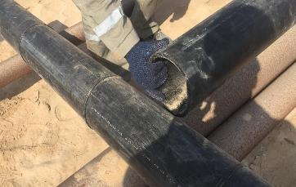

PDO Second Alert
Date:18.01.2021 Incident title: LTI#05
What happened?
On 18th January 2021 a civil crew was engaged in 6” cold cutting and scrap pipe collection activity near to Yibal C station, at around 15:10Hrs while manually shifting the scrap pipes to the allocated area, The helper right little finger pinched in between 2 pipes while aligning the pipe and resulted a laceration in his right little finger. He suffered an open fracture in his right little finger. He was discharged from the hospital on 18th January 2021.
Your learning from this incident..
Always STOP if the task is unsafe to perform.
Always ensure to identify pinch points before starting the task.
Always ask for the suitable PPE for the task.
Always ensure you conduct effective tool box talk and dynamic risk assessment.
Always ensure you observe the surroundings of your area of activity.
Always ensure you do not expose your self to the “line of fire”.
Always avoid manual handling if seen unsafe.
Protect your Hands and fingers, Identify pinch points and Stay out of the “line of fire”
Notes:
Ensure all dates and titles are input
A short description should be provided without mentioning names of contractors or individuals. You should include, what happened, to who (by job title) and what injuries this resulted in. Nothing more!
Four to five bullet points highlighting the main findings from the investigation. Remember the target audience is the front line staff so this should be written in simple terms in a way that everyone can understand.
The strap line should be the main point you want to get across
The images should be self explanatory, what went wrong (if you create a reconstruction please ensure you do not put people at risk) and below how it should be done.

Slide 2
Management self audit
Date:18.01.2021 Incident title: LTI#05
As a learning from this incident and ensure continual improvement all contract
managers must review their HSE HEMP against the questions asked below
Confirm the following:
Do you ensure the activities performed are covered in method statements?
Do you ensure method statement is updated?
Do you ensure HEMP and JSA covers all the tasks in your activity?
Do you ensure that employees are empowered to STOP the activity when it is not safe?
Do you ensure that the activity is planned with adequate resources?
Do you ensure you identify all hazards, pinch points and line or fire in TRIC before starting your task?
* If the answer is NO to any of the above questions please ensure you take action to correct this finding.
Notes:
Ensure all dates and titles are input
Make a list of closed questions (only ‘yes’ or ‘no’ as an answer) to ask others if they have the same issues based on the management or HSE-MS failings or shortfalls identified in the investigation.
Imagine you have to audit other companies to see if they could have the same issues.
These questions should start with: Do you ensure…………………?

