Slide 1
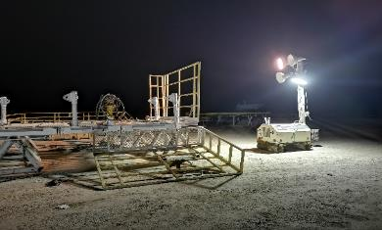
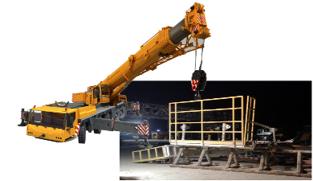
PDO Second Alert
Date:10/03/2022 Incident title: LTI#05 Pattern: Drops Potential severity: C4P
Target Audience: Driller, Asst. Driller, Roustabout Foreman, Derrickman, Floorman
What happened?
As part of the rig dismantling for rig move / maintenance, the monkey board was disconnected from the mast and was placed on two pipe racks to dismantle MB walkways for moving. The night crew was assigned by TP to execute the task. Each walkway platform has two top and bottom tapper connecting pins. The crew had safely dismantled three walkways and laid them down on the ground. Afterward, the crew was working on the fourth and they continued removing the right top pin once the pins were removed the walkway platform flipped down to the ground and contacted FLM right foot. He was first examined at the rig clinic and then moved into the nearest hospital for further check-ups and treatment.
Why it happened/Finding :
Walkway was not secured before removing the pin.
FLM was not part of the task. He was walking nearby workplace.
Workplace wasn't barricaded to prevent unauthorized person from getting closer to temporary NoGo zone.
Task Supervisor moved to another task before completing dismantling Monkey board walkway.
Your learning from this incident..
Always implement securing method for any object, before being dismantled to prevent release of stored energy.
Always barricade the permanent & temporary NoGo zones to avoid unauthorized personnel from entering the area.
Use empowerment to STOP to intervene on any unsafe practices that you may encounter.
Always follow work procedure to execute the task.
Ensure adequate level of supervision assigned for each task.
Encourage crew members to use empowerment to stop to intervene on unsafe acts / conditions
MB Walkway after flapped on ground
Walkways must secure prior dismantling
Ensure that equipment is fully secured before dismantling
Notes:
Ensure all dates and titles are input
A short description should be provided without mentioning names of contractors or individuals. You should include, what happened, to who (by job title) and what injuries this resulted in. Nothing more!
Four to five bullet points highlighting the main findings from the investigation. Remember the target audience is the front line staff so this should be written in simple terms in a way that everyone can understand.
The strap line should be the main point you want to get across
The images should be self explanatory, what went wrong (if you create a reconstruction please ensure you do not put people at risk) and below how it should be done.

Slide 2
Management self audit
Date:10/03/2022 Incident title: LTI#05 Pattern: Drops Potential severity: C4P
As a learning from this incident and ensure continual improvement all contract managers must review their HSE risk management against the questions asked below
Confirm the following:
Do you ensure that line management review control of work and provide feedback to your rig?
Do you ensure that your rig/hoist employees are empowered to STOP any unsafe act or condition?
Do you assign adequate level of supervision at your sites?
Do you verify the hard barrier implementation of DROPS – No go zone ?
* If the answer is NO to any of the above questions please ensure you take action to correct this finding
Notes:
Ensure all dates and titles are input
Make a list of closed questions (only ‘yes’ or ‘no’ as an answer) to ask others if they have the same issues based on the management or HSE-MS failings or shortfalls identified in the investigation.
Imagine you have to audit other companies to see if they could have the same issues.
These questions should start with: Do you ensure…………………?

