Slide 1
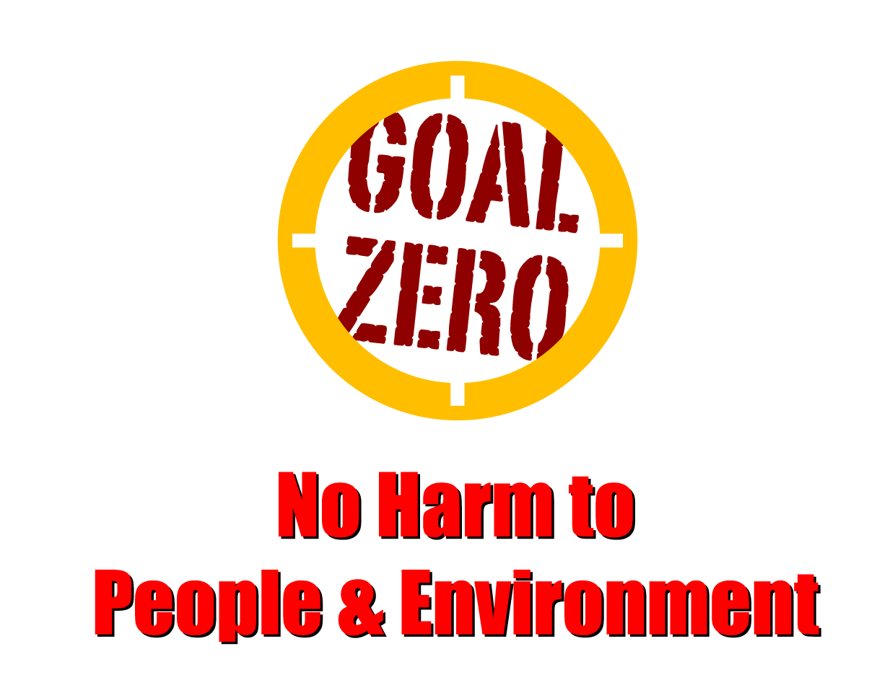
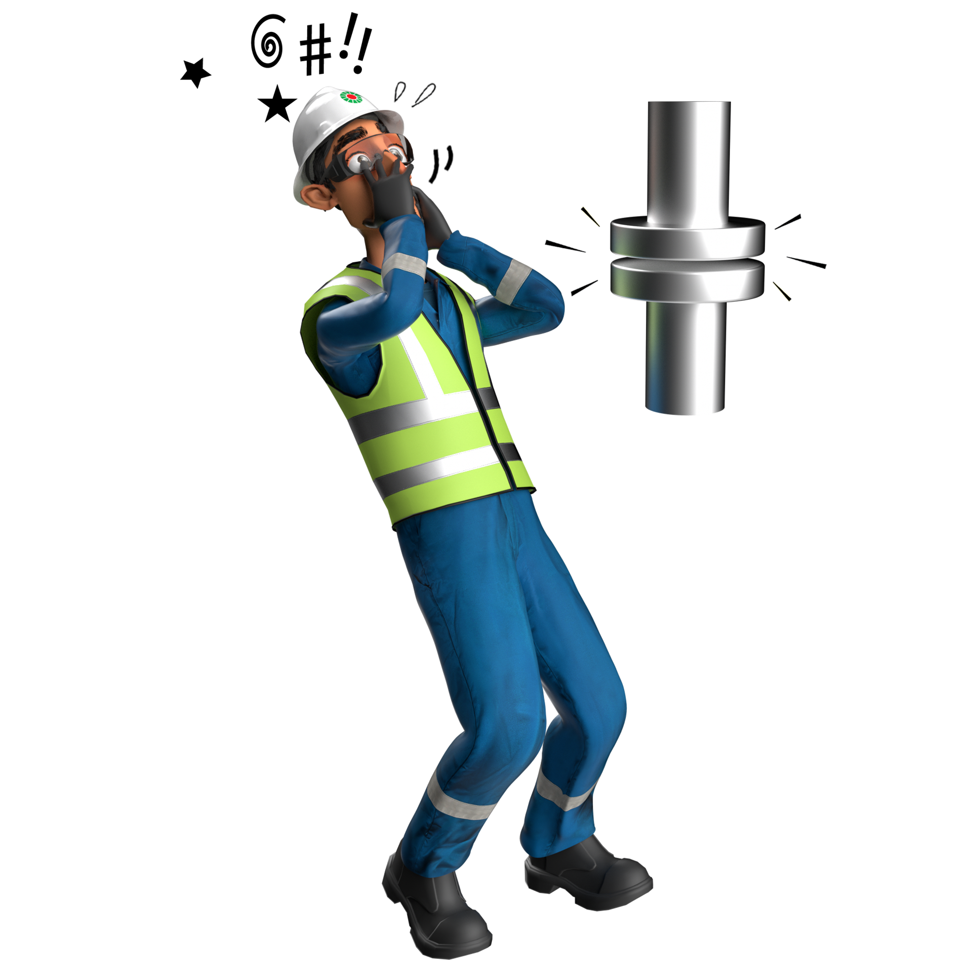
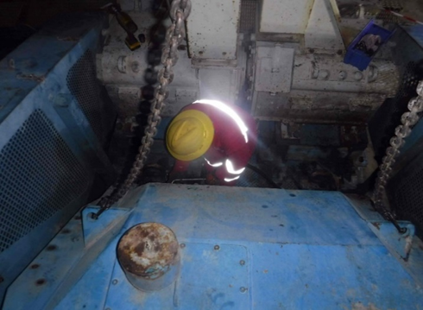
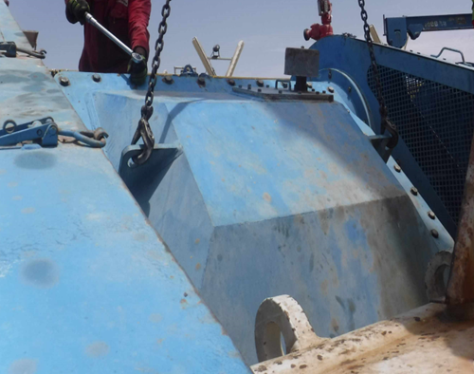
Learning From Incident - First Alert
Prevent
PIM # | 1154245 | Date | 17.05.2023 | Direct / Depart
Incident Type | LTI#05 | Time | 20:00 hrs | Location | Rig-50, Yibal
Pattern | Released Energy | Contractor |  | Activity | Unbolting mud pump cover
Target Audience: All
What happened
While the Mechanic was involved in unbolting the mud pump cover using a crane, the cover slightly moved and hit his left leg causing fracture at his left thigh.
Initial Findings
The supervisor himself was carrying out the task without the help of banksman/assistant
The JSA was not adequate to identify the line of fire hazard
The situation was not reassessed after finding the cover was stuck
Learnings
How do you ensure line of fire risks are identified prior stating the job?
How do you ensure the tasks are being effectively supervised?
Do you always ensure banks man is in place prior lifting a load?
How do you ensure JSA’s are up to date and identifies risks associated with the job?
Never place yourself in the line of fire
In case of an emergency please call PDO Emergency Number (Toll Free): 2467-5555
Notes:
Mr Musleh image on the top right will change according to incident pattern, MSE3 will provide you with the image as per the pattern
What happened: A short description should be provided without mentioning names of contractors or individuals. You should include, what happened, to who (by job title) and what injuries this resulted in. Nothing more!
Initial Finding: Four to five bullet points highlighting the initial main findings from the investigation. Remember the target audience is the front-line staff so this should be written in simple terms in a way that everyone can understand.
Learnings: Four to five learning message in the form of questionnaires linked with initial findings
The strap line should be the main learning point you want to get across
The images should be self explanatory, what went wrong (if you create a reconstruction please ensure you do not put people at risk) and below how it should be done.

