Slide 1
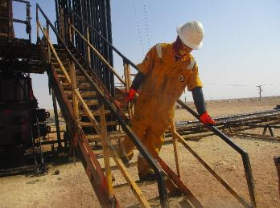
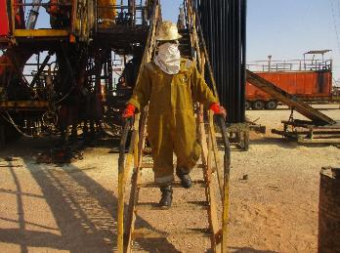
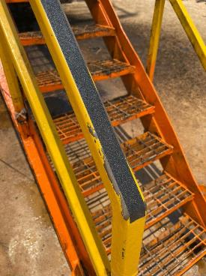
PDO Second Alert
Date 15/03/2022 Incident title: LTI#06 Pattern: Slip & Fall Potential severity: C3P
Target Audience: All crew – Drilling & CWI
What happened?
The Roustabout came down the Rig Floor stairs after bringing the 48”wrench to the Floorman. On the last 4 steps of the Rig Floor stairs he lost balance and fell down. The Floorman came to ask him if he is okey. The Roustabout walked to the rest area near the RM Office caravan. The Roustabout complained about pain in his left leg. The NTP gave ice for cooling. As the pain got more, the Night Tool Pusher took him to the Shaleem Hospital (16 km). He was diagnosed with a broken left leg.
Why it happened/Finding:
The Roustabout was wearing full PPE
The Safety shoes are in good condition
The Roustabout held only one side of the handrail
Handrails are oily, his gloves were full of oil
Stairs not fully levelled (13º degrees incline towards rig floor)
Roustabout has 10 months Roustabout experience, Valid FTW
Your learning from this incident..
Ensure to hold both sides of the Handrail
Ensure to walk slow in stairs
Ensure good footwear (check sole of Safety Shoes)
Always check stairs are levelled
Ensure handrails not slippery (see small pic: solution grip band)
Always maintain three point contact while using stairs
Notes:
Ensure all dates and titles are input
A short description should be provided without mentioning names of contractors or individuals. You should include, what happened, to who (by job title) and what injuries this resulted in. Nothing more!
Four to five bullet points highlighting the main findings from the investigation. Remember the target audience is the front line staff so this should be written in simple terms in a way that everyone can understand.
The strap line should be the main point you want to get across
The images should be self explanatory, what went wrong (if you create a reconstruction please ensure you do not put people at risk) and below how it should be done.

Slide 2
Management self audit
Date 15/03/2022 Incident title: LTI#06 Pattern: Slip & Fall Potential severity: C3P
As a learning from this incident and ensure continual improvement all contract managers must review their HSE risk management against the questions asked below
Confirm the following:
Do you ensure that regular inspections and checks are performed to verify if steps of stairs are levelled?
Do you ensure that three-point contact rule and manual handling are part of your HSE Onboarding?
Do you ensure that there is adequate enforcement of three-point contact rule with consequence management?
Do you have a flexible Front Line Supervisor program to include LFI?
Do you ensure that your rig up process includes the verification of the stairs alignment?
Do you ensure your inspection consider the condition of handrail?
* If the answer is NO to any of the above questions please ensure you take action to correct this finding
Notes:
Ensure all dates and titles are input
Make a list of closed questions (only ‘yes’ or ‘no’ as an answer) to ask others if they have the same issues based on the management or HSE-MS failings or shortfalls identified in the investigation.
Imagine you have to audit other companies to see if they could have the same issues.
These questions should start with: Do you ensure…………………?

