Slide 1
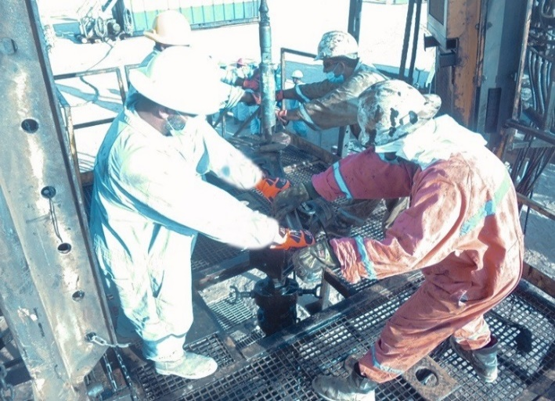
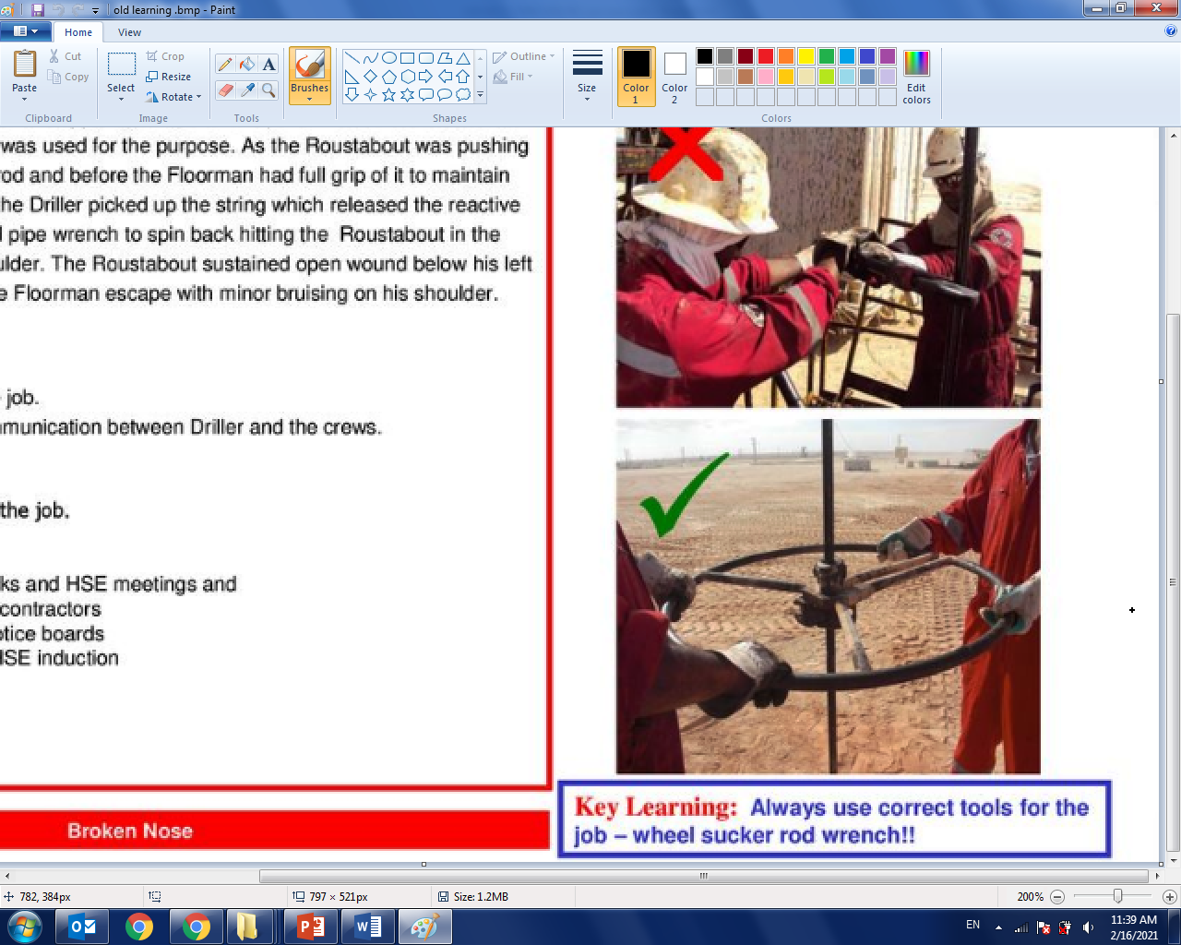
PDO Second Alert
Date: 13.02.2021 Incident title: LTI#06
What happened?
At approximately 14:55 hrs On 13th February 2021, the operation was backing off the continuous rod from the bottom stuck overshot (stuck with the body of the tubing). After TBT crew Installed two pipe wrenches on the continuous rod and started turning anticlockwise to release the connection of the overshot. Two employees were on each pipe wrench. Suddenly the lower pipe wrench slipped off, the torsional force causing the upper pipe wrench to rotate hitting derrick man in his right hand causing him falling and continued rotating and hit Driller in his back.
Your learning from this incident.
Always ensure SOP & JSA are precisely followed.
Always ensure TBT covers the steps and tools mentioned in the SOP & JSA.
Always ensure to use the correct tool prior starting the job.
Always use Ratigan wheel to rotate the continuous rod
Notes:
Ensure all dates and titles are input
A short description should be provided without mentioning names of contractors or individuals. You should include, what happened, to who (by job title) and what injuries this resulted in. Nothing more!
Four to five bullet points highlighting the main findings from the investigation. Remember the target audience is the front line staff so this should be written in simple terms in a way that everyone can understand.
The strap line should be the main point you want to get across
The images should be self explanatory, what went wrong (if you create a reconstruction please ensure you do not put people at risk) and below how it should be done.

Slide 2
Management self audit
Date: 13.06.2021 Incident title: LTI#06
As a learning from this incident and ensure continual improvement all contract
managers must review their HSE HEMP against the questions asked below
Confirm the following:
Do you ensure that the correct tool for the task is in use?
Do you ensure that the crew is adhering to the SOP?
Do you ensure that the proper tools is adequately covered in the SOP?
Do you ensure that the risks are identified prior starting the job?
Do you ensure that all tools required are available at site and in a good condition?
* If the answer is NO to any of the above questions please ensure you take action to correct this finding.
Notes:
Ensure all dates and titles are input
Make a list of closed questions (only ‘yes’ or ‘no’ as an answer) to ask others if they have the same issues based on the management or HSE-MS failings or shortfalls identified in the investigation.
Imagine you have to audit other companies to see if they could have the same issues.
These questions should start with: Do you ensure…………………?

