Slide 1
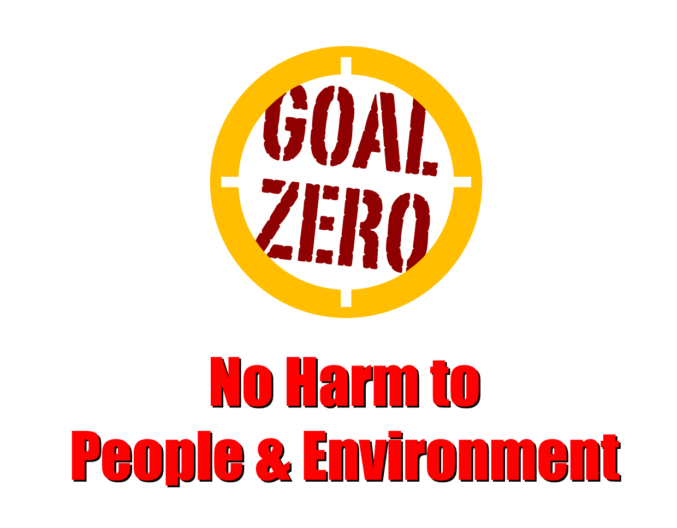
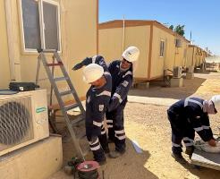
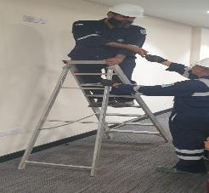
Learning From Incident - First Alert
Prevent
PIM # | 1154203 | Date | 16.05.2023 | Direct / Depart
Incident Type | LTI#06 | Time | 15:30 hrs | Location | Accommodation behind room A19- Amal
Pattern | Hands & Fingers | Contractor |  | Activity | Climbing a ladder
Target Audience: All
What happened
While the Technician was climbing the ladder to fit a piece of trunking to the Air conditioning system (post repair), he lost his balance and fell landing on his left-hand resulting in a fracture to his left wrist.
Initial Findings
Technician was carrying items up the steps and not maintaining 3 points of contact
Procedures and training were not followed
Alternative access method to work at height was not used
Learnings
How do you identify hazards related to using stairs at your working location?
Why is it important to pay attention where you are stepping?
How do you ensure safe descending/ascending while using the stairs?
How do you ensure to maintain housekeeping at all time ?
Always use 3 points of contact when on step ladders
In case of an emergency please call PDO Emergency Number (Toll Free): 2467-5555
Notes:
Mr Musleh image on the top right will change according to incident pattern, MSE3 will provide you with the image as per the pattern
What happened: A short description should be provided without mentioning names of contractors or individuals. You should include, what happened, to who (by job title) and what injuries this resulted in. Nothing more!
Initial Finding: Four to five bullet points highlighting the initial main findings from the investigation. Remember the target audience is the front-line staff so this should be written in simple terms in a way that everyone can understand.
Learnings: Four to five learning message in the form of questionnaires linked with initial findings
The strap line should be the main learning point you want to get across
The images should be self explanatory, what went wrong (if you create a reconstruction please ensure you do not put people at risk) and below how it should be done.

