Slide 1
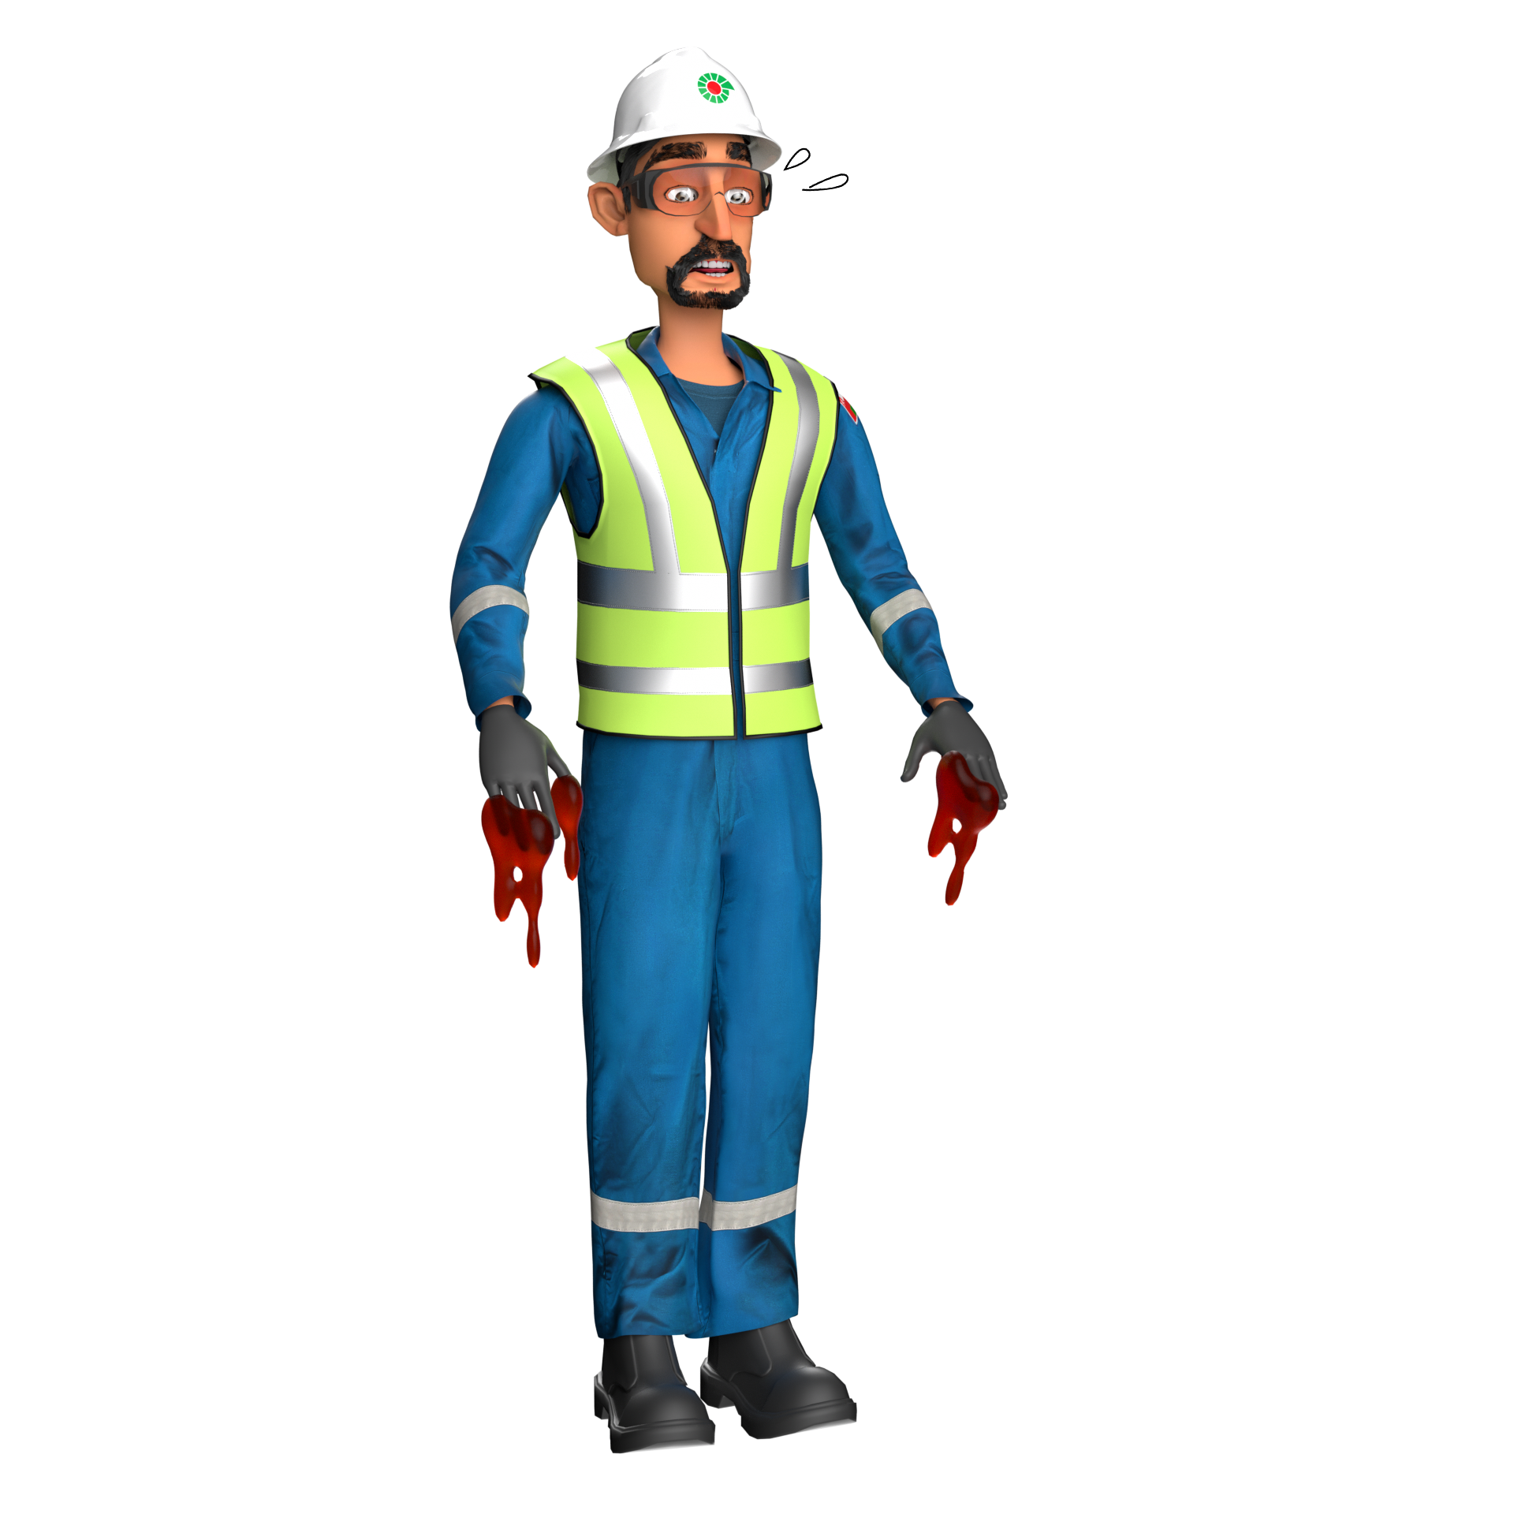

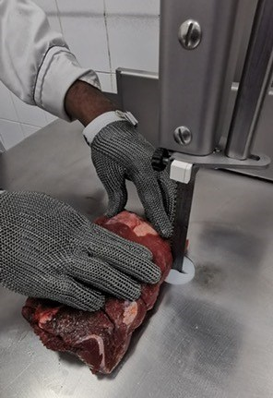
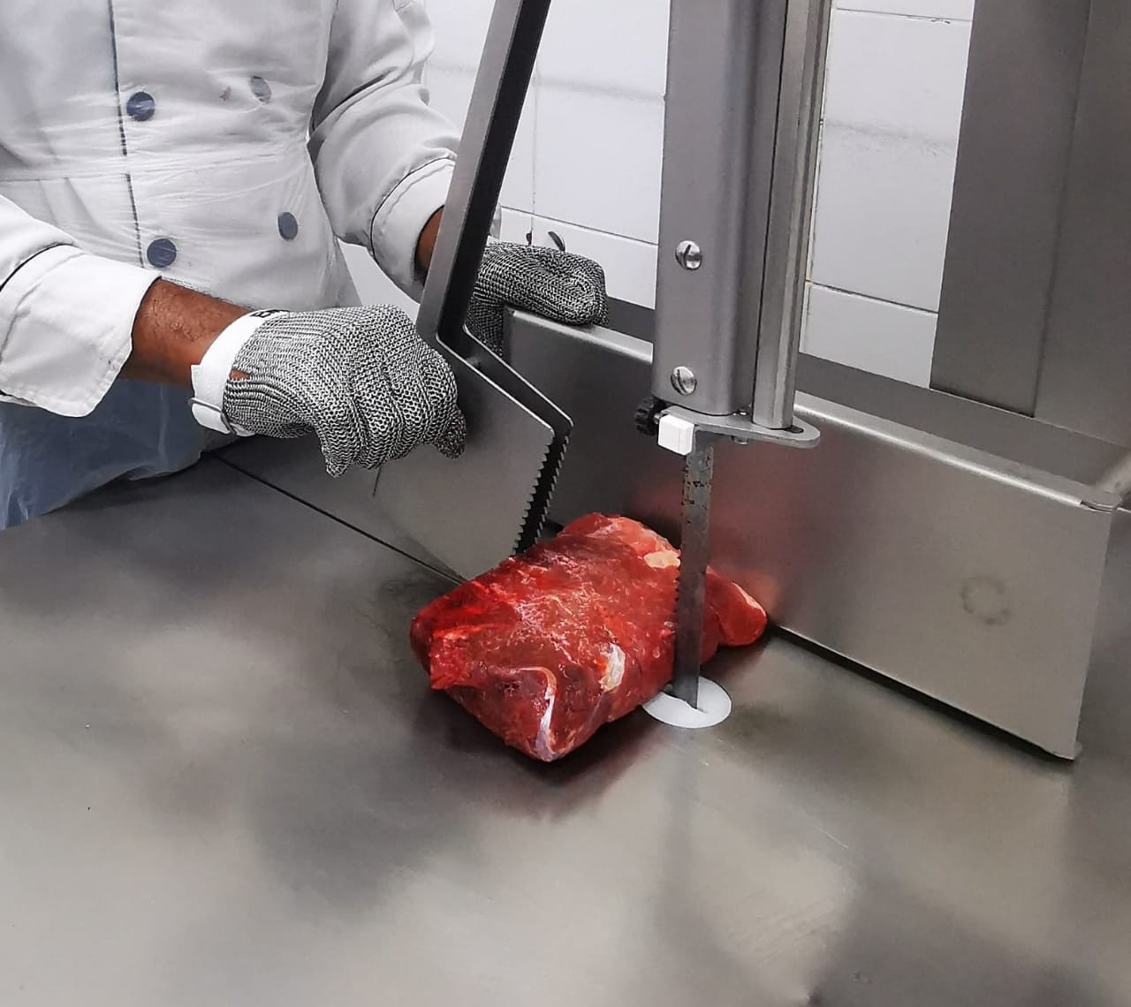
Learning From Incident - First Alert
Prevent
PIM # | 1177465 | Date & Time | 01/05/2025 12:05 | Location | Marmul
Incident Type | LTI#06 | Category | Hands & Fingers (Finger amputation) | Activity | Cutting Meat
Target Audience: All
What happened:
While the Butcher was cutting meat using a bone saw machine, he accidentally cut the tip of his right index finger. He was initially treated at the SJ Abed clinic in Marmul before being transferred to Salalah Hospital, where he was diagnosed with fingertip amputation.
Initial Findings:
The IP intentionally removed the band saw guard from the meat-cutting machine to expedite the task.
There was a lack of intervention by the crew to prevent the unsafe behavior.
The contractor's emergency response team effectively implemented the appropriate emergency response procedures.
Engagement Questions:
Do you ensure that safety mitigation and safety gear are consistently maintained and functioning effectively?
Do you consistently emphasize hazard identification and safety control measures during TBTs?
Do you ensure continuous and effective supervision of the task throughout its execution until completion?
Do you actively encourage and support team members to intervene when they observe unsafe behaviors or conditions?
Remember your life depends on your safety gear; ensure to use it properly
In case of an emergency please call PDO Emergency Number (Toll Free): 2467-5555
Notes:
Mr Musleh image on the top right will change according to incident pattern, MSE3 will provide you with the image as per the pattern
What happened: A short description should be provided without mentioning names of contractors or individuals. You should include, what happened, to who (by job title) and what injuries this resulted in. Nothing more!
Initial Finding: Four to five bullet points highlighting the initial main findings from the investigation. Remember the target audience is the front-line staff so this should be written in simple terms in a way that everyone can understand.
Learnings: Four to five learning message in the form of questionnaires linked with initial findings
The strap line should be the main learning point you want to get across
The images should be self explanatory, what went wrong (if you create a reconstruction please ensure you do not put people at risk) and below how it should be done.

