Slide 1
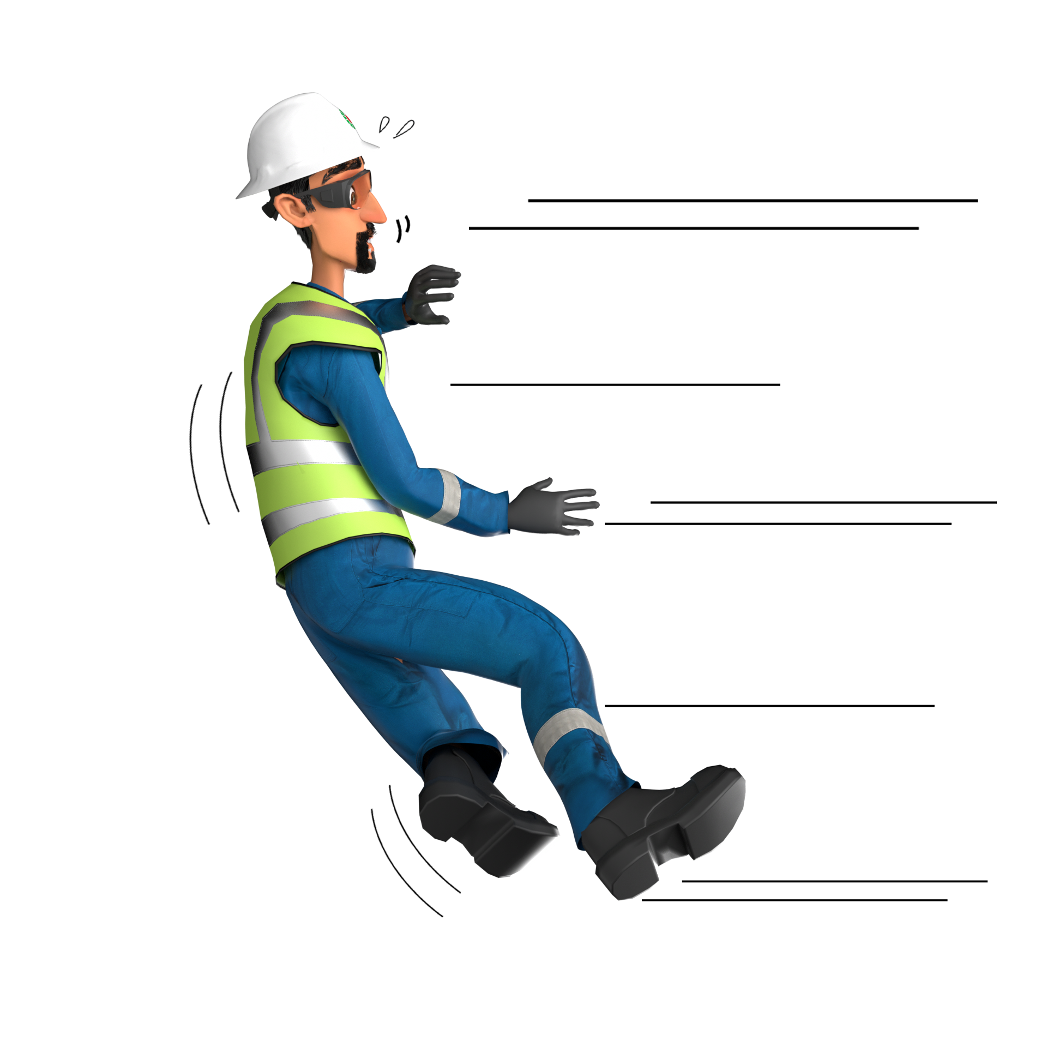
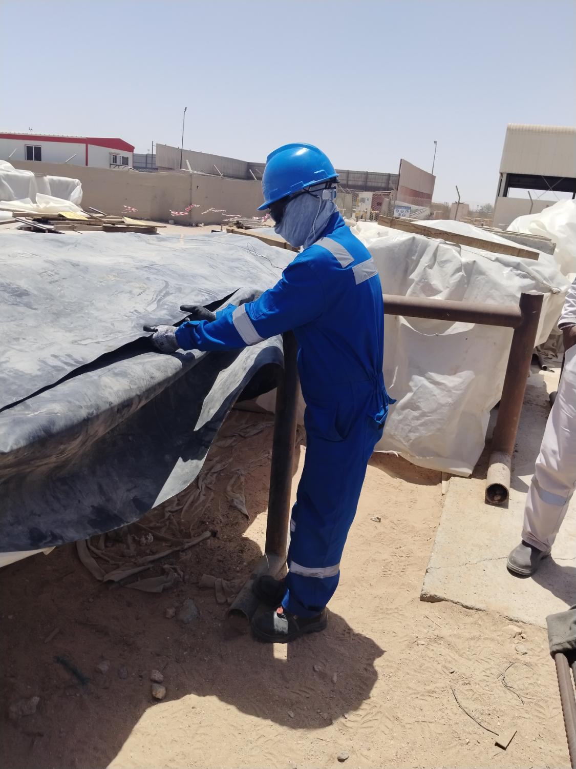
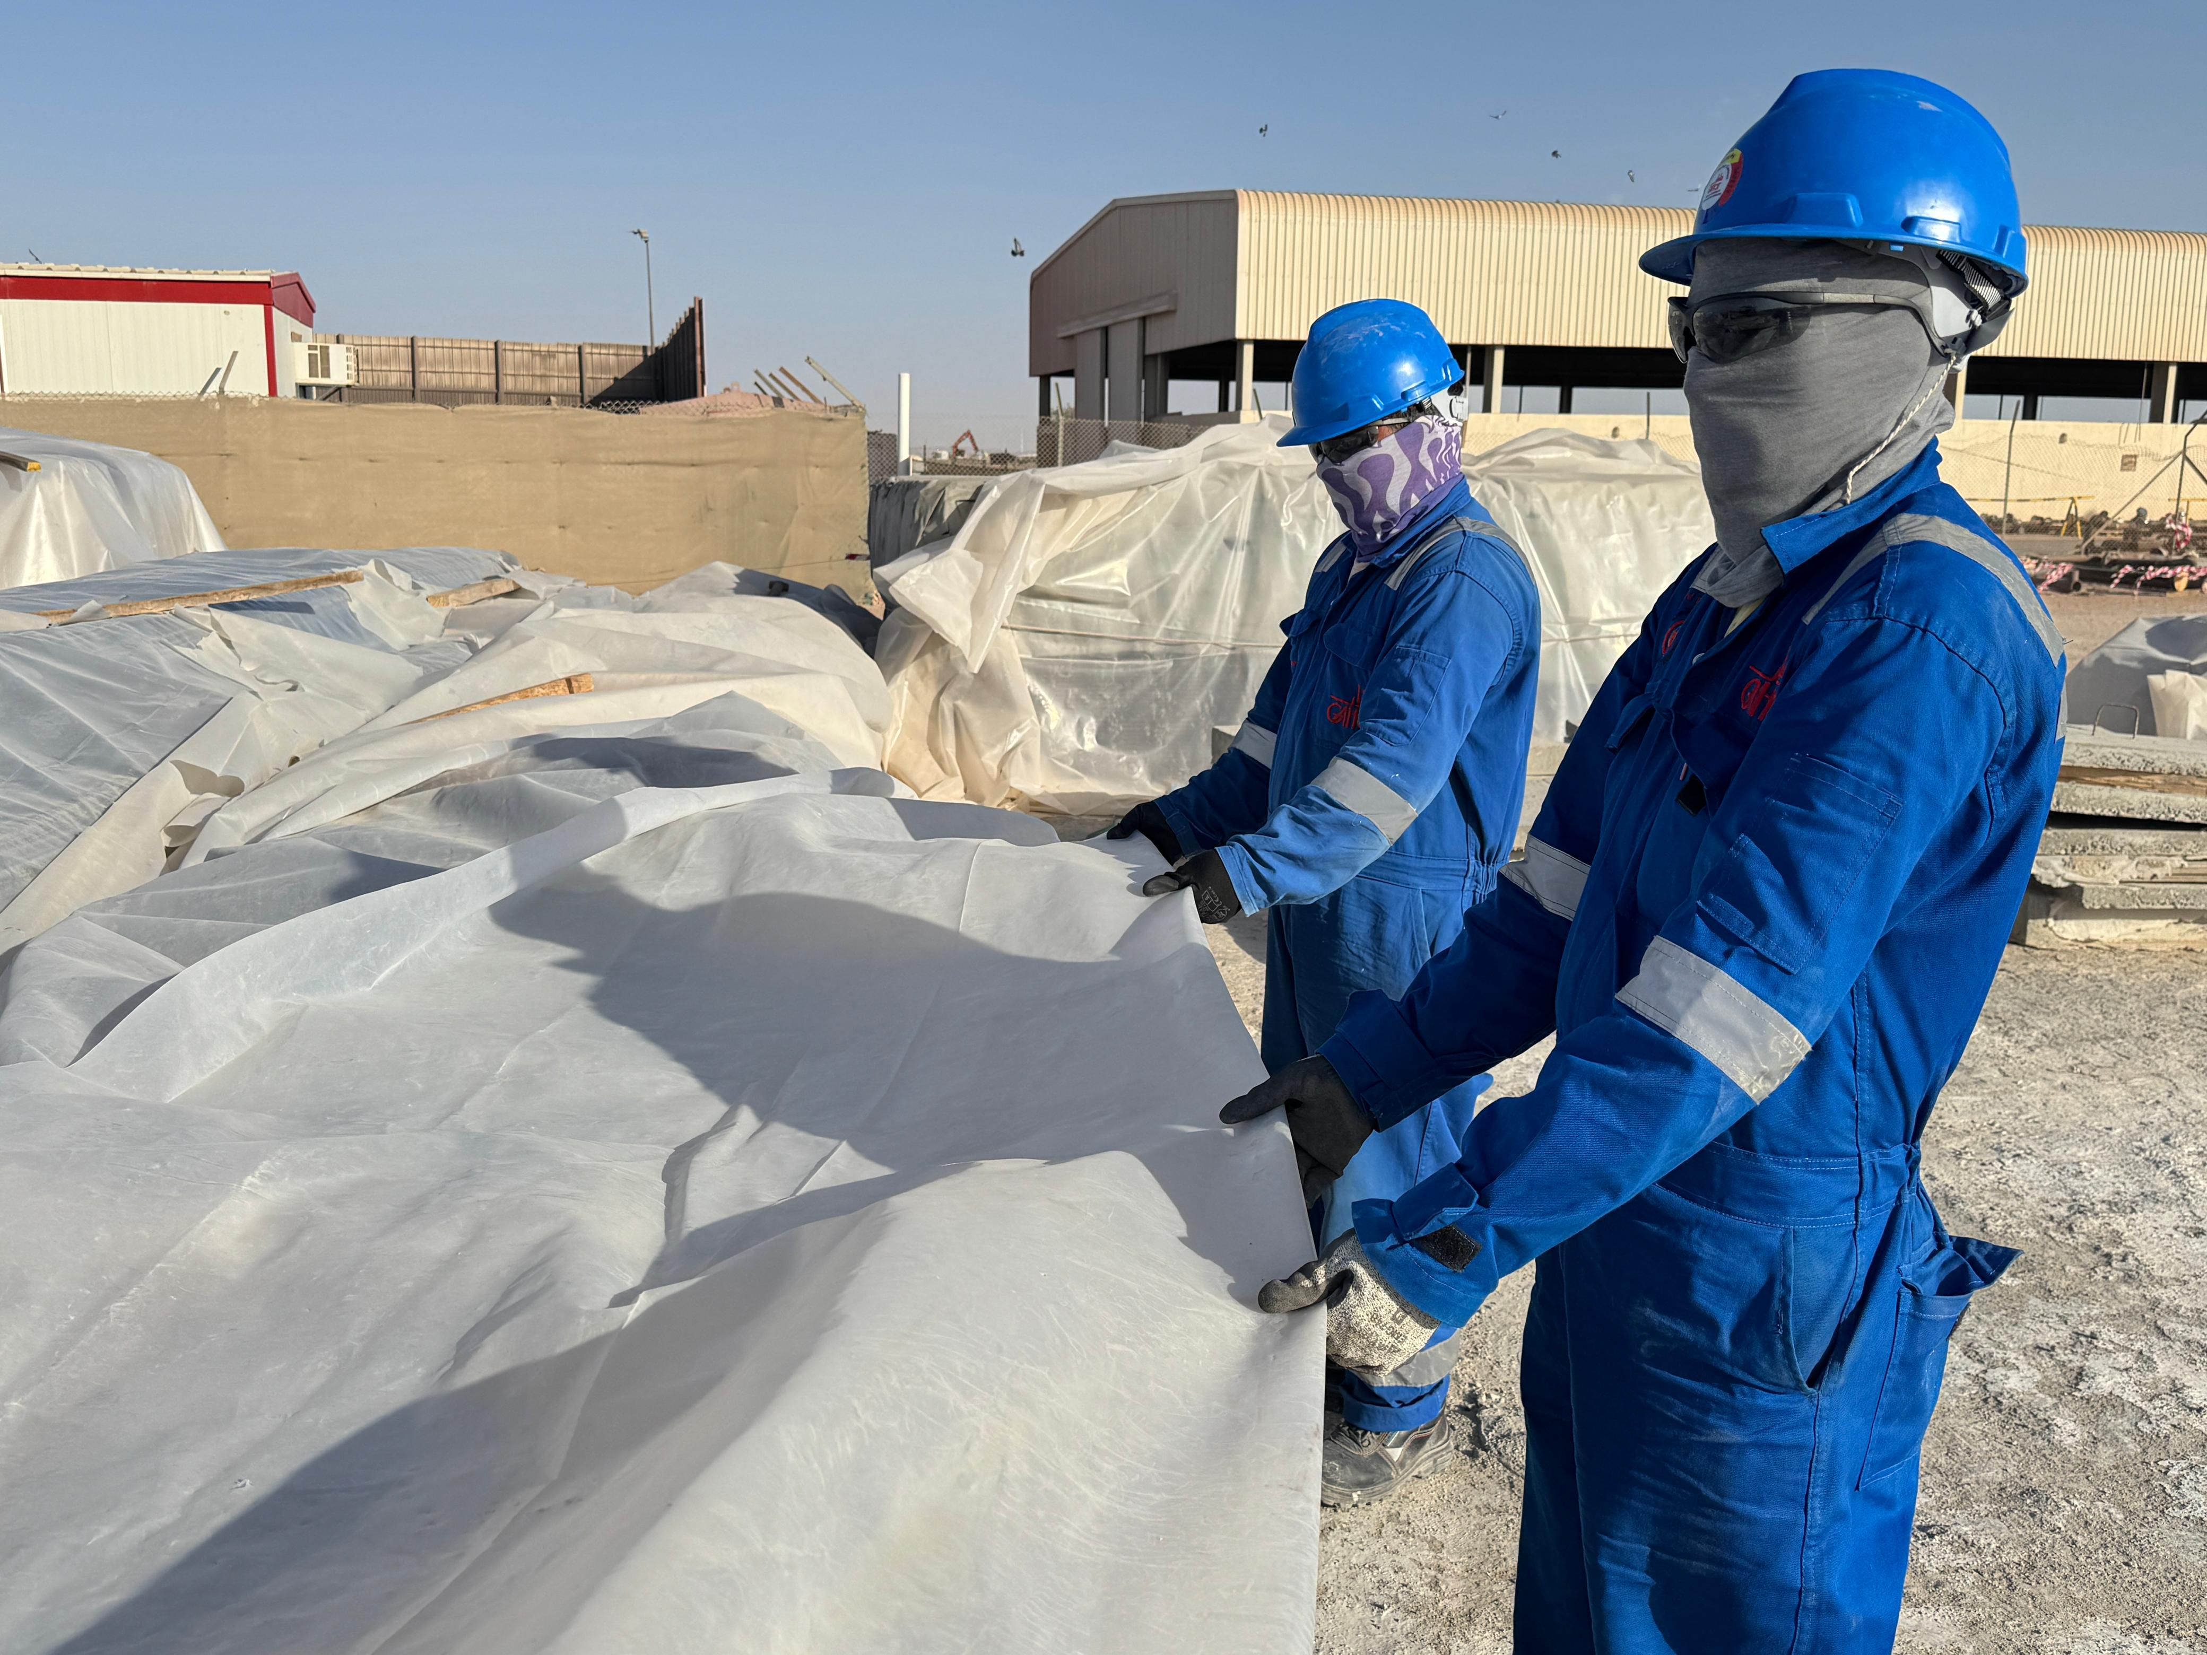
Learning From Incident - First Alert
Prevent
PIM # | 1177759 | Date & Time | 11/05/2025 16:30 | Location | Qarn Alam
Incident Type | LTI#07 | Category | Fall at same level | Activity | Yard activity: Covering of rebar bundles
Target Audience: Construction
What happened:
A steel fixer was engaged in covering rebar bundles with an HDPE Sheet as part of routine activity. While attempting to pull the sheet into its correct position, he lost his balance, and fell onto the ground, landing heavily on his left hand. The Steel Fixer taken to site First aid centre and later transferred to Badar Al Samaa Hospital in Nizwa, where he was diagnosed with fracture on his left-hand forearm.
Initial Findings:
HDPE sheets are provided over the plastic sheet as additional protection of the steel rebars (HDPE sheet is normally not required).
Worn out hand gloves caused Inadequate grip protection.
Ineffective supervision during task execution (Task required two persons, Double protection is not required).
Steel Fixer has normalized the risk as the task was a routine.
Engagement Questions:
Before starting the task, how do you identify and assess the potential hazards involved?
Are you aware of the manual handling risk associated with the task?
Do Your Ensure that all the activities in industrial area are effectively supervised ?
What steps do you take to make sure that everyone on site is wearing the right always PPE & wearing it correctly?
How do you spot and address behaviors where workers may have become too comfortable with risk? What role do inspections and conversations play in that?
Even routine tasks can lead to serious injuries when risk is not properly assessed.
In case of an emergency please call PDO Emergency Number (Toll Free): 2467-5555
Notes:
Mr Musleh image on the top right will change according to incident pattern, MSE3 will provide you with the image as per the pattern
What happened: A short description should be provided without mentioning names of contractors or individuals. You should include, what happened, to who (by job title) and what injuries this resulted in. Nothing more!
Initial Finding: Four to five bullet points highlighting the initial main findings from the investigation. Remember the target audience is the front-line staff so this should be written in simple terms in a way that everyone can understand.
Learnings: Four to five learning message in the form of questionnaires linked with initial findings
The strap line should be the main learning point you want to get across
The images should be self explanatory, what went wrong (if you create a reconstruction please ensure you do not put people at risk) and below how it should be done.

