Slide 1

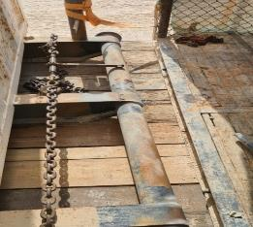

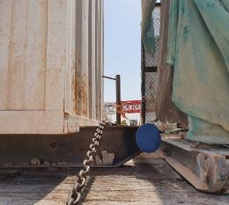

PDO Second Alert
Date: 15.03.2021 Incident title LTI # 07(struck by)
What happened?
A Helper was between two loads on a trailer bed. At the same time, a Foreman was guiding a forklift truck in loading a 3rd load at the rear of the trailer. The Foreman instructed the Forklift truck operator to push the 3rd load further on the trailer using the forklift tines. This also pushed the 2nd load causing the Helpers legs to become crushed between the 1st and 2nd load. The Helper suffered 2 fractures and a laceration to his right leg and 1 fracture to his left leg
Your learning from this incident..
Foreman / Supervisors
Always ensure you give your team specific instructions on when it is safe to approach a vehicle for load security
Always ensure you check there are no persons in the line of fire.
Always ensure you are acting as the Supervisor overseeing the full task
Always ensure your crew follow the correct load security methods
Always ensure you conduct a 4CAAP (Crosscheck, Assure & Accountability Programme) before starting tasks
Helpers / Drivers staff
Always ensure you do not enter the line of fire, make sure it is safe to carry out the task before doing it.
Always ensure you do not rush to finish a task, take your time and do it safely.
Always ensure you use your empowerment to STOP if you feel that it is unsafe, even if your supervisor gives you instructions to do something.
Always ensure you conduct load security from the ground level
USE YOUR EMPOWERMENT TO STOP – EVEN AGAINST YOUR SUPERVISOR!
Ensure that you check that all staff are out of the line of fire before starting loading / unloading operations
Notes:
Ensure all dates and titles are input
A short description should be provided without mentioning names of contractors or individuals. You should include, what happened, to who (by job title) and what injuries this resulted in. Nothing more!
Four to five bullet points highlighting the main findings from the investigation. Remember the target audience is the front line staff so this should be written in simple terms in a way that everyone can understand.
The strap line should be the main point you want to get across
The images should be self explanatory, what went wrong (if you create a reconstruction please ensure you do not put people at risk) and below how it should be done.

Slide 2
Management self audit
Date: 15.03.21 Incident title LTI # 07.
As a learning from this incident and ensure continual improvement all contract
managers must review their HSE HEMP against the questions asked below
Confirm the following:
Do you ensure there are adequate Safe Systems of Work in place for forklift truck operations and they are understood and followed by all?.
Do you ensure that employees are aware of line of fire hazards?
Do you ensure regular drills are conducted to train employees on using the emergency number?
Do you ensure staff are aware of their empowerment to stop?
* If the answer is NO to any of the above questions please ensure you take action to correct this finding.
Notes:
Ensure all dates and titles are input
Make a list of closed questions (only ‘yes’ or ‘no’ as an answer) to ask others if they have the same issues based on the management or HSE-MS failings or shortfalls identified in the investigation.
Imagine you have to audit other companies to see if they could have the same issues.
These questions should start with: Do you ensure…………………?

