Slide 1
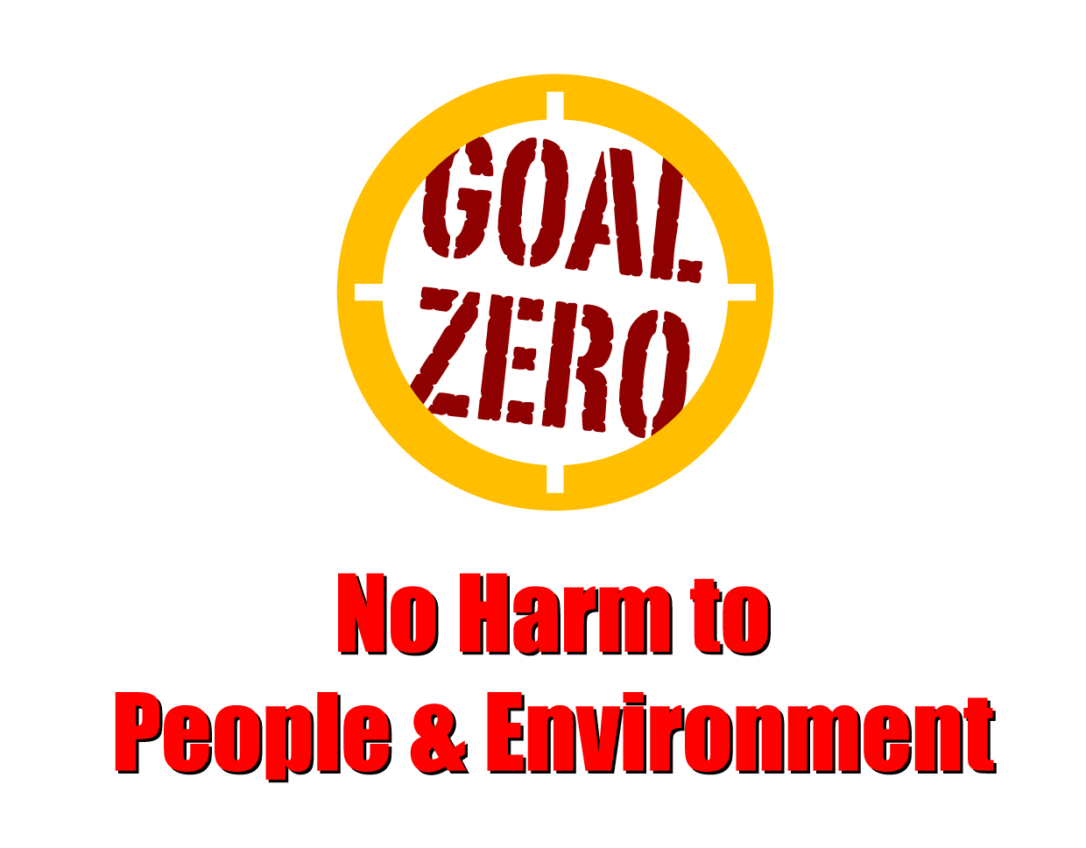
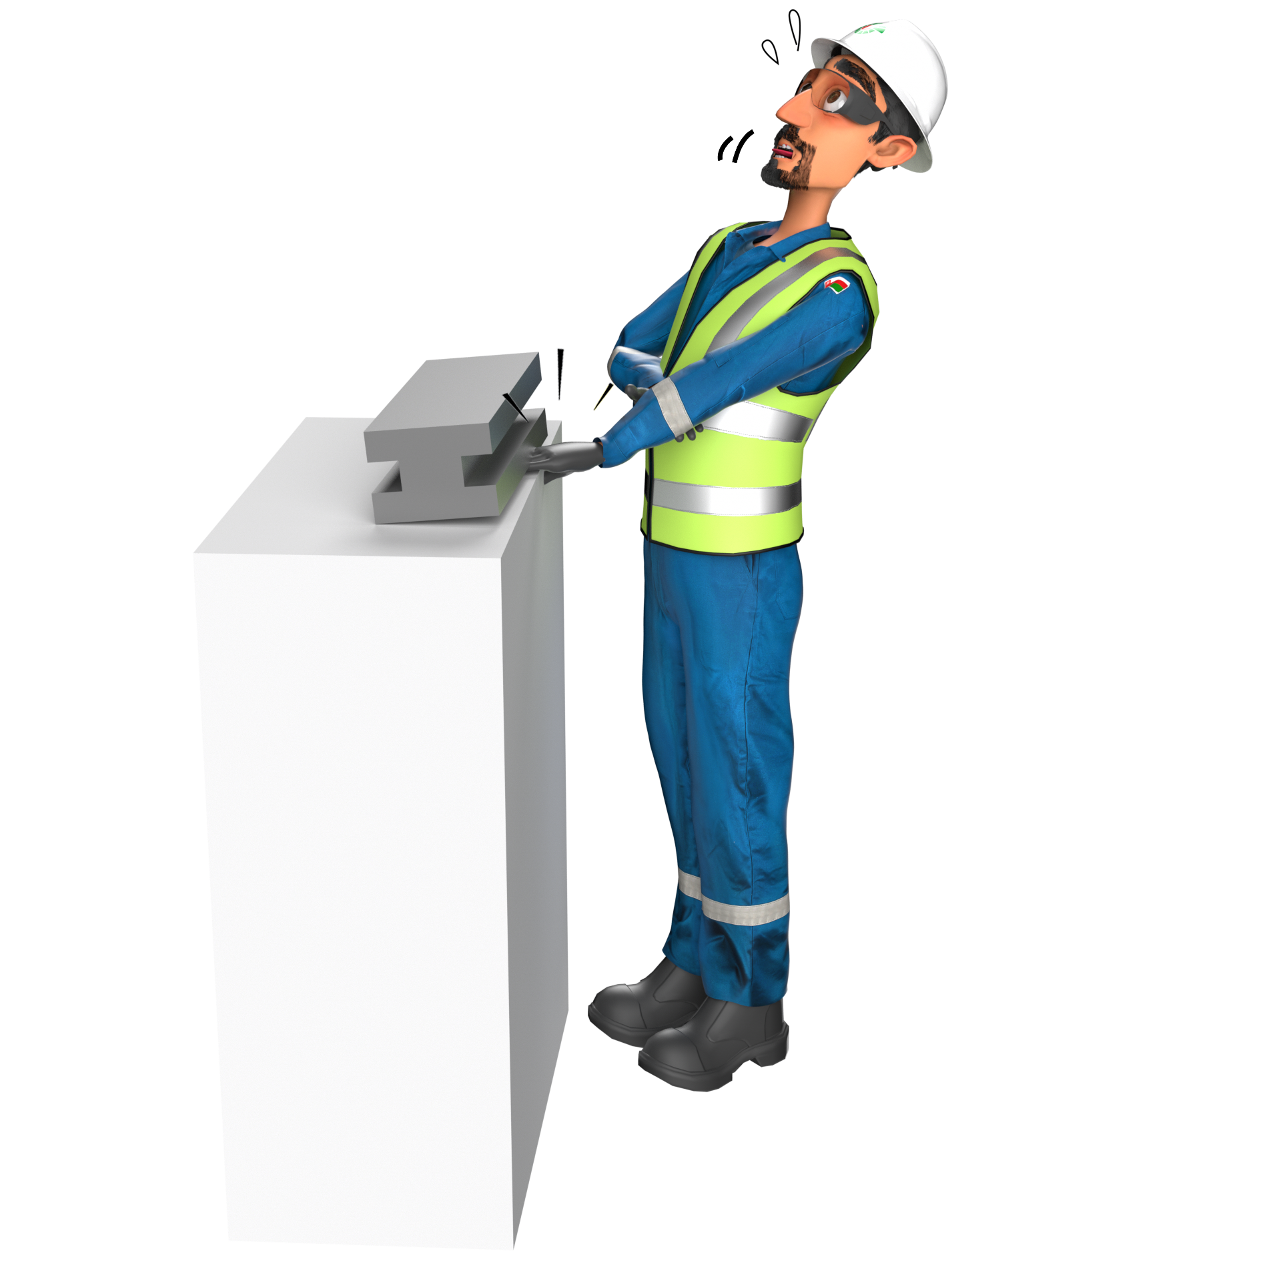
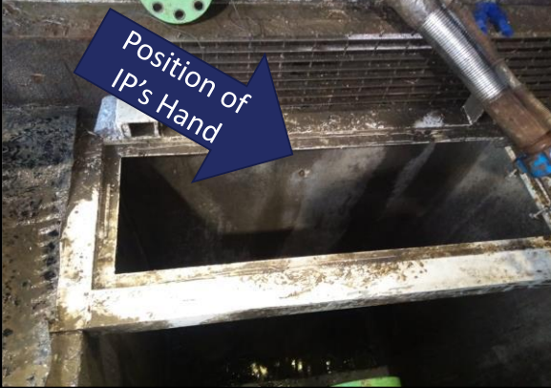
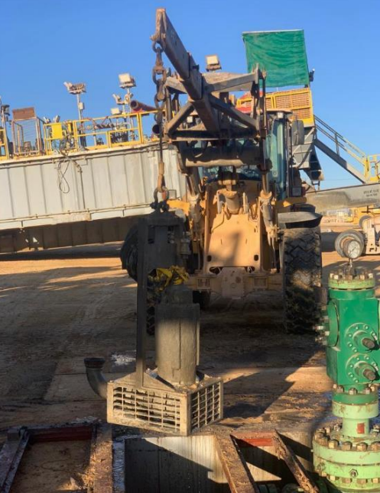
Learning From Incident - First Alert
Prevent
PIM # | 1154347 | Date | 21.05.2023 | Direct / Depart
Incident Type | LTI#07 | Time | 01:10 hrs | Location | Rig-150, Nimr
Pattern | Hands & Fingers | Contractor |  | Activity | Lifting cellar pump
Target Audience: All
What happened
During the preparations for a rig move activity and while a Driller was operating the winch line to lift cellar pump, Floorman’s’ right hand finger got caught between the cellar pump and caller’s grating resulting in a fracture to his right-hand middle finger.
Initial Findings
Procedure was not followed properly by the Banksman and the Floorman.
The activity was unplanned and risk assessment was not conducted.
Floorman put his hand in the line of fire and pinch point area whilst the winch was operated.
Learnings
Do you ensure Mustaed engagement is effectively done prior the task ?
How do you ensure all crew members are aware of all the pinch points related hazards?
Do you always ensure that all activities are planned well before starting the task?
Do you ensure to use appropriate tools and equipment for the task?
Never put your hands in the line of fire and use hands off tools
In case of an emergency please call PDO Emergency Number (Toll Free): 2467-5555
Notes:
Mr Musleh image on the top right will change according to incident pattern, MSE3 will provide you with the image as per the pattern
What happened: A short description should be provided without mentioning names of contractors or individuals. You should include, what happened, to who (by job title) and what injuries this resulted in. Nothing more!
Initial Finding: Four to five bullet points highlighting the initial main findings from the investigation. Remember the target audience is the front-line staff so this should be written in simple terms in a way that everyone can understand.
Learnings: Four to five learning message in the form of questionnaires linked with initial findings
The strap line should be the main learning point you want to get across
The images should be self explanatory, what went wrong (if you create a reconstruction please ensure you do not put people at risk) and below how it should be done.

