Slide 1

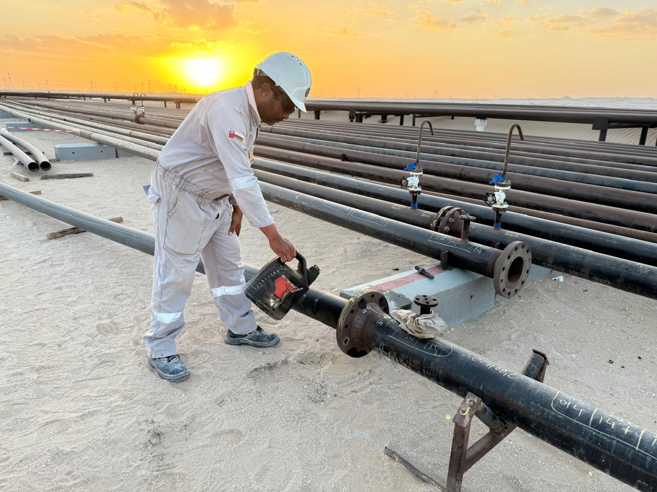
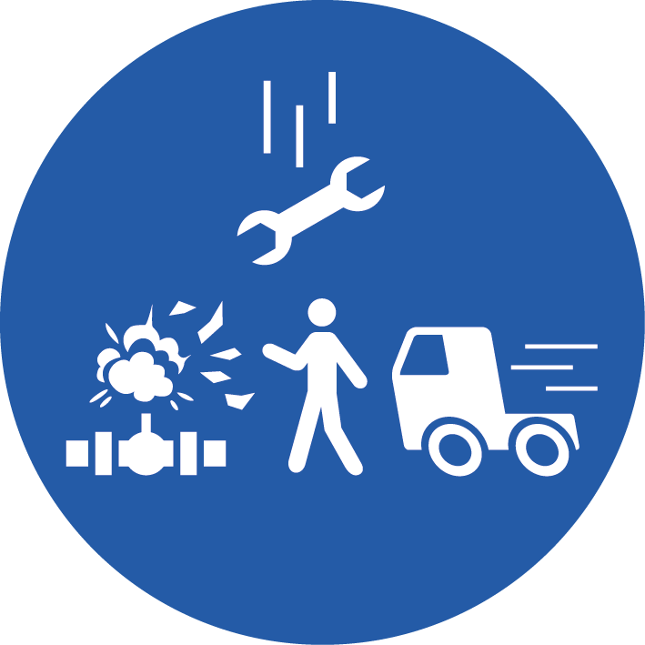
Learning From Incident - First Alert
Prevent
PIM # | 1177808 | Date & Time | 13.05.2025 / 13:40 | Location | Anzooz, Bahja
Incident Type | LTI#08 | Category | Leg Injury (Struck by) | Activity | Pulling HDPE Pipes.
Target Audience: All
What happened:
During the flowline laying activity by the mechanical team in Anzuz area, a Helper was standing near the line lubricating the HDPE liner which was being pulled into a carbon steel pipe. Suddenly, the pipe tilted and fell onto the helper’s left leg resulting in a fracture of the bone in his left shin.
Initial Findings:
The roll support for the carbon steel pipe suddenly tilted, causing the pipe to tilt and fall over.
The helper was standing in line of fire of stored energy.
Inadequate pipe support was used for the activity.
Engagement Questions:
How do you ensure you are using the right equipment for the task?
Do you ensure securing the pipes with proper supports to prevent from falling before starting the task.
Are you aware of line of fire risks for the tasks you are working on?
Do you ensure to conduct pre-task risk assessments and toolbox talks highlighting potential hazards including Line of Fire?
Do you comply with the specific method of statement / SOP of the task?
Always ensure crew are aware of line of fire risks and avoid them
In case of an emergency please call PDO Emergency Number (Toll Free): 2467-5555
Notes:
Mr Musleh image on the top right will change according to incident pattern, MSE3 will provide you with the image as per the pattern
What happened: A short description should be provided without mentioning names of contractors or individuals. You should include, what happened, to who (by job title) and what injuries this resulted in. Nothing more!
Initial Finding: Four to five bullet points highlighting the initial main findings from the investigation. Remember the target audience is the front-line staff so this should be written in simple terms in a way that everyone can understand.
Learnings: Four to five learning message in the form of questionnaires linked with initial findings
The strap line should be the main learning point you want to get across
The images should be self explanatory, what went wrong (if you create a reconstruction please ensure you do not put people at risk) and below how it should be done.

