Slide 1
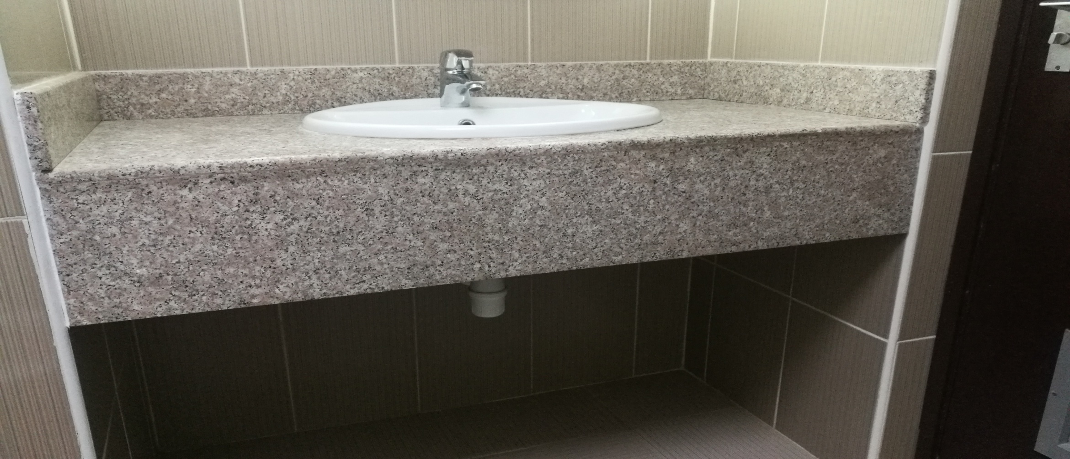
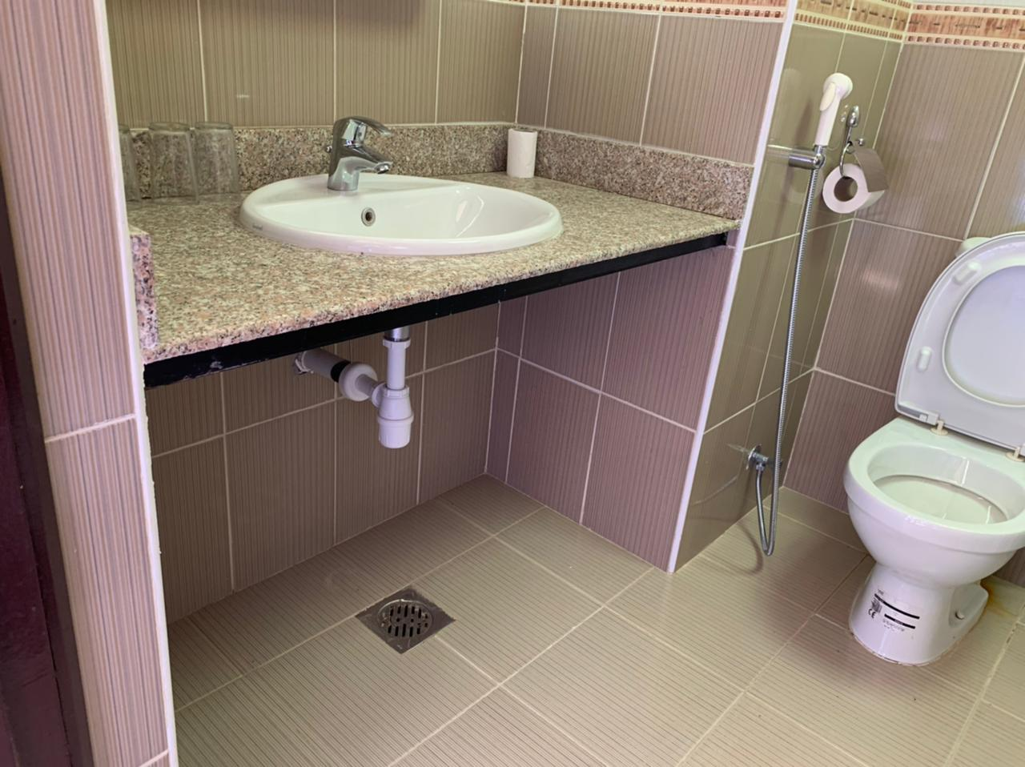
PDO Second Alert
Date:15.03.2021 Incident Type: LTI#08 (Drop)
What happened?
While the production supervisor was completing the ablutions in her room, the granite tile of the wash basin fall down on her left foot causing a fracture in her big toe.
Your learning from this incident..
Anticipate the surrounding hazards
Always report any unsafe condition and Near Miss observations/incidents
Always call 5555 for all emergencies
Maintenance team
Good checks lead to identify potential threats
Carryout survey in other area for any reported unsafe condition/Near Miss to ensure appropriate actions taken to prevent incidents
Granite glue adhesive
Joint silicone sealant
Light weight
Beware of hidden hazards
Notes:
Ensure all dates and titles are input
A short description should be provided without mentioning names of contractors or individuals. You should include, what happened, to who (by job title) and what injuries this resulted in. Nothing more!
Four to five bullet points highlighting the main findings from the investigation. Remember the target audience is the front line staff so this should be written in simple terms in a way that everyone can understand.
The strap line should be the main point you want to get across
The images should be self explanatory, what went wrong (if you create a reconstruction please ensure you do not put people at risk) and below how it should be done.

Slide 2
Management self audit
Date:15.03.2021 Incident Type: LTI#08
As a learning from this incident and to ensure continual improvement all contract managers must review their HSE HEMP against the questions asked below
Confirm the following:
Do you always ensure that granite & tiles are inspected in regular basis.
Do you always ensure that reinforcement is done for all granite & tiles (and similar installations)?
Do all camps occupants know how to check the facilities to spot the potential hazards?
Do you always review your standards and update them?
Do you always report unsafe conditions & near misses?
Do you always cascades the learnings from incidents to all?
* If the answer is NO to any of the above questions please ensure you take action to correct this finding.
Notes:
Ensure all dates and titles are input
Make a list of closed questions (only ‘yes’ or ‘no’ as an answer) to ask others if they have the same issues based on the management or HSE-MS failings or shortfalls identified in the investigation.
Imagine you have to audit other companies to see if they could have the same issues.
These questions should start with: Do you ensure…………………?

