Slide 1
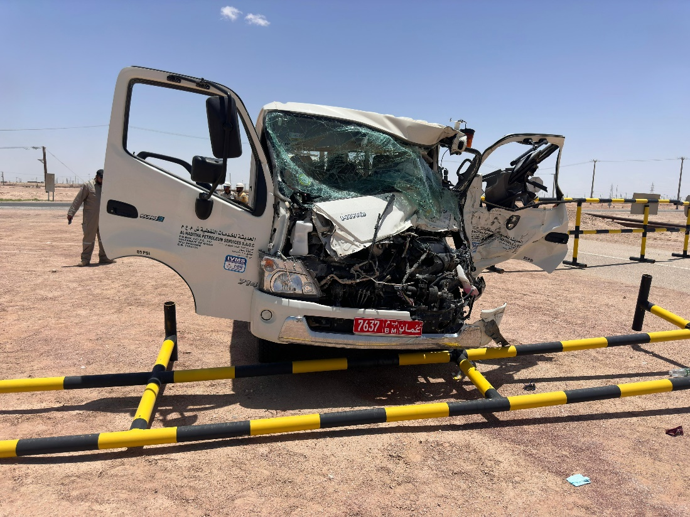
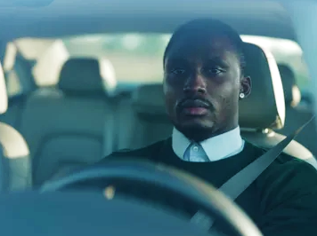
PDO Second Alert
Date: 05/05/2024 Incident title: LTI #8 Category: MVI Potential Severity: 5P Activity: Driving
Target Audience: Drilling, Logistics, Operation & Construction
What happened?
On 05.05.2024 at approximately 11:10hrs, while a Mechanical crew consisting of a driver and four passengers were travelling from Al Huwaisah worksite towards Yibal Camp in a canter vehicle, the canter collided with the rear right-side of a bucket truck which was approaching the T- junction to enter the main Yibal road. This resulted in an injury to the canter driver while the four passengers and the bucket truck driver were uninjured. An X-ray revealed that the canter driver’s left leg sustained a fracture.
Why it happened/Finding :
Driver experienced microsleep while driving
Driver continued to drive while experiencing micro sleep/fatigue symptoms
Driver approached the T-Junction at a high speed (89km/h).
Your learning from this incident.
Remember you are empowered to STOP work if unsafe
Recognize the signs of fatigue while driving and take appropriate rests.
Always comply with Defensive Driving Techniques
Journey Managers, watch out for signs of fatigue with Drivers before dispatch.
Be Aware and Alert of Fatigue while Driving !
Notes:
Ensure all dates and titles are input
A short description should be provided without mentioning names of contractors or individuals. You should include, what happened, to who (by job title) and what injuries this resulted in. Nothing more!
Four to five bullet points highlighting the main findings from the investigation. Remember the target audience is the front line staff so this should be written in simple terms in a way that everyone can understand.
The strap line should be the main point you want to get across
The images should be self explanatory, what went wrong (if you create a reconstruction please ensure you do not put people at risk) and below how it should be done.

Slide 2
Management self audit
Date:05/05/2024 Incident title: LTI# 08 Pattern: LTI / MVI. Potential severity: C5P Activity: Driving
As a learning from this incident and ensure continual improvement all contract managers must review their HSE risk management against the questions asked below
Confirm the following:
Do you always comply with Defensive driving techniques and Safe Journey requirements?
Do you always ensure all your employees position are risk assessed ?
Do you always keep your focused and maintain appropriate speeds while driving?
Do you always speak up if you have concerns or issues related to driving?
Do you always ensure TBT done effectively covering driving related hazards and controls?
* If the answer is NO to any of the above questions please ensure you take action to correct this finding
Notes:
Ensure all dates and titles are input
Make a list of closed questions (only ‘yes’ or ‘no’ as an answer) to ask others if they have the same issues based on the management or HSE-MS failings or shortfalls identified in the investigation.
Imagine you have to audit other companies to see if they could have the same issues.
These questions should start with: Do you ensure…………………?

