Slide 1
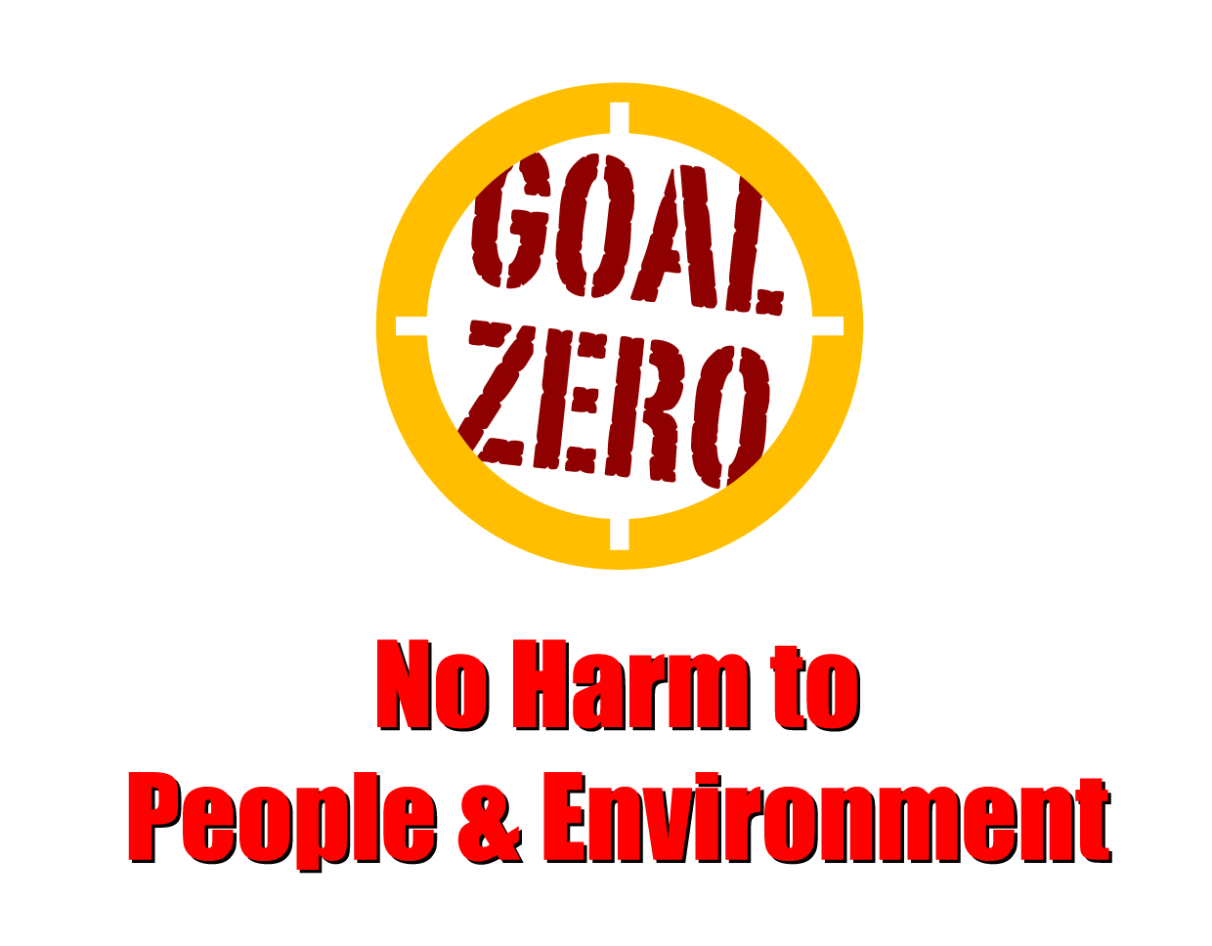
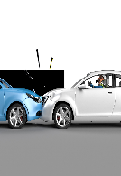
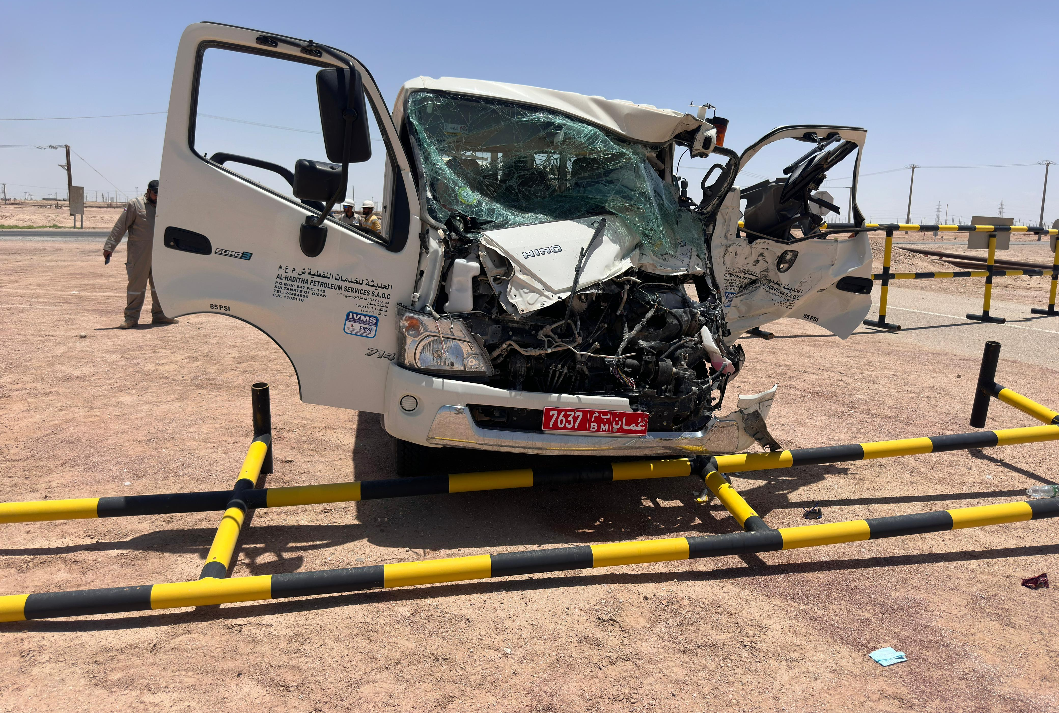
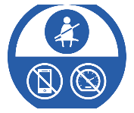
Learning From Incident - First Alert
Prevent
PIM # | 1165674 | Date & Time | 05.05.2024 11:10 AM | Location | Yibal
Incident Type | LTI#08 | Category | MVI | Activity | Driving
Target Audience: All
What happened
On 05.5.2024 at approximately 11:10hrs, While Mechanical crew consist of Driver and Four passengers were travelling from Al Huwaisah worksite towards Yibal Camp in a canter vehicle, the canter collided with the rear right-side of bucket truck which was approaching the T- junction to enter the main Yibal road resulting in an injury to the canter Driver with remaining passengers escape unhurt. X-ray revealed left leg fractured.
Initial Findings
Canter collided into the rear right side of the bucket truck with no brake indication.
Canter average speed on collision was 89 Kmph and rested at 77 Kmph.
Bucket Truck at the T Junction was 15 Kmph at the impact time.
All Canter vehicle occupants worn seat belts and the airbags worked as intended.
Engagement Questions:
How do you ensure that drivers are keep safe distance while driving?
How do you know that drivers are well rested before commencing a journey?
As a driver, what steps do you take to ensure your safety while driving?
As a passenger, what steps you take to ensure your safety as a passenger?
Follow the driving life saving rules and maintain safe distance while driving
Always keep safe distance with front vehicle while driving
In case of an emergency please call PDO Emergency Number (Toll Free): 2467-5555
Notes:
Mr Musleh image on the top right will change according to incident pattern, MSE3 will provide you with the image as per the pattern
What happened: A short description should be provided without mentioning names of contractors or individuals. You should include, what happened, to who (by job title) and what injuries this resulted in. Nothing more!
Initial Finding: Four to five bullet points highlighting the initial main findings from the investigation. Remember the target audience is the front-line staff so this should be written in simple terms in a way that everyone can understand.
Learnings: Four to five learning message in the form of questionnaires linked with initial findings
The strap line should be the main learning point you want to get across
The images should be self explanatory, what went wrong (if you create a reconstruction please ensure you do not put people at risk) and below how it should be done.

