Slide 1
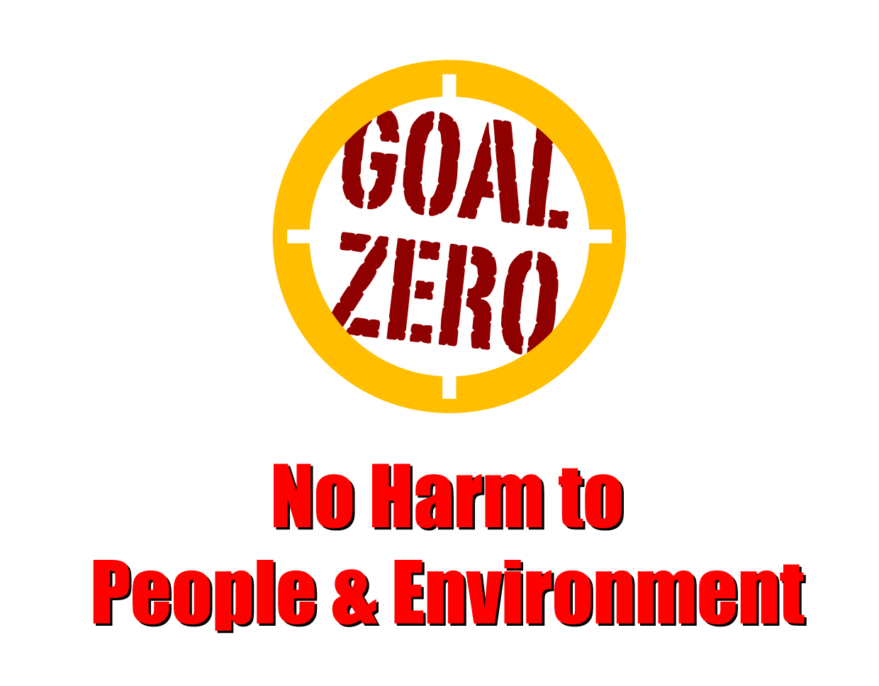
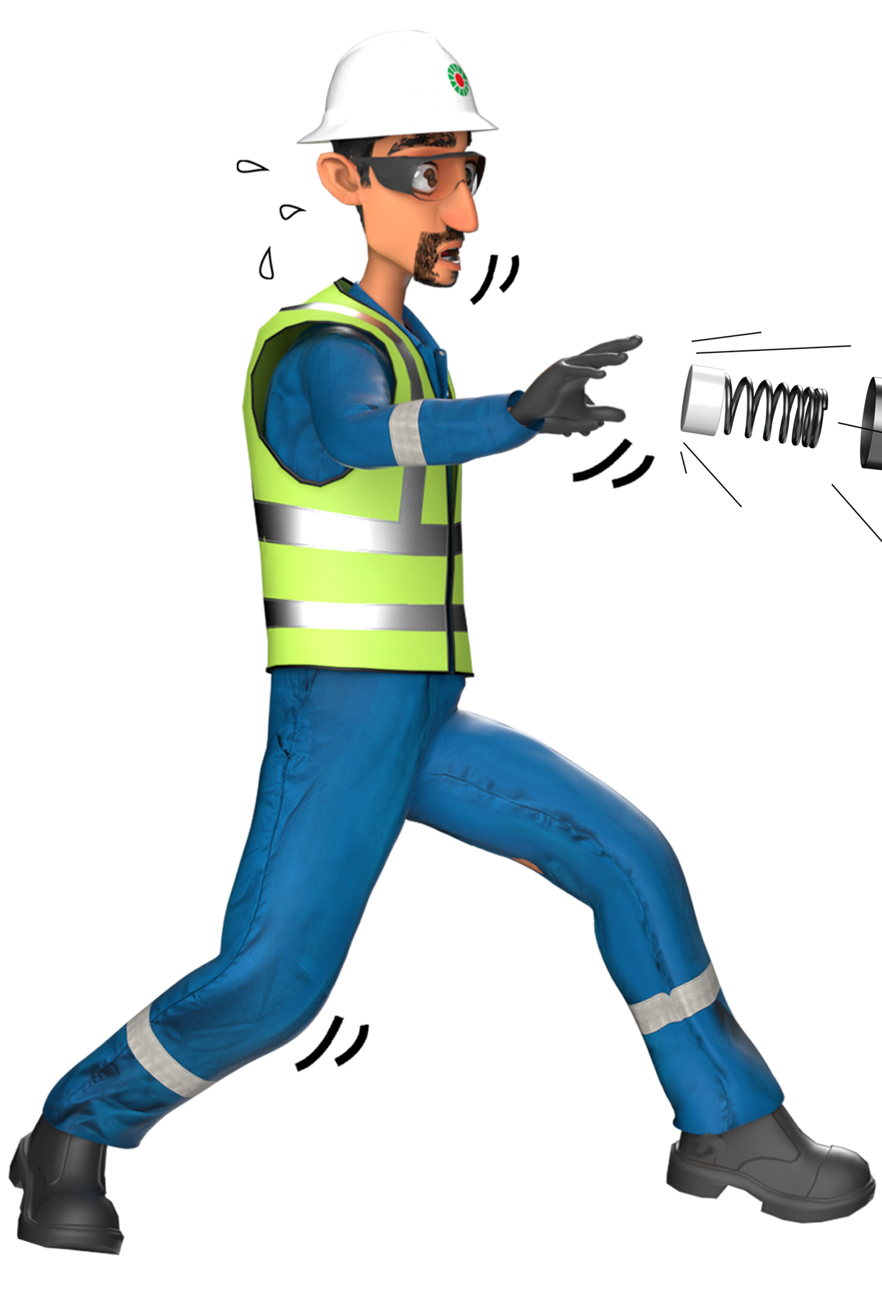
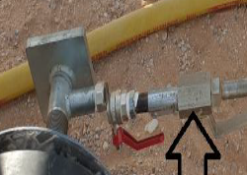
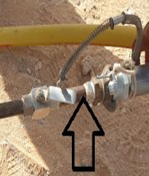
Learning From Incident - First Alert
Prevent
PIM # | 1154239 | Date | 17.05.2023 | Direct / Depart
Incident Type | LTI#08 | Time | 16:00 hrs | Location | Lekhwair
Pattern | Released Energy | Contractor |  | Activity | Air pressure testing
Target Audience: All
What happened
During the air pressure testing of 16” HDPE liner for a line section and while the PTW holder and Helper were attempting to carry out pressure verification check on the gauge attached to the manifold, the ball valve attached to the gauge suddenly failed and caused the manifold to detach and hit the Helpers’ left leg resulting in a fracture
Initial Findings
The whip lock arrestor between the test plug and manifold section was missing.
No support was provided for the manifold section during the air filling time.
Anchoring wasn’t done for the manifold section to prevent whipping in case of valve failure.
MTC or rating certificate were not available for the ball valve and the test plug.
Learnings
Do you ensure you aware of all pressure release hazards before starting the task?
How do you ensure using the correct rated tools, materials and fittings for the activity?
Do you ensure to follow the correct procedure before starting the task?
How do you ensure you intervene in case of unsafe condition?
Always ensure to use correct pressure rated tools
In case of an emergency please call PDO Emergency Number (Toll Free): 2467-5555
Notes:
Mr Musleh image on the top right will change according to incident pattern, MSE3 will provide you with the image as per the pattern
What happened: A short description should be provided without mentioning names of contractors or individuals. You should include, what happened, to who (by job title) and what injuries this resulted in. Nothing more!
Initial Finding: Four to five bullet points highlighting the initial main findings from the investigation. Remember the target audience is the front-line staff so this should be written in simple terms in a way that everyone can understand.
Learnings: Four to five learning message in the form of questionnaires linked with initial findings
The strap line should be the main learning point you want to get across
The images should be self explanatory, what went wrong (if you create a reconstruction please ensure you do not put people at risk) and below how it should be done.

