Slide 1
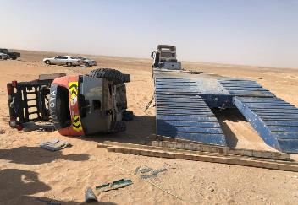
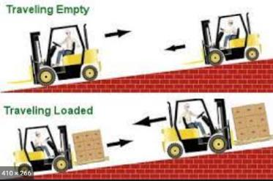
PDO Second Alert
Date: 05.04.2021 Incident title: LTI #09 (rollover)
What happened?
A 3rd party contractor had arrived to drop off a new forklift (FLT) and collect a de-hired 3-ton FLT from the yard and workshops area in Yibal.
At the time of arrival of the truck and low-bed trailer with the replacement forklift on the trailer they reported to CPDS yard coordinator and discussed the requirement of a larger loader for the off and on loading of the FLTs. The yard coordinator decided to have a supervisor from the near by hoist come to make an assessment for the safe off loading and loading. The driver and forklift operator were told that assistance was coming, and they were to wait. Whilst waiting for supervision and coordination for loading, the 3rd party FLT operator decided to offload by baking down the new forklift off the trailer on one ramp only and then attempted to drive the other FLT onto the trailer.
The FLT slipped off the side of the loading ramp and landed on the ground. The operator jump clear of the falling unit, though suffered an ankle injury in the process.
Your learning from this incident..
Use proper arrangement for intended tasks
Ensure sub contractors comply with requirement while driving on slope.
Ensure all activities are supervised by a competent person.
Always wear seat belt and proper PPE while moving lifting equipment.
Always ensure to Intervene when something is being done incorrectly.
Do not operate equipment, if you are not authorized.
Ensure training certifications are valid.
Ensure equipment is not accessible by non authorized people
Supervise sub-contractor’s non-routine activities
Notes:
Ensure all dates and titles are input
A short description should be provided without mentioning names of contractors or individuals. You should include, what happened, to who (by job title) and what injuries this resulted in. Nothing more!
Four to five bullet points highlighting the main findings from the investigation. Remember the target audience is the front line staff so this should be written in simple terms in a way that everyone can understand.
The strap line should be the main point you want to get across
The images should be self explanatory, what went wrong (if you create a reconstruction please ensure you do not put people at risk) and below how it should be done.

Slide 2
Management self audit
Date: 05.04.2021 Incident title: LTI#09
As a learning from this incident and ensure continual improvement all contract
managers must review their HSE HEMP against the questions asked below
Confirm the following:
Do you audit, your plant suppliers for compliance with SP-2001 & SP2273 (section 5)?
Do you ensure your operators ( forklift/crane) don’t operate the equipment if their license is expired?
Do you ensure that your plant supplier has developed safe working procedures for all activities?
Do you ensure that your plant supplier provides suitable equipment and proper training?
Do you ensure effective communication system is in place?
* If the answer is NO to any of the above questions please ensure you take action to correct this finding.
Notes:
Ensure all dates and titles are input
Make a list of closed questions (only ‘yes’ or ‘no’ as an answer) to ask others if they have the same issues based on the management or HSE-MS failings or shortfalls identified in the investigation.
Imagine you have to audit other companies to see if they could have the same issues.
These questions should start with: Do you ensure…………………?

