Slide 1
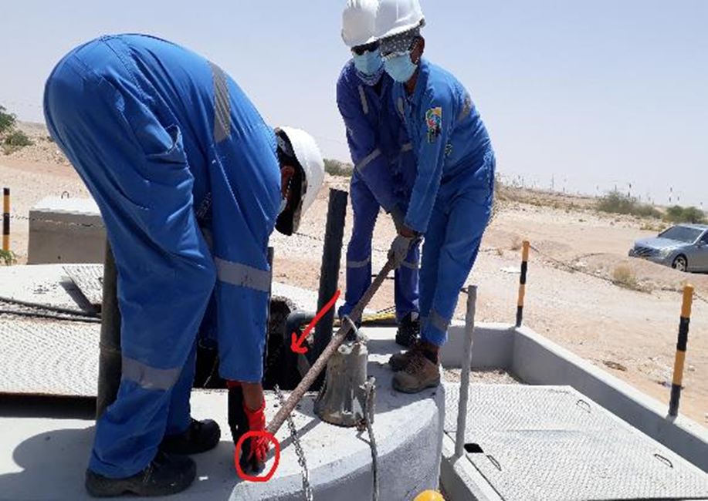
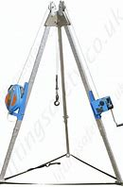
PDO Second Alert
Date:29/03/2022 Incident title: LTI#09 Pattern: Hands & Fingers. Potential severity: C4P
Target Audience: Drilling, Logistics, Operation & Construction
What happened?
On the 29/03/2022, at 08.00hrs Carillion Maintenance Team, attended Marmul Rig Camp Sewage Lifting Station, (SLS), to repair sewage pumps. After repairing one pump, the team went to reinstall the pump into the SLS. As they lifted the pump on to the top of the SLS using a steel bar, the bar was not kept horizontal, the pump then slid down to the lower end, the person dropped the bar and the pump trapping his finger between the pump and the concrete plinth. This caused a fracture and amputation to the top of middle finger. First aider attended to the wound and then he was transferred to the PAC clinic and later to Badda Al Summa Hospital for further medical treatment
Why it happened/Finding :
Incorrect people doing the work
Poor planning of work
Poor Supervision
Permits not authorized
Hazards and risks not correctly identified
Not using the correct equipment for lifting
Employee Intervention ignored when applied
Your learning from this incident..
Always ensure you are briefed on the work before you start by your supervisor
Always ensure you have competent people to do the work
Always ensure you identify all the hazards before starting the work
Always ensure you have the right equipment in place before you do the work
Always ensure that you are out of the line of fire, away form any risk
Always ensure that you keep your hands away from pinch points at all times
Always be empowered to say no if it is unsafe work, use 4 CAAP emergency line to report unsafe work
Keep Hands Safely Away for Another Day
Notes:
Ensure all dates and titles are input
A short description should be provided without mentioning names of contractors or individuals. You should include, what happened, to who (by job title) and what injuries this resulted in. Nothing more!
Four to five bullet points highlighting the main findings from the investigation. Remember the target audience is the front line staff so this should be written in simple terms in a way that everyone can understand.
The strap line should be the main point you want to get across
The images should be self explanatory, what went wrong (if you create a reconstruction please ensure you do not put people at risk) and below how it should be done.

Slide 2
Management self audit
Date:29/03/2022 Incident title: LTI#09 Pattern: Hands & Fingers. Potential severity: C4P
As a learning from this incident and ensure continual improvement all contract managers must review their HSE risk management against the questions asked below
Confirm the following:
Do you always ensure that the there is clarity on what is in you contract scope of work?
Do you always ensure that you have competent employees in place for the work required ?
Do you ensure that the correct PSP are being followed for the scope of work at hand?
Do you ensure that you have the correct equipment in place to carryout the task at hand?
Do you ensure that you carry out assurance checks to ensure that any process is followed and hardwired into the people on the ground ?
Do you ensure that there is a 2-way clear communication between supervisors and people?
Do you ensure that employees are fully aware of the emergency actions to be taken in the event of a major injury?
Do you ensure proper supervision while carrying out the task?
Do you carry out the appropriate assurance checks for your line of work?
* If the answer is NO to any of the above questions please ensure you take action to correct this finding
Notes:
Ensure all dates and titles are input
Make a list of closed questions (only ‘yes’ or ‘no’ as an answer) to ask others if they have the same issues based on the management or HSE-MS failings or shortfalls identified in the investigation.
Imagine you have to audit other companies to see if they could have the same issues.
These questions should start with: Do you ensure…………………?

