Slide 1
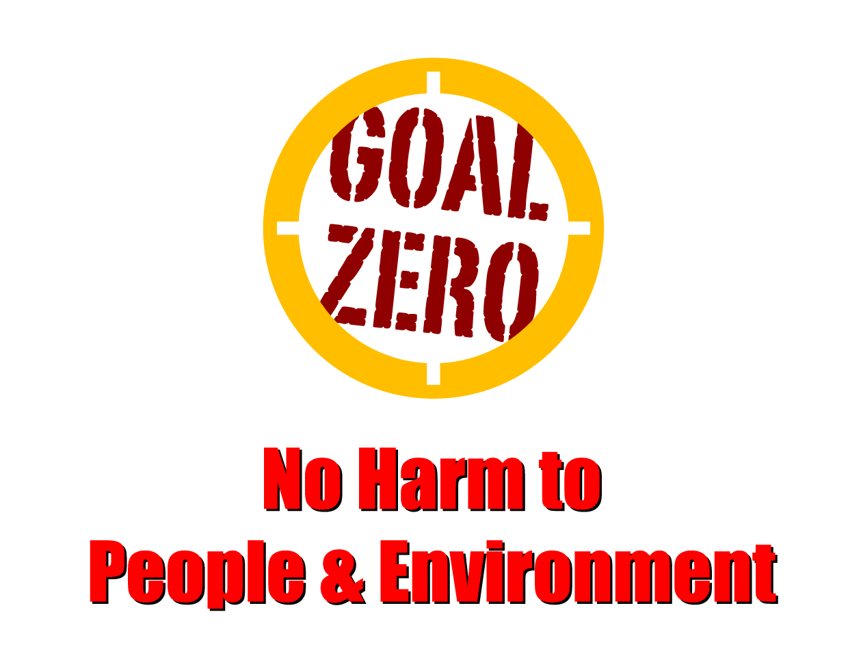
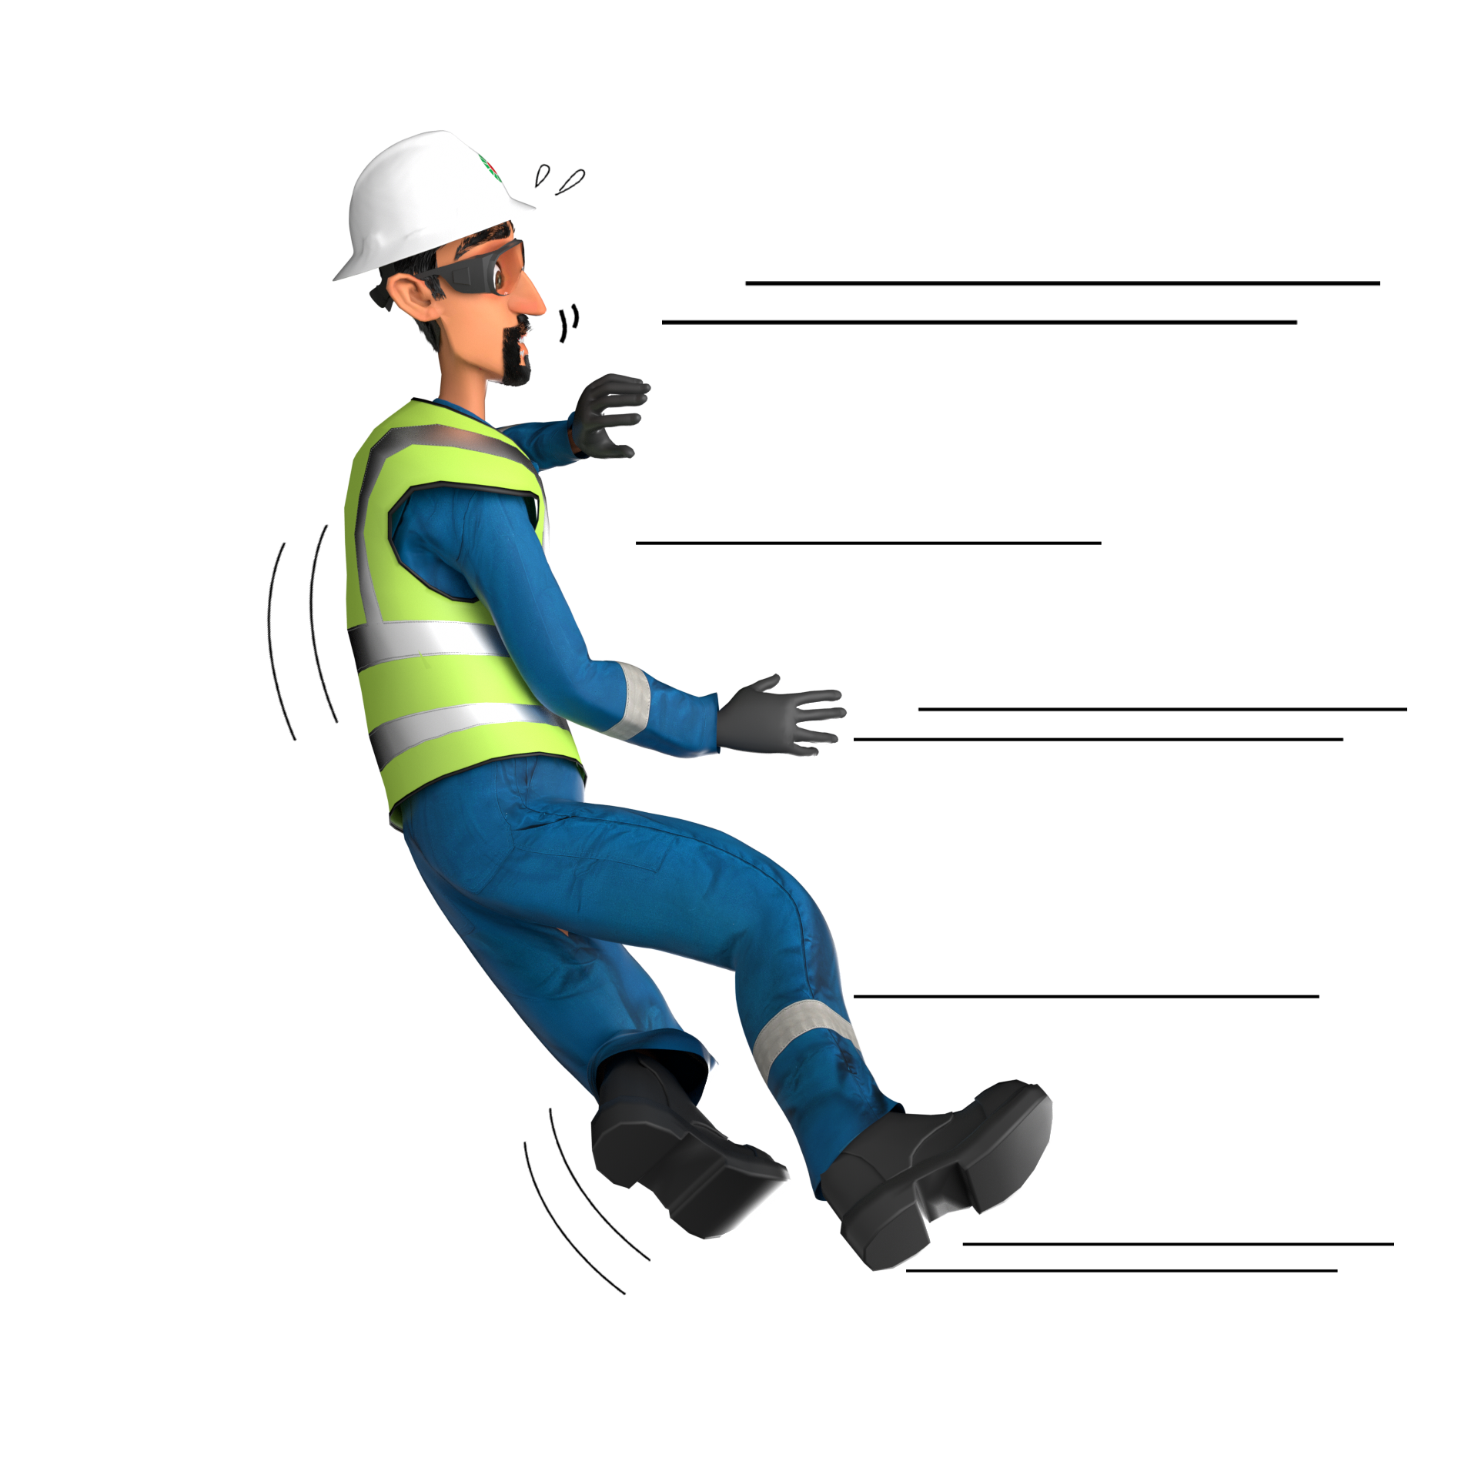
Learning From Incident - First Alert
Prevent
PIM # | 1168101 | Date & Time | 05.07.2024, 15:00 PM | Location | Qarn Alam - Mabrouk
Incident Type | LTI#09 | Category | Slip, Trip & Fall | Activity | Access & Egress from prime mover
Target Audience: All
What happened
On 05th July 2024 at 1500hrs, a 3rd party driver completed offloading liquids at Rig-45, he stopped the tanker outside the location and while exiting the truck cabin, his right foot slipped from the last step. He tried to break his fall by using his outstretched right hand. Soon after, he felt pain and swelling in his right-hand wrist. He was transferred to Rig medic and first aid given. The Driver sent to Fahud PDO clinic for further diagnoses. The X-ray revealed right hand was fractured.
Initial Findings
Incorrect method of exiting
The driver was exiting the truck cabin while facing forward.
The Driver right foot slipped, causing a loss of balance contributing to the fall.
Engagement Questions:
How do you ensure Drivers knows how to safely position human body while descending from the truck cabin?
How do you ensure the drivers use three point of contact while climbing and descending from trucks ?
Correct method of exiting
Always be aware of safe access/egress techniques.
In case of an emergency please call PDO Emergency Number (Toll Free): 2467-5555
Notes:
Mr Musleh image on the top right will change according to incident pattern, MSE3 will provide you with the image as per the pattern
What happened: A short description should be provided without mentioning names of contractors or individuals. You should include, what happened, to who (by job title) and what injuries this resulted in. Nothing more!
Initial Finding: Four to five bullet points highlighting the initial main findings from the investigation. Remember the target audience is the front-line staff so this should be written in simple terms in a way that everyone can understand.
Learnings: Four to five learning message in the form of questionnaires linked with initial findings
The strap line should be the main learning point you want to get across
The images should be self explanatory, what went wrong (if you create a reconstruction please ensure you do not put people at risk) and below how it should be done.

