Slide 1

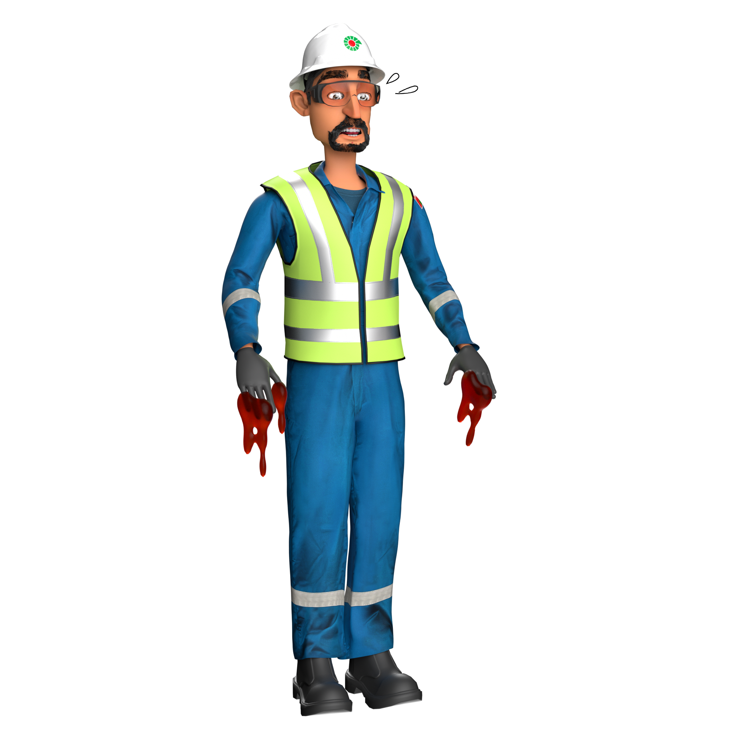
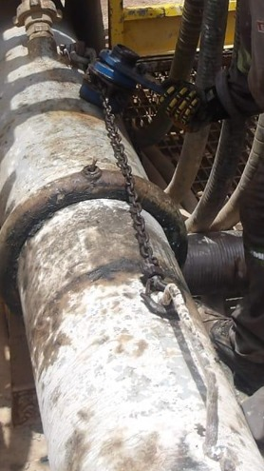

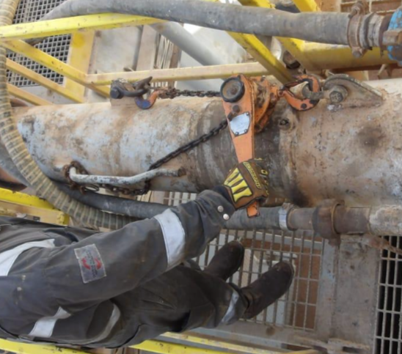
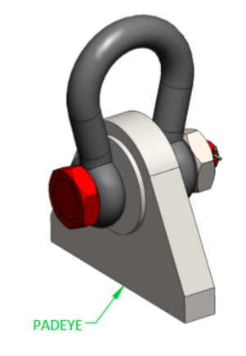
Learning From Incident - First Alert
Prevent
PIM # | 1177900 | Date & Time | 17.05.2025 / 03:20 | Location | Marmul
Incident Type | LTI#09 | Category | Hands & Finger (Struck by) | Activity | Disconnecting flow line
Target Audience: All
What happened:
While rigging down the surface flow line between the Mud Tank and Water Tank, the Mud Tester was attempting to pull the line from the handle arm of the flow line, the handle arm broke from the welded area leading to the lever hoist hook striking the Mud Tester’s right hand, resulting in an injury to his index finger. This was later diagnosed as a dislocation and fracture of the finger.
Initial Findings:
Wrong anchor point used (handle used as anchor)
Incorrect anchor point was used for the task (handle).
The potential risk of uncontrolled release of energy from the lever hoist hook whilst pulling was not identified.
This is a routine task where the tension on the flow line is released by adjusting the lever anchored to certified pad eyes on the flow line
The handle was in place to guide the flowline during rig up /rig down
Engagement Questions:
How do you ensure correct and approved anchor points are being used for the task?
How do you ensure the SOP is adequately covering all activities related to all tasks and it is being followed?
Do you identify all potential risks during your pre job planning (using Musta’ed) and discuss them during pre job meetings?
Always ensure right anchoring points are available and used.
Use the correct anchor points
In case of an emergency please call PDO Emergency Number (Toll Free): 2467-5555
Notes:
Mr Musleh image on the top right will change according to incident pattern, MSE3 will provide you with the image as per the pattern
What happened: A short description should be provided without mentioning names of contractors or individuals. You should include, what happened, to who (by job title) and what injuries this resulted in. Nothing more!
Initial Finding: Four to five bullet points highlighting the initial main findings from the investigation. Remember the target audience is the front-line staff so this should be written in simple terms in a way that everyone can understand.
Learnings: Four to five learning message in the form of questionnaires linked with initial findings
The strap line should be the main learning point you want to get across
The images should be self explanatory, what went wrong (if you create a reconstruction please ensure you do not put people at risk) and below how it should be done.

