Slide 1
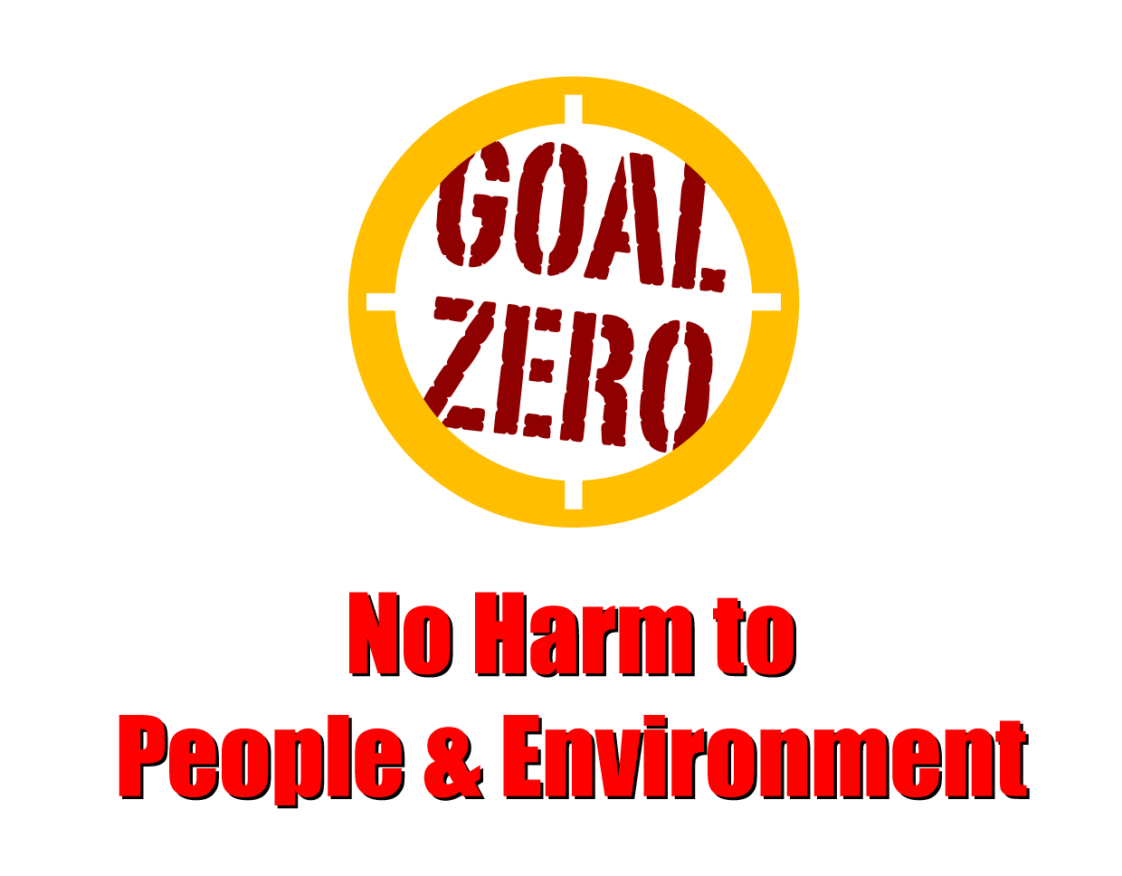
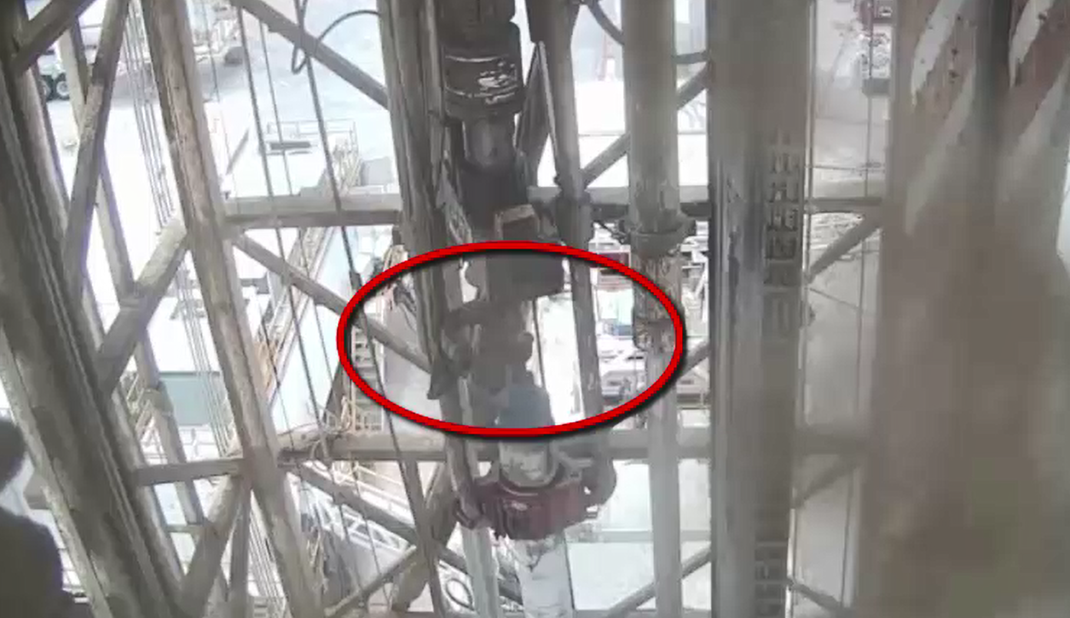
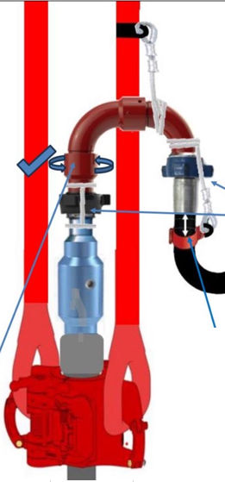
Learning From Incident - First Alert
Prevent
PIM # | 1168420 | Date & Time | 18.07.2024, 12:40 PM | Location | Lekhwair
Incident Type | LTI#10 | Category | DROPS | Activity | RIH 9” 5/8 casing and making up landing joint
Target Audience: Drilling & Operations
What happened:
On July 18th, at approximately 12:40 pm, the operation involved Running in Hole (RIH) a 9 5/8" casing along with the landing joint in preparation for a cementing job. To facilitate smooth landing at the desired depth and to enable circulation, the team decided to set up a circulating head along with the swivel. The swivel assembly stopped against the Top Drive bails, while the hammer union connection continued rotating. Unexpectedly, the swivel assembly disengaged from the hammer union connection dropping approximately 11 meters, striking the power tong body and the Floorman on the right forearm.
The Floorman received immediate medical attention from the Rig Medic X-ray revealed fracture of forearm close to the wrist area.
Initial Findings:
Swivel was not secured with secondary retention while making up the landing joint
The watch man on the MEWP to check on the swivel functionality left before completing the task.
SOP for RIH 9-5/8 casing did not cover the Rig up steps of the circulating head.
Engagement Questions:
How do you re-evaluate the setup process for circulating assembly methods for 9-5/8 casing in safe manner ?
How do you ensure Procedures are reviewed and Lessons are captured and translated in the SOP and Risk Assessments?
How do you continuously assess all potential dynamic line of fire hazards while working?
How do you ensure Mustae’ed is implemented in effective manner ?
How do you ensure that potential drop hazards are identified and secondary retention are installed ?
Always be aware of potential dropped objects and ensure secondary retention in place
In case of an emergency please call PDO Emergency Number (Toll Free): 2467-5555
Notes:
Mr Musleh image on the top right will change according to incident pattern, MSE3 will provide you with the image as per the pattern
What happened: A short description should be provided without mentioning names of contractors or individuals. You should include, what happened, to who (by job title) and what injuries this resulted in. Nothing more!
Initial Finding: Four to five bullet points highlighting the initial main findings from the investigation. Remember the target audience is the front-line staff so this should be written in simple terms in a way that everyone can understand.
Learnings: Four to five learning message in the form of questionnaires linked with initial findings
The strap line should be the main learning point you want to get across
The images should be self explanatory, what went wrong (if you create a reconstruction please ensure you do not put people at risk) and below how it should be done.

