Slide 1
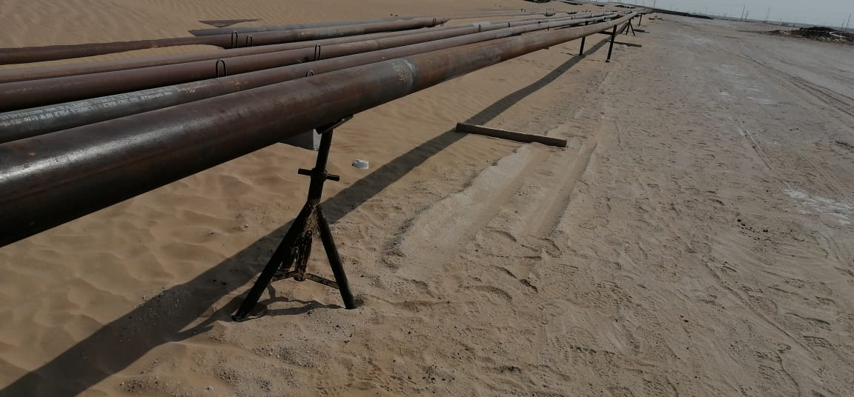
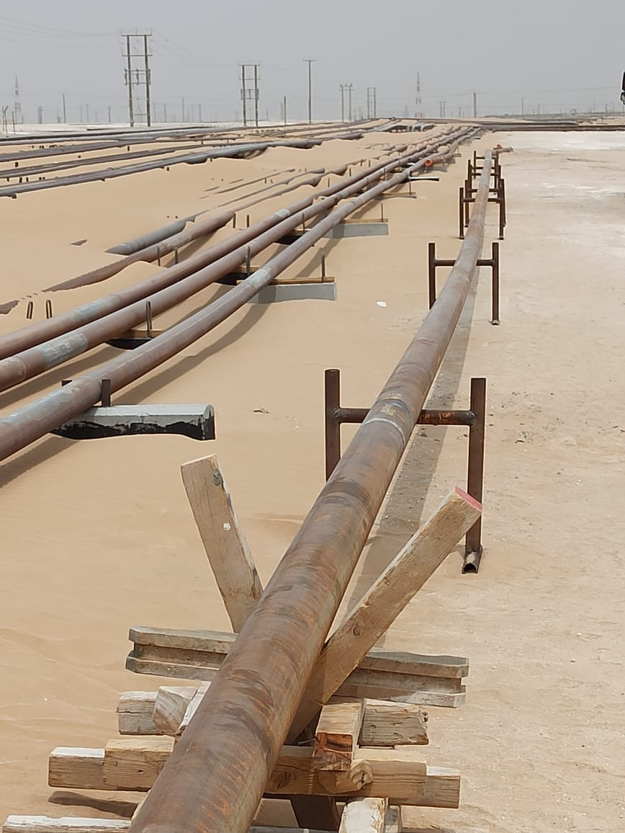
PDO Second Alert
Date: 09/04/2022 Incident title: LTI#10 Pattern: Released Energy Potential severity: C3P
Target Audience: Drilling, Logistics, Operation & Construction
What happened?
While the pipe grinder was involved in grinding activity, a pipe rolled off from the supporting frame and hit the
Grinder right shinbone causing a fracture.
Why it happened/Finding :
Tripod used as pipe support fell off due to improper use.
Control measures in method statement was inadequate for a known Hazard.
Supervision failed to timely intervene and analyze the potential Hazard..
Your learning from this incident..
Always use the correct tools which fit the purpose.
Always update the method statements with relevant learnings
Always ensure correct support while performing Flow line activity.
Never utilize Tripods as load bearing tools.
Ensure Supervisors and PHs utilize potential failure scenarios for two way discussion in TBTs .
Tripods are not for load bearing tools
Notes:
Ensure all dates and titles are input
A short description should be provided without mentioning names of contractors or individuals. You should include, what happened, to who (by job title) and what injuries this resulted in. Nothing more!
Four to five bullet points highlighting the main findings from the investigation. Remember the target audience is the front line staff so this should be written in simple terms in a way that everyone can understand.
The strap line should be the main point you want to get across
The images should be self explanatory, what went wrong (if you create a reconstruction please ensure you do not put people at risk) and below how it should be done.

Slide 2
Management self audit
Date: 09/04/2022 Incident title: LTI#10 Pattern: Released Energy Potential severity: C3P
As a learning from this incident and ensure continual improvement all contract managers must review their HSE risk
management against the questions asked below
Confirm the following:
Do you ensure that supervisors communicate the potential hazards to workforce?
Do you ensure that workers understand their Safety responsibilities while performing task?
Do you ensure that the supervisors carryout Hazard hunt sessions at worksites?
Do you ensure that the skilled workers are able to carryout their responsibilities?
Do you ensure that permit holders refer LFIs and discuss during the Tric sessions?
* If the answer is NO to any of the above questions please ensure you take action to correct this finding
Notes:
Ensure all dates and titles are input
Make a list of closed questions (only ‘yes’ or ‘no’ as an answer) to ask others if they have the same issues based on the management or HSE-MS failings or shortfalls identified in the investigation.
Imagine you have to audit other companies to see if they could have the same issues.
These questions should start with: Do you ensure…………………?

