Slide 1
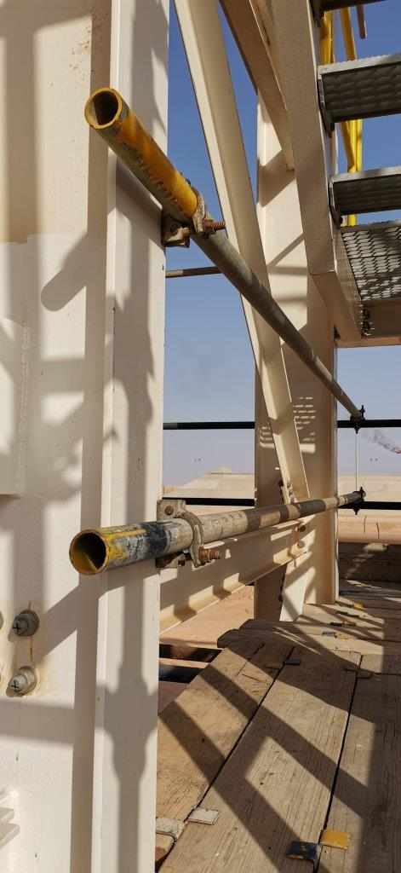
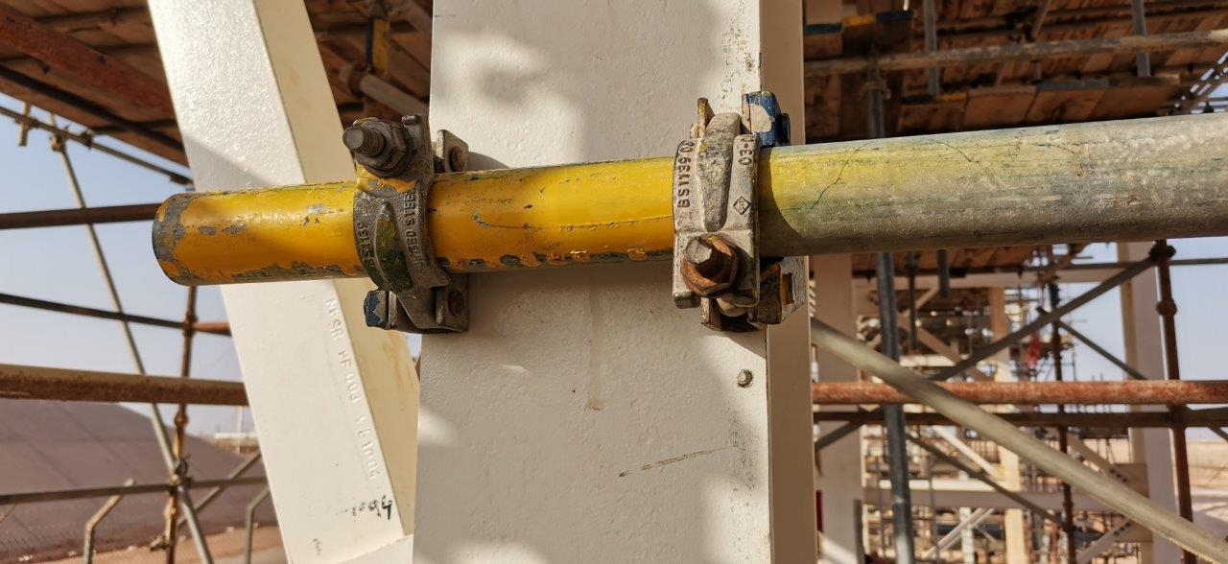
PDO Second Alert
Date: 17.05.2021 Incident title: LTI#10 ( Drops)
What happened?
Two scaffolders were engaged in modifying a scaffolding platform attached to a pipe rack structural stairway area. The scaffolder-1 removed the middle rail pipe and was removing the beam clamp of the mid rail. While removing the mid rail beam clamp, top rail beam clamp with tube slipped from its position through the vertical beam causing the scaffolder-1’s left ring finger tip crushed between the clamps.
Your learning from this incident..
Always ensure that beam clamps on scaffolding are used/installed in pairs
Always ensure that standard scaffolding erection and dismantling procedures are followed
Always ensure your hands and fingers are away from line of fire.
Identify all possible hazards and dropping objects before starting a task
Always ensure hazards & controls pertaining to the task is discussed in TBT.
Always ensure communication and coordination while working in a team
Always intervene to stop unsafe acts/condition.
Always use scaffold beam clamps in pair
Notes:
Ensure all dates and titles are input
A short description should be provided without mentioning names of contractors or individuals. You should include, what happened, to who (by job title) and what injuries this resulted in. Nothing more!
Four to five bullet points highlighting the main findings from the investigation. Remember the target audience is the front line staff so this should be written in simple terms in a way that everyone can understand.
The strap line should be the main point you want to get across
The images should be self explanatory, what went wrong (if you create a reconstruction please ensure you do not put people at risk) and below how it should be done.

Slide 2
Management self audit
Date: 17.05.2021 Incident title: LTI#10
As a learning from this incident and ensure continual improvement all contract
managers must review their HSE HEMP against the questions asked below
Confirm the following:
Do you ensure your scaffolding inspection checklist have updated with all the requirements of PDO SP 1257 standard?
Do you ensure your scaffolders follow standard procedures for dismantling and modifying of scaffolds?
Does your HEMP for scaffolding erection, modification and dismantling address the hazard of beam clamps?
Do you ensure that your employees always intervene unsafe acts/conditions?
Do you ensure that your employees are aware of the dangers of pinch points?
Do you ensure regular inspection process that the risk normalization behavior are identified and corrected?
* If the answer is NO to any of the above questions please ensure you take action to correct this finding.
Notes:
Ensure all dates and titles are input
Make a list of closed questions (only ‘yes’ or ‘no’ as an answer) to ask others if they have the same issues based on the management or HSE-MS failings or shortfalls identified in the investigation.
Imagine you have to audit other companies to see if they could have the same issues.
These questions should start with: Do you ensure…………………?

