Slide 1
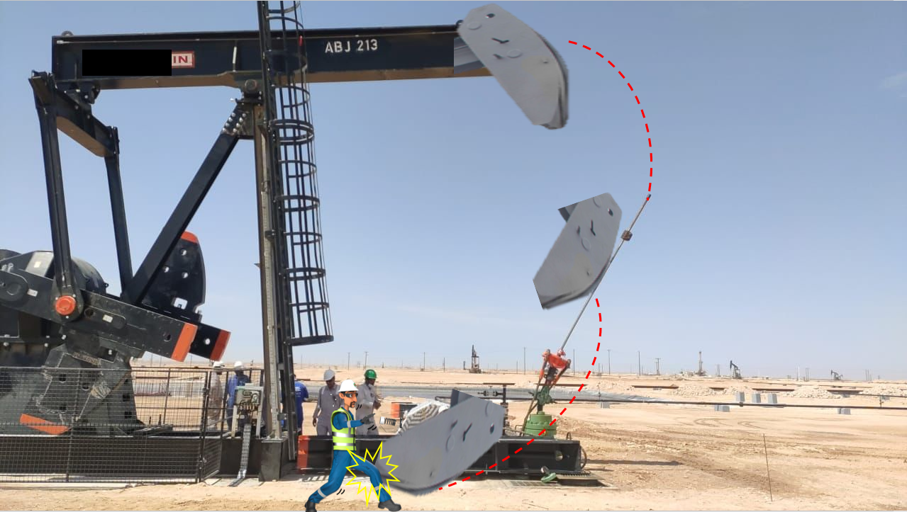
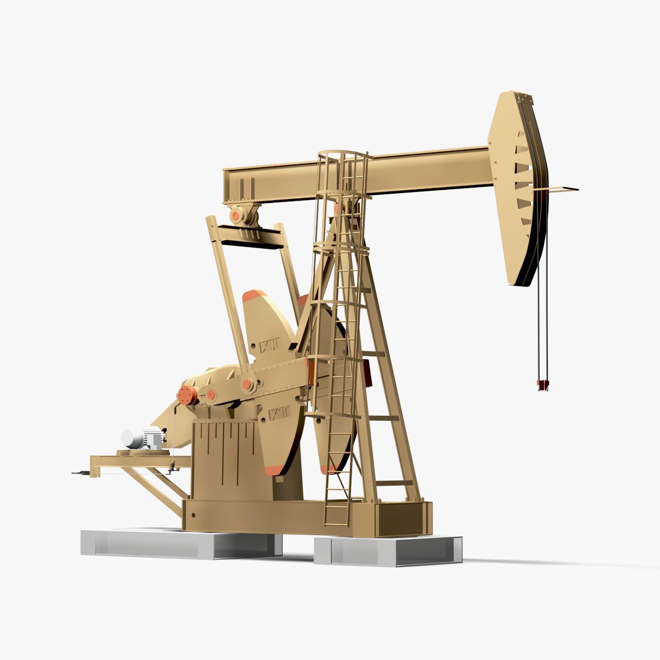
Learning From Incident - First Alert
PIM # | 1155012 | Date | 04.06.2023 | Direct / Depart
Incident Type | LTI#10 | Time | 09:50 hrs | Location | Nimr
Pattern | Released Energy | Contractor |  | Activity | Commissioning of new beam pump
Prevent
Target Audience: All
What happened
While one of the crew released the hand brake to align the polish rod for the load cell installation, the horse head disassembled and fell striking the polish rod and bounced back hitting the Technicians’ leg resulting in a fracture to his left thigh.
Initial Findings
Failure in connection of the horse head latch pin on the walking beam.
No means available to ensure that the latch securing pin is seated in position.
Learnings
How do you ensure that you are outside line of fire?
How do you ensure that all crew are aware of the relevant SOP to be followed?
How do you confirm the bolts/pins are in position prior starting the task?
Always ensure critical checks are performed
In case of an emergency please call PDO Emergency Number (Toll Free): 2467-5555
Notes:
Mr Musleh image on the top right will change according to incident pattern, MSE3 will provide you with the image as per the pattern
What happened: A short description should be provided without mentioning names of contractors or individuals. You should include, what happened, to who (by job title) and what injuries this resulted in. Nothing more!
Initial Finding: Four to five bullet points highlighting the initial main findings from the investigation. Remember the target audience is the front-line staff so this should be written in simple terms in a way that everyone can understand.
Learnings: Four to five learning message in the form of questionnaires linked with initial findings
The strap line should be the main learning point you want to get across
The images should be self explanatory, what went wrong (if you create a reconstruction please ensure you do not put people at risk) and below how it should be done.

