Slide 1
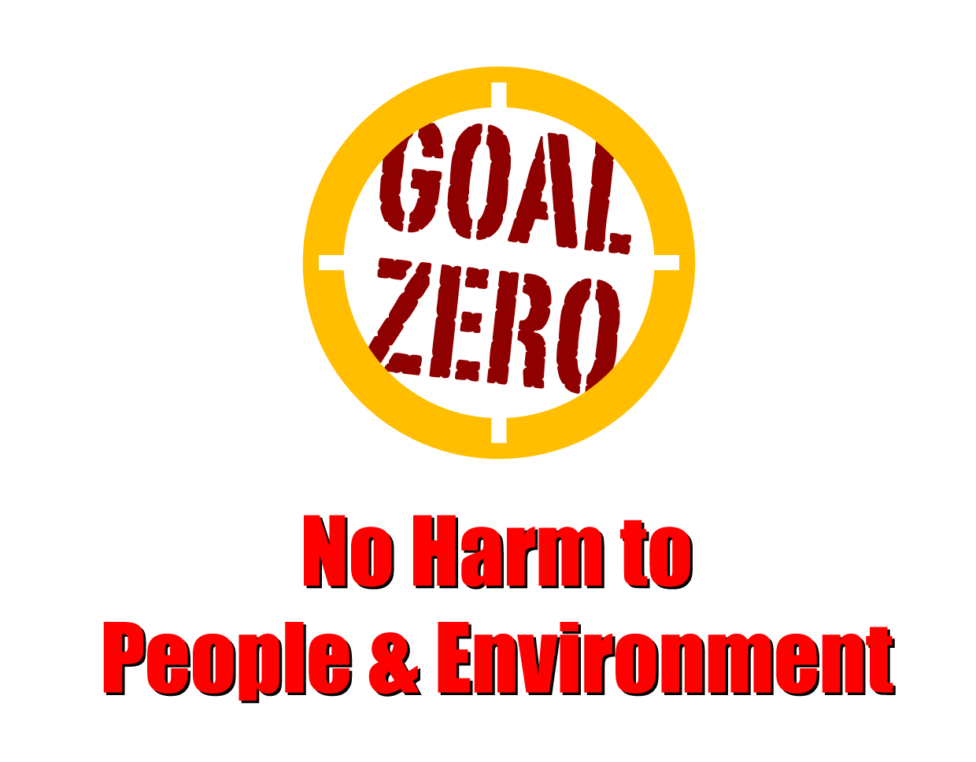
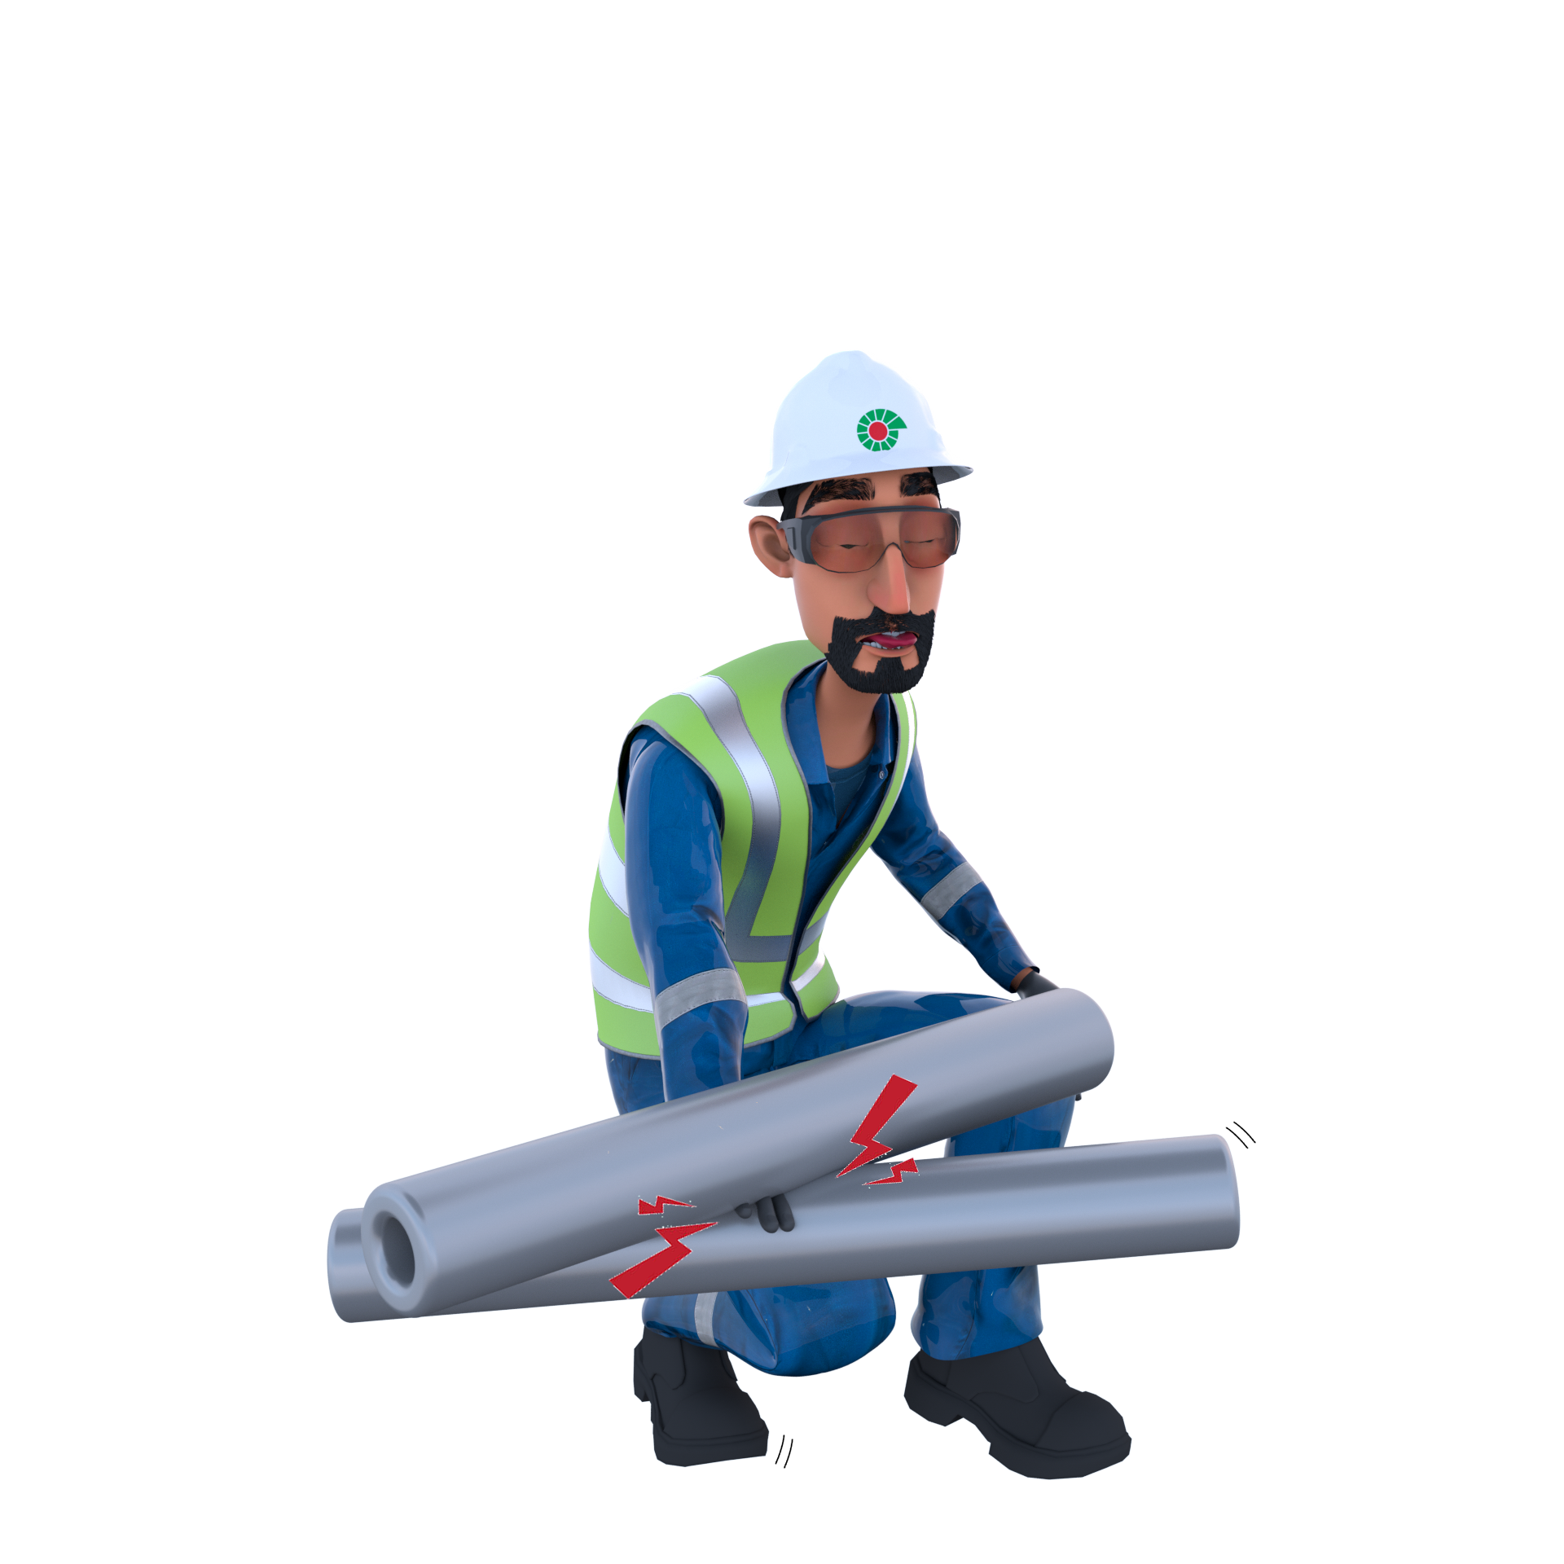
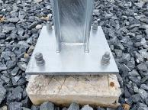
Learning From Incident - First Alert
Prevent
PIM # | 1169216 | Date & Time | 10.08.2024, 18:20 PM | Location | Lekhwair
Incident Type | LTI#11 | Category | Hands & Fingers (crush fingers) | Activity | Erection of new vent stack
Target Audience: All
What happened:
On 10.08.2024 at 18.20 during the erection of vent stack, a mechanical crew were trying to align the structure with the base plate's bolts. A Mechanical Fitter was holding a wooden piece underneath the base plate to align with one of the bolts while another crew member was hammering the wooden piece align the bolt with the hole. Unfortunately, the Mechanical Fitter placed his fingers in the line of fire under the wooden piece, which he was holding in position, resulting in a finger crush injury on the right-hand ring and little finger when the vent stack was seated.
Initial Findings:
The worker was heavily focused on completing the task, not realizing his hand was in the line of fire.
The correct method for re-aligning the bolts and base plate holes was not followed.
Lack of the intervention by the crew.
Engagement Questions:
Do you look for possible pinch points before you start a task?
Do you plan your actions and determine the necessary steps to work safely and avoid the line of fire?
What measures do you take to ensure you are not distracted at work – many accidents occur you are not giving your full attention to the task?
Do you engage in any work task when you place hands or fingers where you cannot see them. What precautions do you take to avoid this?
Be aware of your hand positions and ALWAYS avoid the line of fire!
In case of an emergency please call PDO Emergency Number (Toll Free): 2467-5555
Notes:
Mr Musleh image on the top right will change according to incident pattern, MSE3 will provide you with the image as per the pattern
What happened: A short description should be provided without mentioning names of contractors or individuals. You should include, what happened, to who (by job title) and what injuries this resulted in. Nothing more!
Initial Finding: Four to five bullet points highlighting the initial main findings from the investigation. Remember the target audience is the front-line staff so this should be written in simple terms in a way that everyone can understand.
Learnings: Four to five learning message in the form of questionnaires linked with initial findings
The strap line should be the main learning point you want to get across
The images should be self explanatory, what went wrong (if you create a reconstruction please ensure you do not put people at risk) and below how it should be done.

