Slide 1
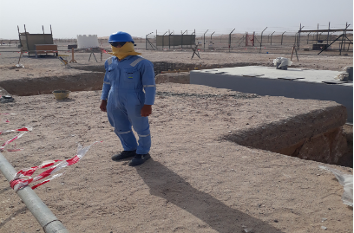
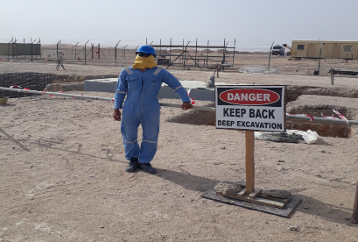
PDO Second Alert
Date:09-03-2022 Incident title: LTI#11 Pattern: Slip & fall Potential severity: B3P
Target Audience: Drilling, Logistics, Operation & Construction
What happened?
On April 9th, 2022, at 10:35 Hrs, a Carpenter (AIP Sub-contractor – Al Fouj) deployed to spread polyethylene sheet on ground (to offload the pre-cast foundation) closer to a foundation pit, stepped backward toward the pit while placing the sheet and fell into the pit (1.5m deep) over a rebar (steel rod with mushroom rebar cap), resulting in injury on his left buttock near the coccyx area.
Why it happened/Finding :
The supervisor made the decision to unload the precast foundation inside the barricaded area.
Inadequate attention to the hazards posed by the surroundings while working close to open pit.
PTW Holder / crew members did not intervene/observe the carpenter's risky movement.
Your learning from this incident
Always keep safe distance from edge of excavations
Always be cautious of your surroundings and the hazards involved
Always be mindful and observant of the warning signs and barricades in the area
Always ensure barricades are close to the excavation (1m) without any extra space for other activities.
Always cut the rebar used as form work support to required length avoiding excess projection.
Keep away from the edge of excavations
Notes:
Ensure all dates and titles are input
A short description should be provided without mentioning names of contractors or individuals. You should include, what happened, to who (by job title) and what injuries this resulted in. Nothing more!
Four to five bullet points highlighting the main findings from the investigation. Remember the target audience is the front line staff so this should be written in simple terms in a way that everyone can understand.
The strap line should be the main point you want to get across
The images should be self explanatory, what went wrong (if you create a reconstruction please ensure you do not put people at risk) and below how it should be done.

Slide 2
Management self audit
Date:09-03-2022 Incident title: LTI#11 Pattern: Slip & fall Potential severity: B3P
As a learning from this incident and ensure continual improvement all contract managers must review their HSE risk management against the questions asked below
Confirm the following:
Do you ensure that the excavations are properly barricaded, and sign posted?
Do you ensure that your workers stay away from edge of excavations?
Do you ensure that the hazards involved have been effectively assessed and captured in the TBT discussion prior to deploying the crew for the task?
Do you ensure that your workers are well aware of the emergency protocol?
Do you ensure that the workers are aware of their authority to stop unsafe work practices?
* If the answer is NO to any of the above questions please ensure you take action to correct this finding
Notes:
Ensure all dates and titles are input
Make a list of closed questions (only ‘yes’ or ‘no’ as an answer) to ask others if they have the same issues based on the management or HSE-MS failings or shortfalls identified in the investigation.
Imagine you have to audit other companies to see if they could have the same issues.
These questions should start with: Do you ensure…………………?

