Slide 1
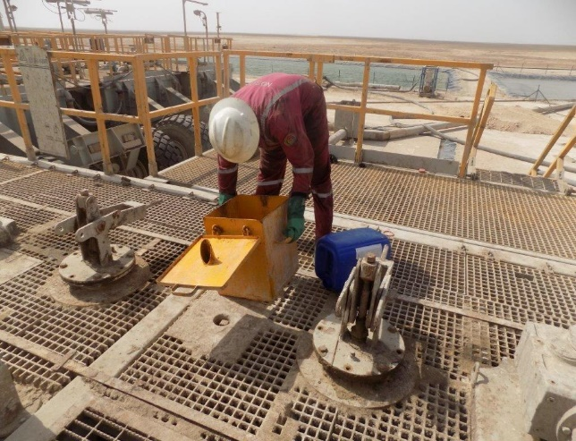
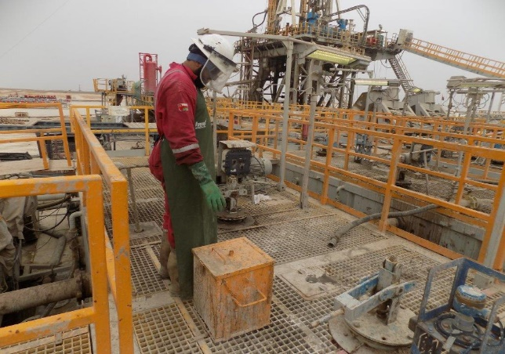
PDO Second Alert
Date: 01.03.2021 Incident type: LTI#11 ( chemical burn)
What happened?
On 27th May 2021 at around 9:00am, the Operation was circulating hole through 4-1/2” tubing at bottom prior to cementation. Mud engineer instructed mud tester to mix the caustic soda and Biocide on intermediate tank no.2 prior to backloading the mud to the mud plant. While the mud tester was attempting to mix the biocide with pre-existing caustic soda into the caustic soda device, the reaction between the two chemicals resulted in splashing the fluid on his face and body causing multiple burn injuries. First aid was administrated by Rig medic and then referred to Nizwa Hospital by PDO doctor for further medical examination
Your learning from this incident..
Always ensure to conduct effective TBT to identify all hazards/controls before starting the task
Always ensure to raise PTW for hazardous mixing chemical activity.
Always ensure to follow the correct mixing procedure for the task.
Always ensure to use the correct PPE for handling chemical.
Always ensure to mix Caustic soda well in the tank with agitators before adding Biocide or any other chemicals.
Mixing Biocide closely to the caustic Soda
Never Mix Caustic Soda With Other Chemical
Ensure to mix chemical safely.
Notes:
Ensure all dates and titles are input
A short description should be provided without mentioning names of contractors or individuals. You should include, what happened, to who (by job title) and what injuries this resulted in. Nothing more!
Four to five bullet points highlighting the main findings from the investigation. Remember the target audience is the front line staff so this should be written in simple terms in a way that everyone can understand.
The strap line should be the main point you want to get across
The images should be self explanatory, what went wrong (if you create a reconstruction please ensure you do not put people at risk) and below how it should be done.

Slide 2
Management self audit
Date: 01.03.2021 Incident type: LTI#11
As a learning from this incident and ensure continual improvement all contract
managers must review their HSE HEMP against the questions asked below
Confirm the following:
Do you ensure effective TBT is conducted?
Do you ensure effective PTW system is in place?
Do you ensure your crew identify all hazards before starting the task?
Do you ensure your crew follow the correct procedure for the task?
Do you ensure you place your body away from line of fire?
Do you ensure your crew at site are using the correct PPE for handling chemicals?
* If the answer is NO to any of the above questions, please ensure you take action to correct this finding.
Notes:
Ensure all dates and titles are input
Make a list of closed questions (only ‘yes’ or ‘no’ as an answer) to ask others if they have the same issues based on the management or HSE-MS failings or shortfalls identified in the investigation.
Imagine you have to audit other companies to see if they could have the same issues.
These questions should start with: Do you ensure…………………?

