Slide 1
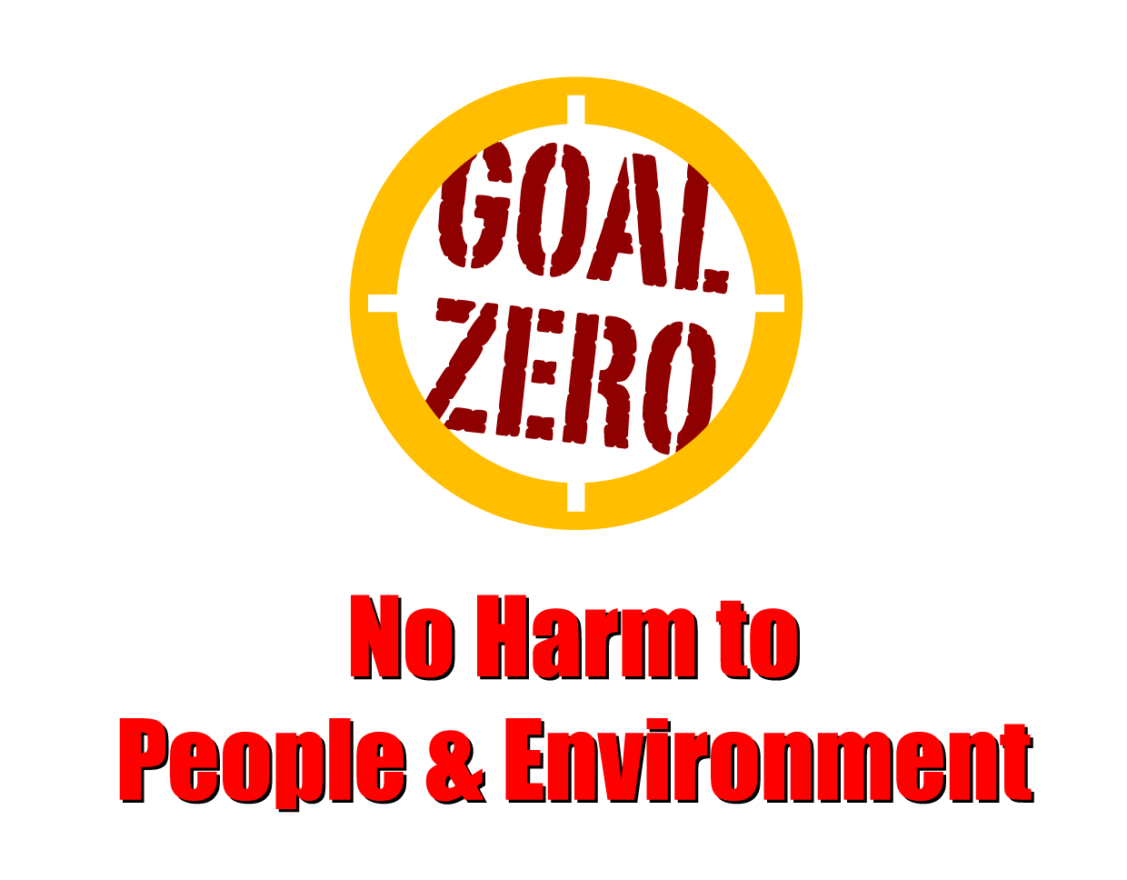
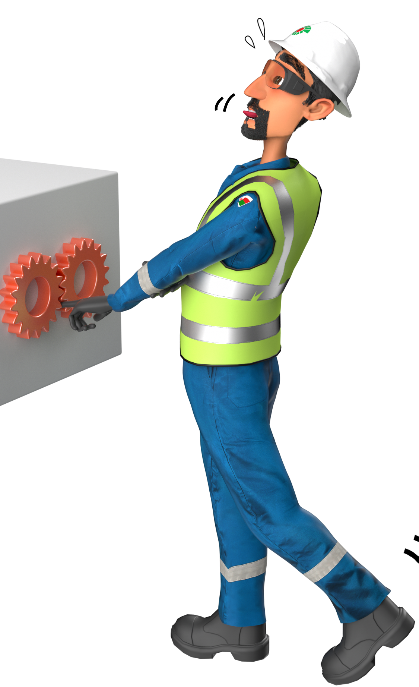
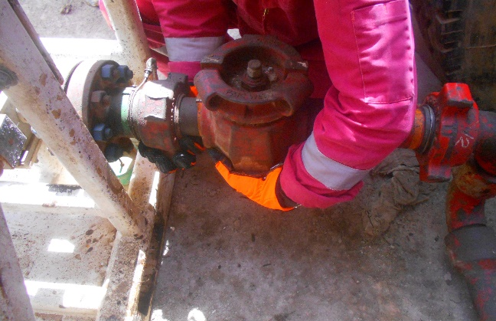
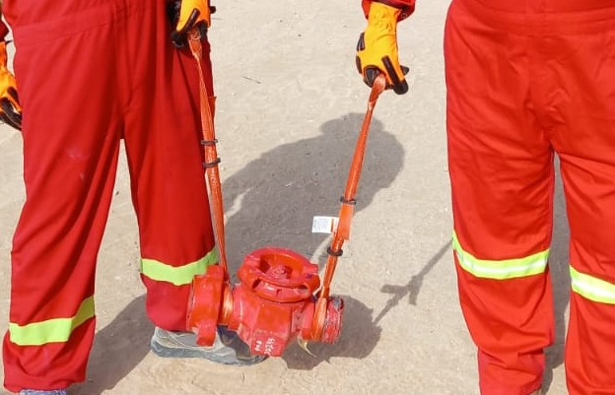
Learning From Incident - First Alert
PIM # | 1155190 | Date | 09.06.2023 | Direct / Depart
Incident Type | LTI#11 | Time | 19:15 hrs | Location | Lekhwair
Pattern | Hands & Fingers | Contractor |  | Activity | Fixing low torque valve
Prevent
Target Audience: All
What happened
During installation of a torque valve and while the Roustabout was attempting to maintain the position of the low torque valve, at approximately 30cm from the ground, it suddenly disconnected and dropped trapping the Roustabout’s right-hand finger between the torque valve and the ground and resulting in crush injury to his right-hand ring finger.
Initial Findings
Failure to identify the hazard related to disconnection of the low torque valve from its position.
Failure to remove hands from line of fire.
Failure to ensure all tools required are available prior starting the task.
1ft height from ground
Learnings
Do you ensure proper planning before starting the task?
Do you ensure to follow the correct manual handling practices during the task?
Do you ensure to conduct a dynamic risk assessment of potential hazards when conditions change?
How do you ensure active intervention during unsafe acts?
Be aware from LOF situations and always know your hand position
In case of an emergency please call PDO Emergency Number (Toll Free): 2467-5555
Notes:
Mr Musleh image on the top right will change according to incident pattern, MSE3 will provide you with the image as per the pattern
What happened: A short description should be provided without mentioning names of contractors or individuals. You should include, what happened, to who (by job title) and what injuries this resulted in. Nothing more!
Initial Finding: Four to five bullet points highlighting the initial main findings from the investigation. Remember the target audience is the front-line staff so this should be written in simple terms in a way that everyone can understand.
Learnings: Four to five learning message in the form of questionnaires linked with initial findings
The strap line should be the main learning point you want to get across
The images should be self explanatory, what went wrong (if you create a reconstruction please ensure you do not put people at risk) and below how it should be done.

