Slide 1
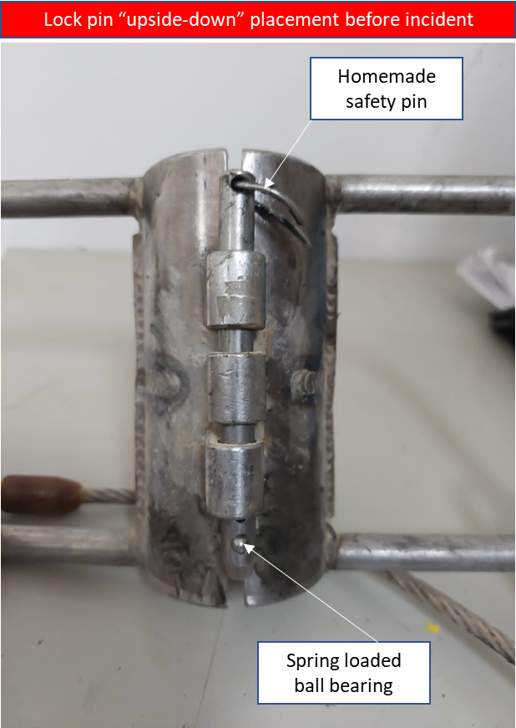
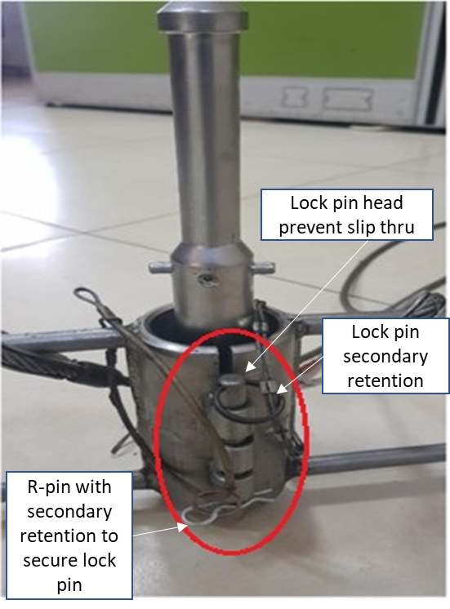
PDO Second Alert
Date:21/04/2022 Incident title: LTI#12 & LTI#13 Pattern drops Potential severity: B4P
Target Audience: MWD Engineers, Directional Drillers, Rig Crew
Lock pin placement “upside down” before incident
What happened?
On the 21st of April at approximately 17:22 Hrs. during preparation of 12 ¼” Bottom Hole Assembly (BHA), the Measurement While Drilling (MWD) string, consisted of a pulser; a directional drilling module and two set of lithium batteries, dropped inside the Non-Magnetic Drill Collar (NMDC) which was sitting on the slips inside the well.
Due to the dropped impact, lithium battery #1 blasted resulting in two MWD Engineers sustained second degree burns and superficial wounds on their right hands.
Why it happened/Finding:
Non OEM recommended safety pin was used and fell, causing the lock pin slipped out off the pin holes which was installed wrongly i.e. upside down. Later attempt to re-install lock pin failed as the pin holes were not aligned
When a new hazard have been identified during operation the MWD Engineer Supervisor, Directional Driller and Rig Driller failed to conduct dynamic risk assessment before making the decision to continue with the operation
MWD Kit#14 was not inspected on rig site to confirm inventory availability as per checklist enclosed to identify missing OEM safety pin
Original Equipment Manufacturer (OEM) lock pin was not ‘failed proof’ design i.e. it can be inserted into the pin holes from top and bottom.
The risk of MWD string falling off the lifting clamp was recognised therefore non-essential personnel were cleared off the rig floor.
Your learning from this incident:
Supervisors to ensure equipment is inspected before use and any missing equipment reported
MWD Engineers always assure correct safety pin installed in MWD lifting clamp
MWD Engineers always ensure lithium battery hazards are part of JSA and discussed before handling
All employees to intervene and exercise STOP work authority
Supervisors ensure MOC applied when new risk introduced or change in the work process
Product line Management always assure operating manual is up-to-date and followed
Supervisors always assure emergency response plan, emergency kit are available before handling hazardous materials
Correct method of installing the lock pin
Always ensure correct safety pin installed!
Always make sure to load/unload MWD tool on the ground!
Notes:
Ensure all dates and titles are input
A short description should be provided without mentioning names of contractors or individuals. You should include, what happened, to who (by job title) and what injuries this resulted in. Nothing more!
Four to five bullet points highlighting the main findings from the investigation. Remember the target audience is the front line staff so this should be written in simple terms in a way that everyone can understand.
The strap line should be the main point you want to get across
The images should be self explanatory, what went wrong (if you create a reconstruction please ensure you do not put people at risk) and below how it should be done.

Slide 2
Management self audit
Date:21/04/2022 Incident title: LTI#12 & LTI#13 Pattern drops Potential severity: B4P
As a learning from this incident and ensure continual improvement all contract managers must review their HSE risk management against the questions asked below
Confirm the following:
Do you ensure all equipment and tools received onsite are inspected?
Do you ensure that materials received from supplier/vendor as per the Material Request?
Do you ensure that all senior personnel understand the Management of Change process?
Do you ensure all team members aware about hazard of handling of lithium batteries?
Do you ensure you have ERP, contingency plan in place before start operations?
Do you ensure that the site team is empowered to intervene any unsafe behavior / act or Condition?
Do you ensure that Job Safety Analysis being periodically reviewed and revised as required?
Do you ensure loading and unloading of MWD tool is done on the ground?
* If the answer is NO to any of the above questions please ensure you take action to correct this finding
Notes:
Ensure all dates and titles are input
Make a list of closed questions (only ‘yes’ or ‘no’ as an answer) to ask others if they have the same issues based on the management or HSE-MS failings or shortfalls identified in the investigation.
Imagine you have to audit other companies to see if they could have the same issues.
These questions should start with: Do you ensure…………………?

