Slide 1
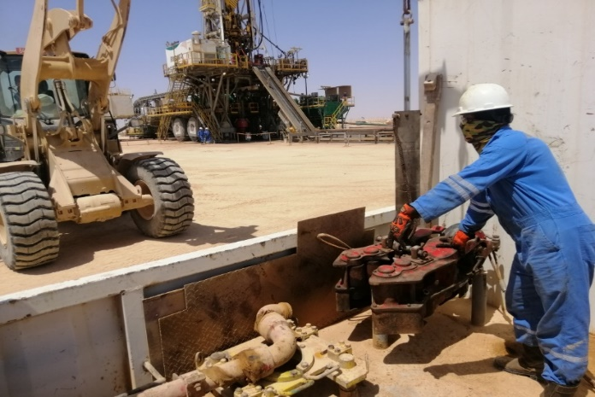
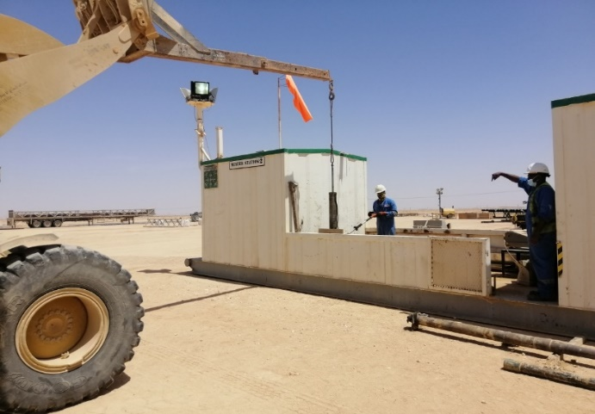
PDO Second Alert
Date: 29.05.2021 Incident Type: LTI#12 (Drop)
What happened?
On 29.05.2021 at 02:00 hrs, While the Mechanic was attempting to guide the pipe spinner to its storage position suspended from a forklift boom, the pipe spinner initially rested on the positioning pins and fell down from 20 cm height on his left foot. He was initially treated at Mobile Accommodation Camp-4 Clinic before being transferred to Khoula Hospital Where an x-ray revealed a fracture of his left foot.
Your learning from this incident..
Always have a banksman to give clear signals for all lifting jobs
Always use Hands off Tools
Always stay away from LOF
Always identifying stored energy that could be released while performing the job
Always use empowerment to stop unsafe act/unsafe condition
Have a Banksman and Use Hands off Tools for Lifting job
Notes:
Ensure all dates and titles are input
A short description should be provided without mentioning names of contractors or individuals. You should include, what happened, to who (by job title) and what injuries this resulted in. Nothing more!
Four to five bullet points highlighting the main findings from the investigation. Remember the target audience is the front line staff so this should be written in simple terms in a way that everyone can understand.
The strap line should be the main point you want to get across
The images should be self explanatory, what went wrong (if you create a reconstruction please ensure you do not put people at risk) and below how it should be done.

Slide 2
Management self audit
Date: 29.05.2021 Incident Type: LTI#12
As a learning from this incident and ensure continual improvement all contract
managers must review their HSE HEMP against the questions asked below
Confirm the following:
Do you ensure that your team comply to lifting procedure?
Do you ensure you have the right supervision in out of sight location?
Do you ensure your team has empowerment to STOP?
Do you ensure your team conducts TBTs effectively?
Do you ensure your team stops and assess the dynamic risk situations?
* If the answer is NO to any of the above questions please ensure you take action to correct this finding.
Notes:
Ensure all dates and titles are input
Make a list of closed questions (only ‘yes’ or ‘no’ as an answer) to ask others if they have the same issues based on the management or HSE-MS failings or shortfalls identified in the investigation.
Imagine you have to audit other companies to see if they could have the same issues.
These questions should start with: Do you ensure…………………?

