Slide 1
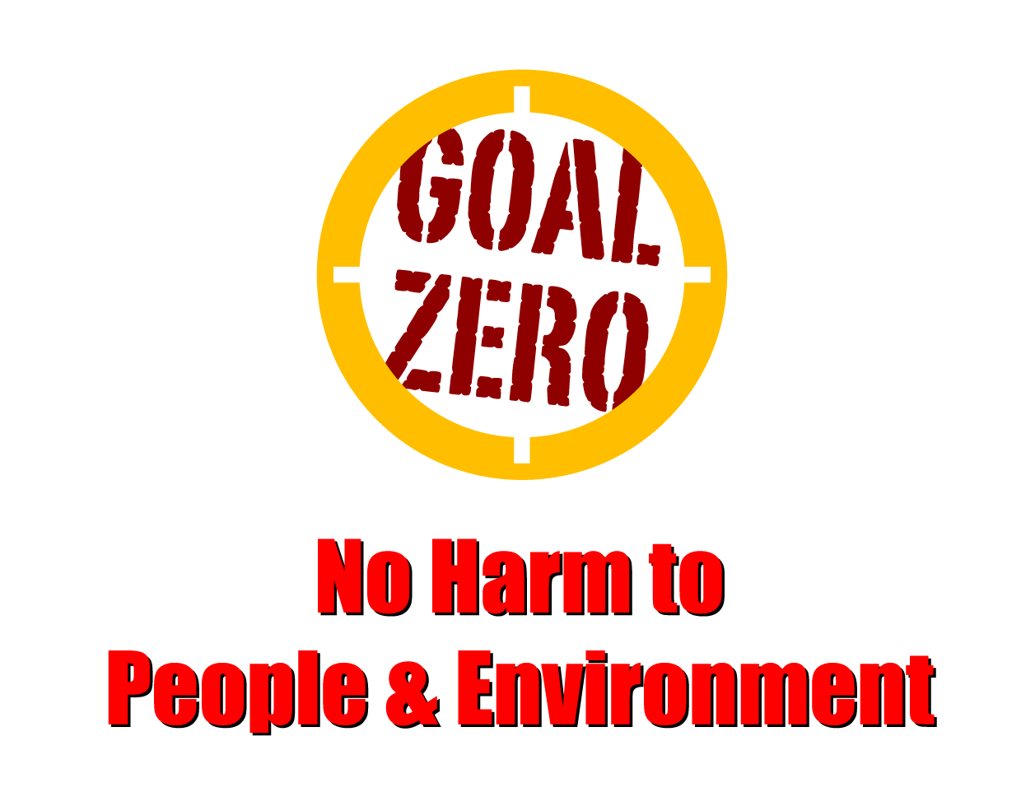
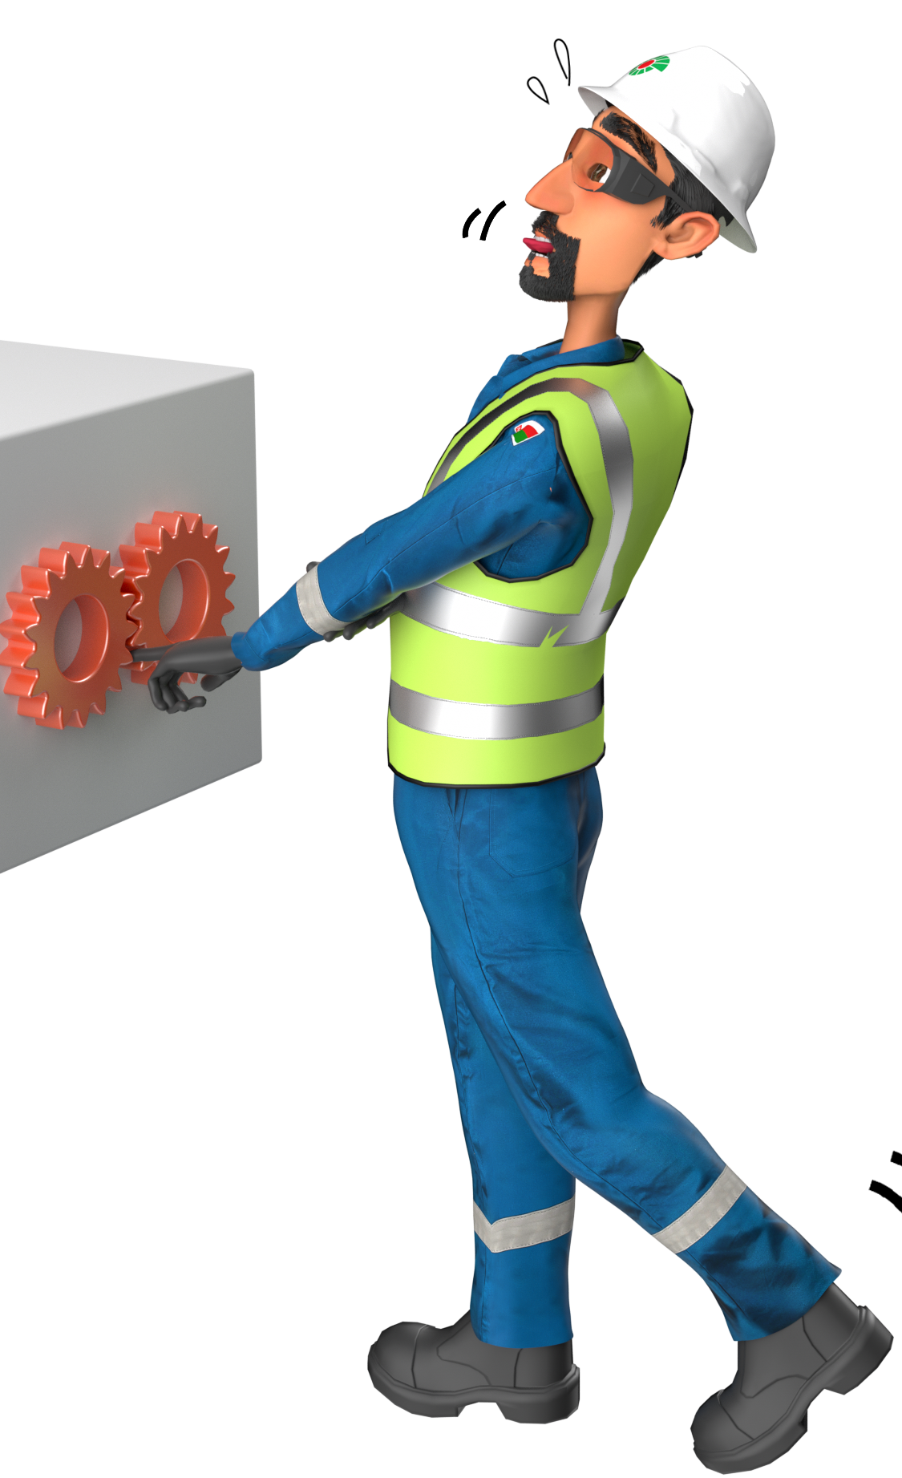
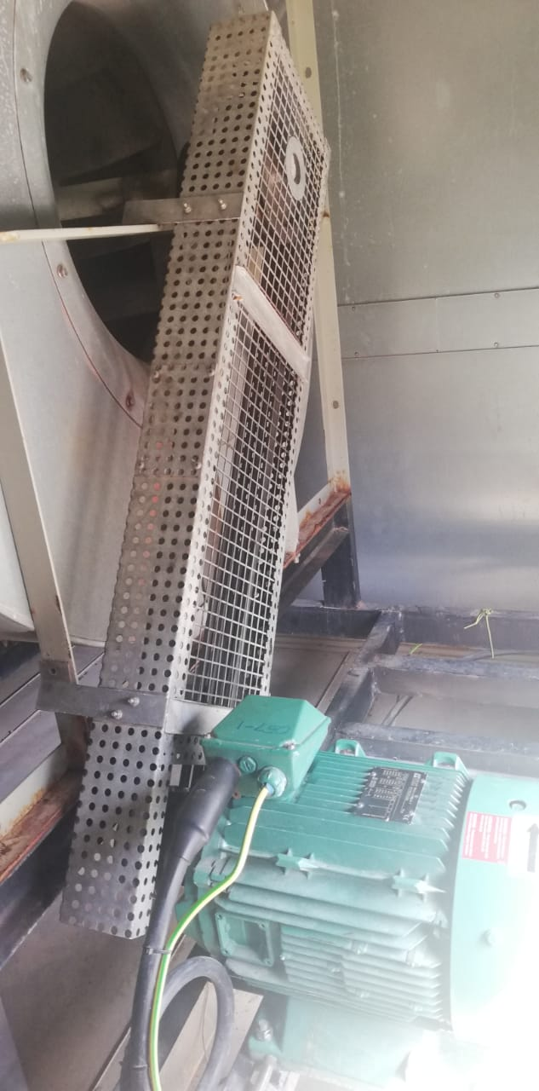
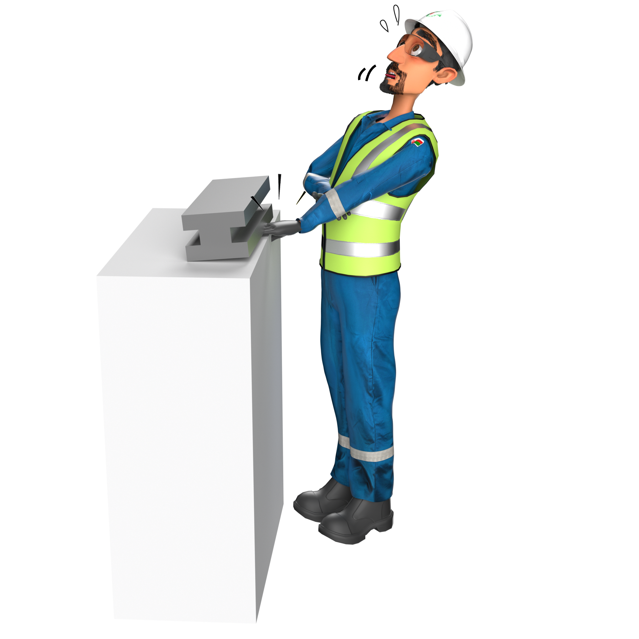
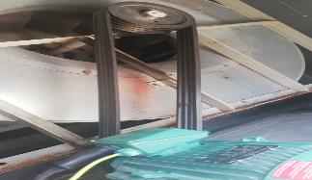
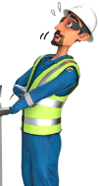
Learning From Incident - First Alert
PIM # | 1155613 | Date | 18.06.2023 | Direct / Depart
Incident Type | LTI#12 | Time | 14:45 hrs | Location | Qarn Alam
Pattern | Hands & Fingers | Contractor |  | Activity | HVAC maintenance
Prevent
Target Audience: All
What happened
During HVAC maintenance activity and while the Technician was replacing the V belt, the guard slipped and fell on his right-hand trapping his middle finger between the guard and the concrete surface, resulting in a fracture to his right-hand middle finger.
Guard intact
Initial Findings
Failure to identify the hazard related to the task.
The task was conducted at out of the sight location.
Steel Guard weighing approx. 2kg was not stored in a safe position during the task
Learnings
Do you identify hand & finger hazards before starting any task and discuss them during TBT?
How do you ensure following the correct procedure while doing the task?
Are the sequencies of doing the task clearly documents and discussed prior to the task?
Do you consider what can drop or suddenly move and trap your finger?
Guard Removed
Ensure proper planning & management of out of sight task
In case of an emergency please call PDO Emergency Number (Toll Free): 2467-5555
Notes:
Mr Musleh image on the top right will change according to incident pattern, MSE3 will provide you with the image as per the pattern
What happened: A short description should be provided without mentioning names of contractors or individuals. You should include, what happened, to who (by job title) and what injuries this resulted in. Nothing more!
Initial Finding: Four to five bullet points highlighting the initial main findings from the investigation. Remember the target audience is the front-line staff so this should be written in simple terms in a way that everyone can understand.
Learnings: Four to five learning message in the form of questionnaires linked with initial findings
The strap line should be the main learning point you want to get across
The images should be self explanatory, what went wrong (if you create a reconstruction please ensure you do not put people at risk) and below how it should be done.

