Slide 1

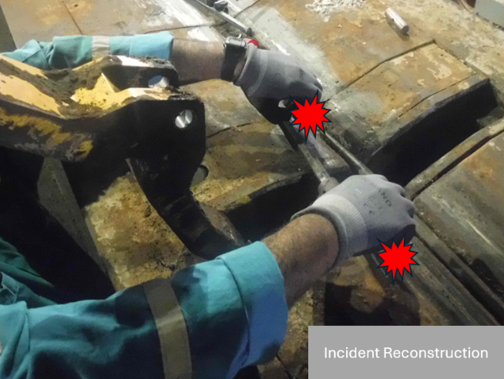
Learning From Incident - First Alert
Prevent
PIM # | 1180491 | Date & Time | 06.08.2025 / 21:55 | Location | Maurid West
Incident Type | LTI#12 | Category | Caught between | Activity | Pipe Catwalk Maintenance
Target Audience: All
What happened:
While performing corrective maintenance on the automatic pipe catwalk, the senior mechanic was holding a crowbar that was inserted into the kicker arm cylinder. The piston of the cylinder retracted unexpectedly while the crowbar was still attached, causing crush injuries to his left hand ring finger and right hand index finger.
Initial Findings:
The injured person grabbed the crowbar at the exact moment the kicker arm piston retracted, causing crush injuries.
Chief Mechanic unintentionally released the remote control buttons, triggering the piston’s downward movement.
Maintenance was performed on energized equipment without proper mechanical and electrical isolation.
The task was carried out without a valid SOP, and the OEM manual was not consulted.
Engagement Questions:
Do you fully understand the risks of energized equipment?
Do you ensure full compliance with the Work Permit and associated isolation requirements providing confidence the equipment is isolated before you begin work?
Do you know how to escalate the situation if SOPs or tools are missing?
Never perform maintenance on energized equipment.
Isolation and SOP compliance are non-negotiable
In case of an emergency please call PDO Emergency Number (Toll Free): 2467-5555
Notes:
Mr Musleh image on the top right will change according to incident pattern, MSE3 will provide you with the image as per the pattern
What happened: A short description should be provided without mentioning names of contractors or individuals. You should include, what happened, to who (by job title) and what injuries this resulted in. Nothing more!
Initial Finding: Four to five bullet points highlighting the initial main findings from the investigation. Remember the target audience is the front-line staff so this should be written in simple terms in a way that everyone can understand.
Learnings: Four to five learning message in the form of questionnaires linked with initial findings
The strap line should be the main learning point you want to get across
The images should be self explanatory, what went wrong (if you create a reconstruction please ensure you do not put people at risk) and below how it should be done.

