Slide 1
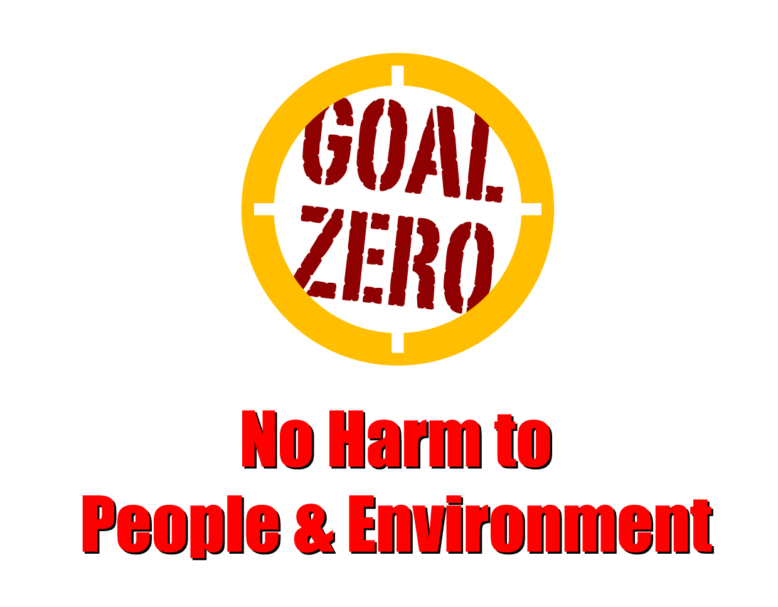
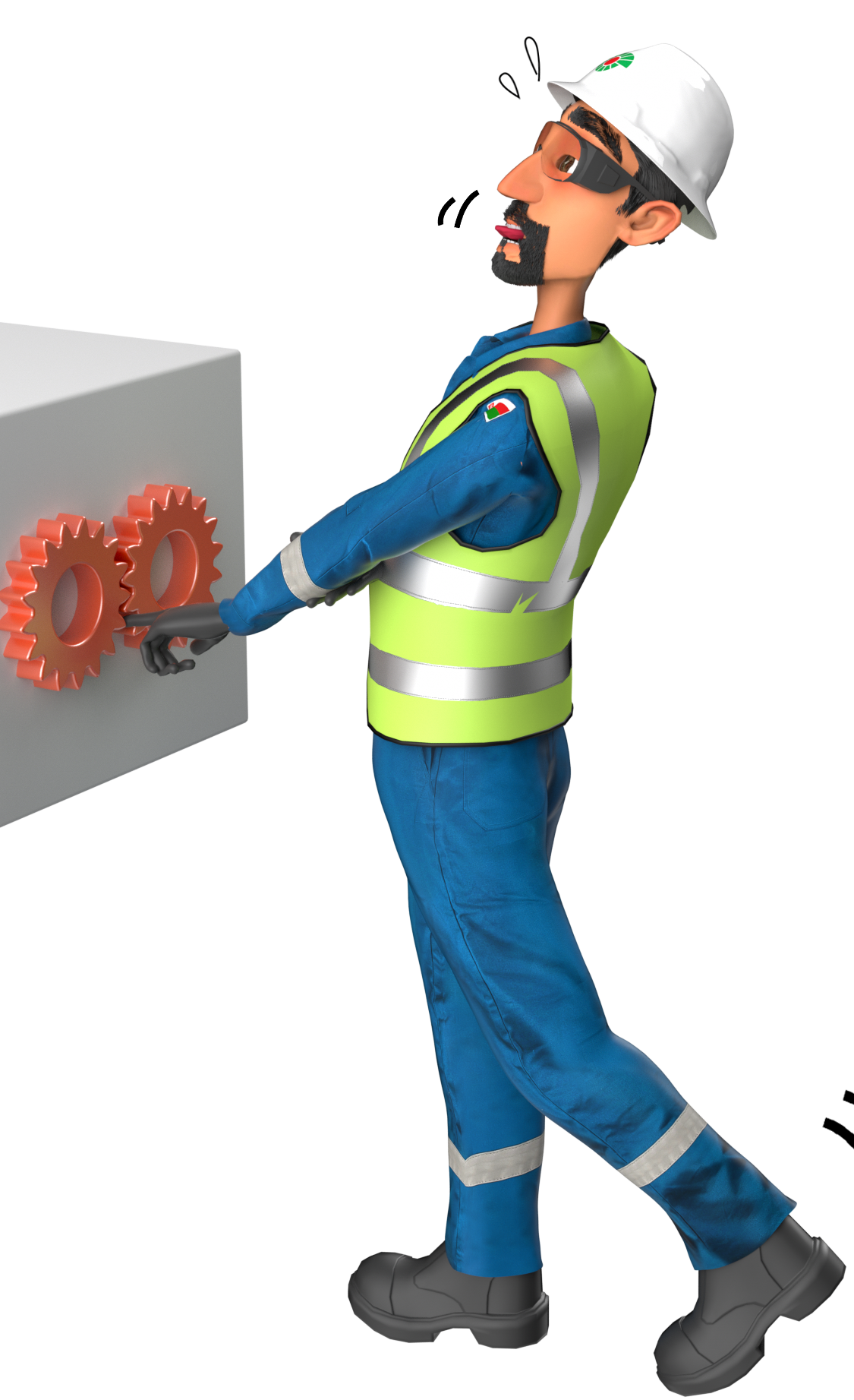
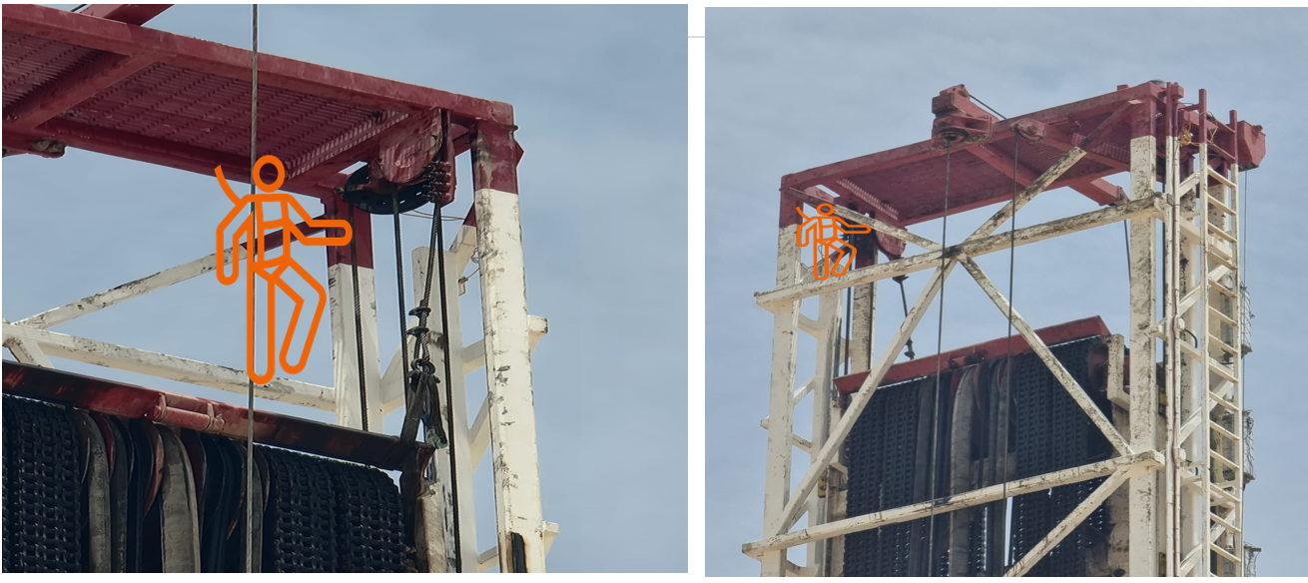
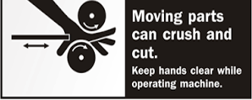
Learning From Incident - First Alert
Prevent
PIM # | 1156181 | Date | 01.07.2023 | Direct / Depart
Incident Type | LTI#13 | Time | 17:35 | Location | Marmul, Rig-148
Pattern | Hands & Fingers | Contractor |  | Activity | Maintenance (tightening the pull line)
Target Audience: All
What happened
While Assistant Driller was tightening up the pull-down lines on the floating crown, he gave the hand signal to the Floorman to convey to the driller (also by hand signal) to hoist up the top drive. At this time he lost his balance and accidently placed his right hand on the line while the driller was raising the Top Drive System (TDS). His index finger got caught between the sheave wheel and the pull-down line resulting in partial amputation of his right-hand index finger.
Initial Findings
Communication between the three team members depended on the use of hand signals, between the Assistant Driller (positioned on top of the mast) to the Floorman (on Rig Floor) and then from the Floorman to the Driller (in the Drillers Console)
The IP placed his hand on the sheave wheel (to correct his balance) just as the top drive hoisted upwards.
The IP was not wearing the supplied impact gloves at the time but was wearing his own non-approved gloves.
CCTV camera was not functioning at the time of the incident.
Emergency response rescue was not fully implemented.
Learnings
How do you ensure the TDS must never be operated when the person is in close proximity to the sheaves?
How do you ensure Personnel move to the platform first before giving any signal to hoist the TDS?
How do you ensure better communication methods are used, such as two Way Radios, thereby reducing reliance on hand signals between three people?
Keep your finger away from moving parts and machinery at all times
In case of an emergency please call PDO Emergency Number (Toll Free): 2467-5555
Notes:
Mr Musleh image on the top right will change according to incident pattern, MSE3 will provide you with the image as per the pattern
What happened: A short description should be provided without mentioning names of contractors or individuals. You should include, what happened, to who (by job title) and what injuries this resulted in. Nothing more!
Initial Finding: Four to five bullet points highlighting the initial main findings from the investigation. Remember the target audience is the front-line staff so this should be written in simple terms in a way that everyone can understand.
Learnings: Four to five learning message in the form of questionnaires linked with initial findings
The strap line should be the main learning point you want to get across
The images should be self explanatory, what went wrong (if you create a reconstruction please ensure you do not put people at risk) and below how it should be done.

