Slide 1
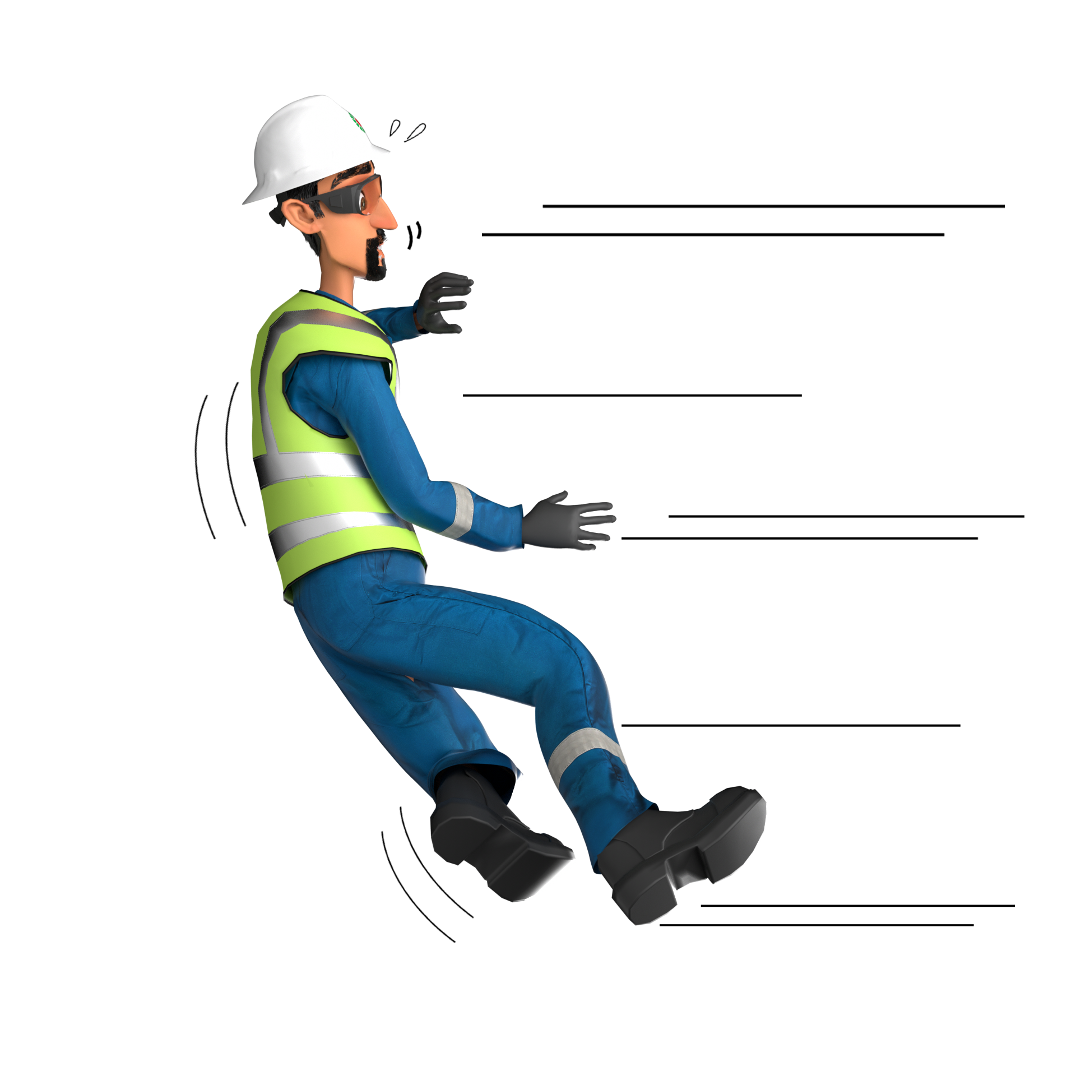
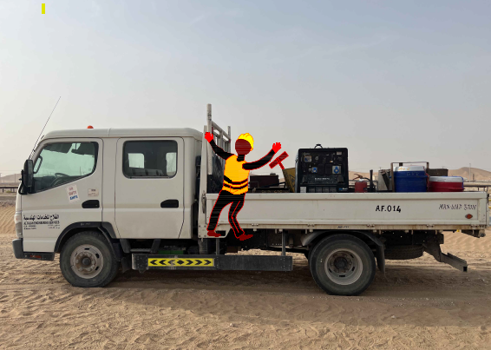
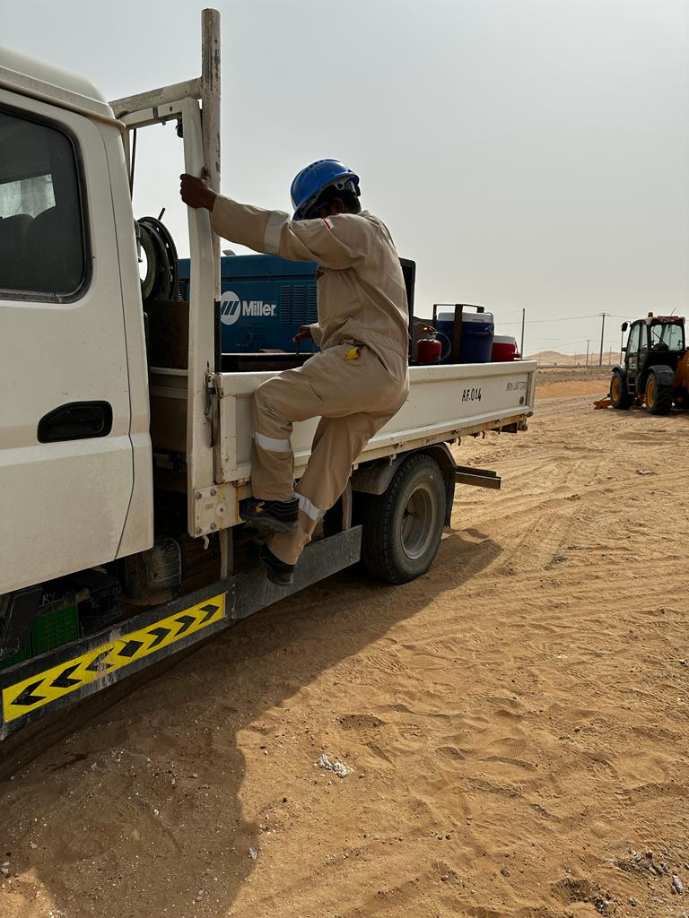
Learning From Incident - First Alert
Prevent
PIM # | 1156464 | Date | 08.07.2023 | Direct / Depart
Incident Type | LTI#14 | Time | 07:10 | Location | GRE Activity
Pattern | Slip, trip & fall | Contractor |  | Activity | GRE Activity
Target Audience: All
What happened
While the GRE Technician was climbing the canter carrier using footstep at the left side of the canter, he lost balance and fell backward with his left foot trapped inside the footstep of the canter carrier resulting left leg fractured.
Initial Findings
Three points of contact were not maintained.
The technician was wearing the right PPE.
Failure to identify the hazard related to the task.
Learnings
How do you ensue to use the correct means of access/egress while climbing the truck?
How do you ensue access/egress are safe to be used?
Do you identify the hazards and risk before starting any task and discuss them during TBT?
Ensue to use three points of contacts while ascending/descending
In case of an emergency please call PDO Emergency Number (Toll Free): 2467-5555
Notes:
Mr Musleh image on the top right will change according to incident pattern, MSE3 will provide you with the image as per the pattern
What happened: A short description should be provided without mentioning names of contractors or individuals. You should include, what happened, to who (by job title) and what injuries this resulted in. Nothing more!
Initial Finding: Four to five bullet points highlighting the initial main findings from the investigation. Remember the target audience is the front-line staff so this should be written in simple terms in a way that everyone can understand.
Learnings: Four to five learning message in the form of questionnaires linked with initial findings
The strap line should be the main learning point you want to get across
The images should be self explanatory, what went wrong (if you create a reconstruction please ensure you do not put people at risk) and below how it should be done.

