Slide 1
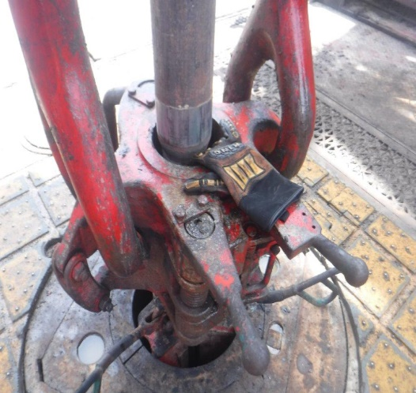
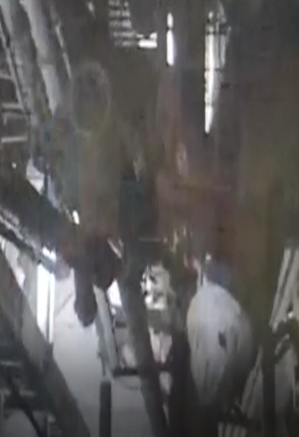
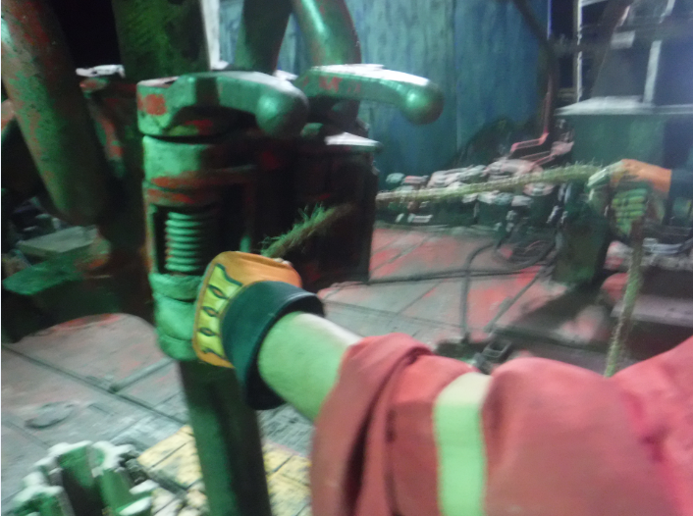
PDO Second Alert
Date: 09.06.2021 Incident type: LTI#14 (Hands & Fingers)
What happened?
On 09th June 2021 at 23:36 hours, operation was drilling 6 1/8” section and while making connection of 5” HWDP (Heavy weight drill pipe) stand, Floorman installed the HWDP stand to elevator and tried to install the rope used to open the elevator latch. Floorman placed his hand between elevator and HWDP stand in pinch point as driller started to pick up. Floor-man signaled to Driller to stop. Driller immediately lowered the elevator to free finger from pinch point. Floor-man climbed down and report to Night Tool Pusher.
Floorman evacuated to camp clinic. After first aid he was sent to Nizwa hospital for further management.
Your learning from this incident..
Always ensure to place hands only on designated handles.
Derrick-man and Driller to use clear communication when ready to lift.
Ensure person working at height is wearing correct PPE before climbing.
Photo explaining what was done wrong
Keep fingers away from pinch points and use designated handles
Notes:
Ensure all dates and titles are input
A short description should be provided without mentioning names of contractors or individuals. You should include, what happened, to who (by job title) and what injuries this resulted in. Nothing more!
Four to five bullet points highlighting the main findings from the investigation. Remember the target audience is the front line staff so this should be written in simple terms in a way that everyone can understand.
The strap line should be the main point you want to get across
The images should be self explanatory, what went wrong (if you create a reconstruction please ensure you do not put people at risk) and below how it should be done.

Slide 2
Management self audit
Date: 09.06.2021 Incident type: LTI#14
As a learning from this incident and ensure continual improvement all contract
managers must review their HSE HEMP against the questions asked below
Confirm the following:
Do you ensure adequate communication between driller and derrick-man?
Do you ensure adequate monkey board communication system available at site?
Do you ensure random self-verification of communication skills are conducted?
Do you ensure to verify the implementation of MoC system?
* If the answer is NO to any of the above questions please ensure you take action to correct this finding.
Notes:
Ensure all dates and titles are input
Make a list of closed questions (only ‘yes’ or ‘no’ as an answer) to ask others if they have the same issues based on the management or HSE-MS failings or shortfalls identified in the investigation.
Imagine you have to audit other companies to see if they could have the same issues.
These questions should start with: Do you ensure…………………?

