Slide 1
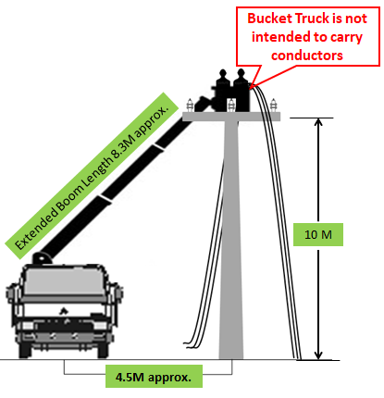
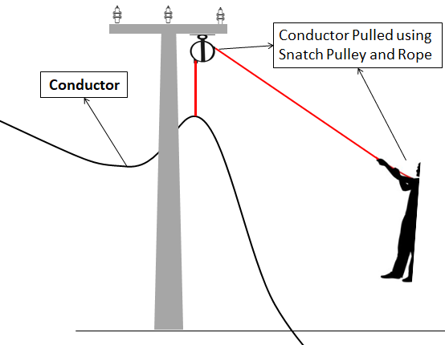

PDO Second Alert
Date: 07.07.2021 Incident title: LTI # 15 & 16
What happened?
On 07.07.2021 at 11:20 Hrs. Stringing team were engaged in stringing Over-Head line at Rabaa-34 location involving the use of bucket truck. Two linemen were working inside the Bucket Truck which is also loaded with three 33 KV OHL conductors & conductor rollers for installation on the pole’s cross arm. While the linemen are in the process of placing the conductors on the cross arm, the Bucket Truck lost its stability and tilted to the ground along with the linemen inside the bucket. The incident resulted in injuries to both linemen, with one of them had a fracture to his right elbow and the other sustained hairline fracture of pelvic.Both the Injured persons were initially treated at Qarn Alam PAC clinic before been transferred to Bader Al Sama, Nizwa for further Treatment.
Your learning from this incident
Always ensure work procedure is followed.
Always ensure work procedures complying with PDO requirements
Always ensure proper leveling of equipment before operation
Always ensure ground stability before use of any lifting equipment.
Always ensure not to exceed the Safe Working Load of equipment.
Always ensure equipment is used for intended purpose only.
Ensure to conduct pre use inspection of equipment.
Ensure equipment must comply with PDO and OEM specification.
Ensure only Trained Operator are operating any equipment and machineries.
Always ensure to Intervene any unsafe acts and conditions.
Always ensure stability and working under the SWL of equipment
Notes:
Ensure all dates and titles are input
A short description should be provided without mentioning names of contractors or individuals. You should include, what happened, to who (by job title) and what injuries this resulted in. Nothing more!
Four to five bullet points highlighting the main findings from the investigation. Remember the target audience is the front line staff so this should be written in simple terms in a way that everyone can understand.
The strap line should be the main point you want to get across
The images should be self explanatory, what went wrong (if you create a reconstruction please ensure you do not put people at risk) and below how it should be done.

Slide 2
Management Self Audit
Date: 07/07/2021 Incident title: LTI # 15 & 16
As a learning from this incident and ensure continual improvement all contract
managers must review their HSE HEMP against the questions asked below
Confirm the following:
Do you ensure personnel engaged are competent to undertake activities?
Do you ensure that you have a clearly defined process for developing, reviewing and approving of procedures?
Do you ensure that only fit for the purpose equipment are been used?
Do you ensure that all potential hazards are considered before start of the activities and communicated to the team?
Do you ensure all the lifting equipment are operated within SWL?
Do you ensure the proper levelling of equipment before operation?
Do you ensure all equipment and machinery are inspected prior to mobilization and use?
Do you ensure that the site team is empowered to intervene any unsafe behavior / act or Condition?
* If the answer is NO to any of the above questions please ensure you take action to correct this finding.
Notes:
Ensure all dates and titles are input
Make a list of closed questions (only ‘yes’ or ‘no’ as an answer) to ask others if they have the same issues based on the management or HSE-MS failings or shortfalls identified in the investigation.
Imagine you have to audit other companies to see if they could have the same issues.
These questions should start with: Do you ensure…………………?

