Slide 1
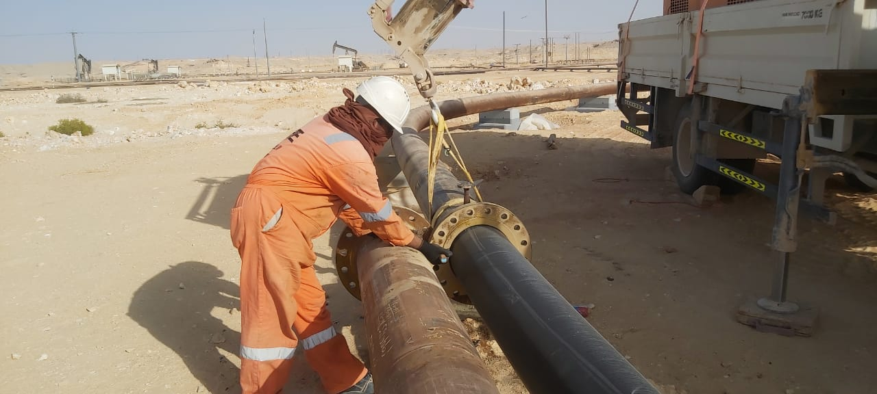
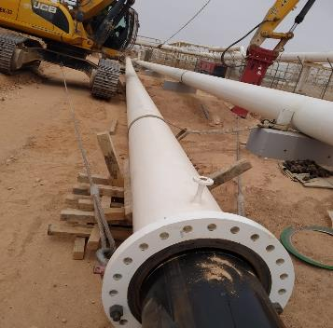
PDO Second Alert
Date: 01/05/2022 Incident title: LTI #15 Pattern: Released Energy Potential severity: C3P
Target Audience: PE Pulling team
What happened?
On 01st May 2022, two pipe sections were bolted together for PE pulling activity. The bolting was done to arrest the
anticipated movements on host pipe during PE pulling. When PE pulling was completed, both lines were in tension
to one another. In order to arrest lateral movement of the host pipe, rigger attached the host pipe to a 07 ton HIAB
by using web slings. After this, the rigger approached the other pipe section to remove the bolt. Rigger observed
that tension is still there on the pipeline and the bolt was not coming manually. He decided to remove the bolt by
hammering it. For removing the bolt, he positioned himself parallelly with the line and hammered it. As soon as the
bolt detached from pipeline, the line made an abrupt movement towards the rigger. Seeing this movement, rigger
tried to move back, but his right leg made contact with the pipeline, injuring him. The rigger then shifted to Tawoos
PAC Clinic and subsequently to SQH Salalah for further medical management.
Why it happened/Finding :
Rigger removed the stiffened pin from a tensed pipe by standing in line of fire.
House keeping of the work place was inadequate to avoid slip, trip & fall.
Site specific hazards not identified by crew before job commencement.
Procedure for anchoring of pipe line was not followed
Your learning from this incident..
Always use earth moving equipment for anchoring during PE pulling activity.
Always identify the tension in pipe line and stay away from line of fire.
Always discuss all the potential line of fire and pinch points in you activities.
Always follow safe work procedure
Always conduct thorough housekeeping before commencing activities
Follow procedure to execute the job
Notes:
Ensure all dates and titles are input
A short description should be provided without mentioning names of contractors or individuals. You should include, what happened, to who (by job title) and what injuries this resulted in. Nothing more!
Four to five bullet points highlighting the main findings from the investigation. Remember the target audience is the front line staff so this should be written in simple terms in a way that everyone can understand.
The strap line should be the main point you want to get across
The images should be self explanatory, what went wrong (if you create a reconstruction please ensure you do not put people at risk) and below how it should be done.

Slide 2
Management self audit
Date: 01/05/2022 Incident title: LTI #15 Pattern: Released Energy Potential severity: C3P
As a learning from this incident and ensure continual improvement all contract managers must review their HSE risk management against the questions asked below
Confirm the following:
Do you ensure that your employees follow procedures for the task?
Do you ensure that appropriate equipment is provided to perform the activity?
Do you ensure that your employees are away from the line of fire?
Do you ensure housekeeping is conducted prior commencing the activity?
Do you ensure all hazards are identified and risk register updated ?
* If the answer is NO to any of the above questions please ensure you take action to correct this finding
Notes:
Ensure all dates and titles are input
Make a list of closed questions (only ‘yes’ or ‘no’ as an answer) to ask others if they have the same issues based on the management or HSE-MS failings or shortfalls identified in the investigation.
Imagine you have to audit other companies to see if they could have the same issues.
These questions should start with: Do you ensure…………………?

