Slide 1
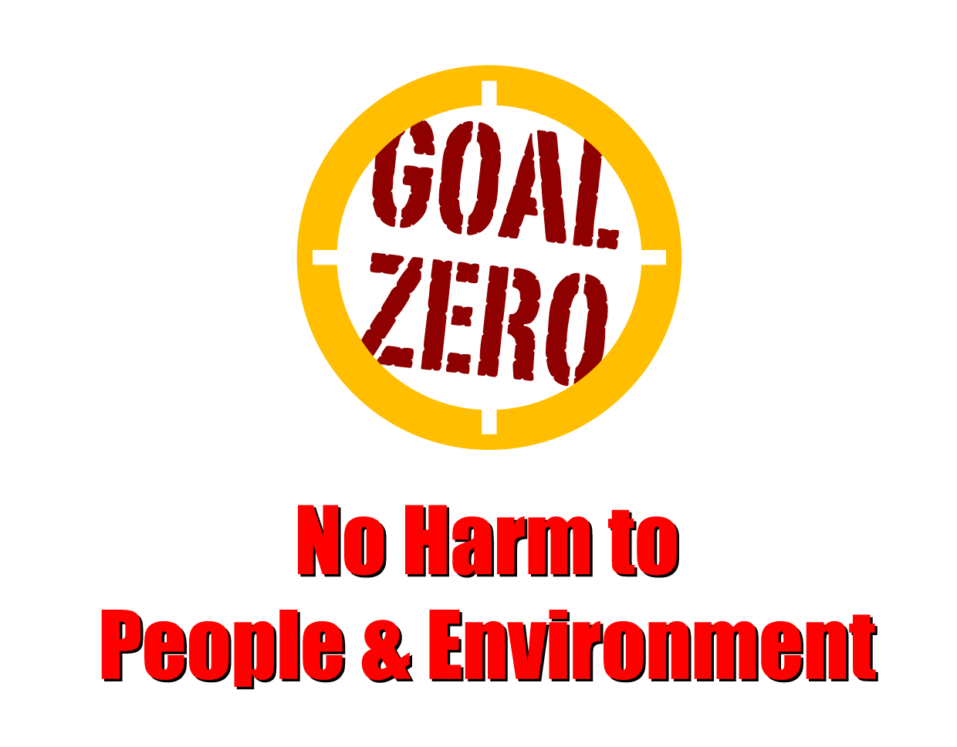
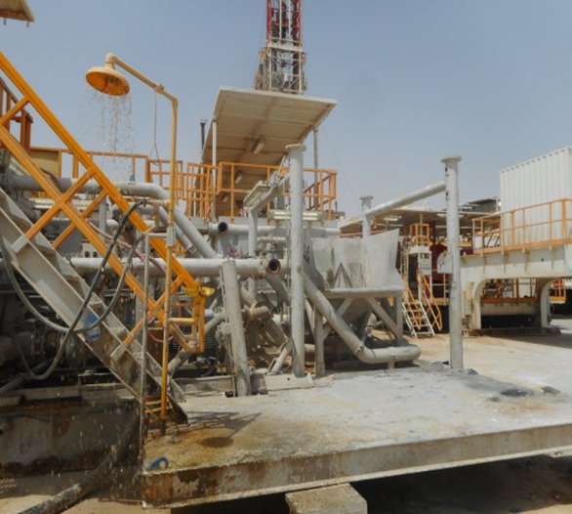
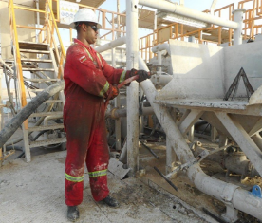
Learning From Incident - First Alert
Prevent
PIM # | 1157585 | Date | 10.05.2023 | Direct / Depart
Incident Type | LTI#15 | Time | 12:30 hrs | Location | Lekhwair
Pattern | Chemical Burn | Contractor |  | Activity | Mixing chemicals
Target Audience: All
What Happened:
While the Roustabout was mixing Calcium Chloride on the mixing hopper, a solid piece of calcium chloride blocked the suction of the hopper . As the Roustabout decided to use the water hose to dilute the solid piece, the water overflowed out of the hopper and spilled onto his left bottom leg and his foot resulting in a burn injury at his left leg foot.
Initial Findings:
Roustabout was wearing a coverall inside the rubber boots
Water was used to dissolve the block of CaCl2 inside the hopper which overflowed.
Job Safety Analysis did not highlight the usage of hand tool (shovel) to break down blocks of salt
The event was not reported as required.
Initial Learnings:
How do you ensure you understand all chemical hazards related to your activity?
When condition changes, do you stop the activity and dynamically risk assess before proceeding?
How do you ensure the work is effectively supervised ?
Do you ensure all incidents are reported as required?
When handling chemicals, always ensure wearing the coverall outside the safety boots
In case of an emergency please call PDO Emergency Number (Toll Free): 2467-5555
Notes:
Mr Musleh image on the top right will change according to incident pattern, MSE3 will provide you with the image as per the pattern
What happened: A short description should be provided without mentioning names of contractors or individuals. You should include, what happened, to who (by job title) and what injuries this resulted in. Nothing more!
Initial Finding: Four to five bullet points highlighting the initial main findings from the investigation. Remember the target audience is the front-line staff so this should be written in simple terms in a way that everyone can understand.
Learnings: Four to five learning message in the form of questionnaires linked with initial findings
The strap line should be the main learning point you want to get across
The images should be self explanatory, what went wrong (if you create a reconstruction please ensure you do not put people at risk) and below how it should be done.

