Slide 1

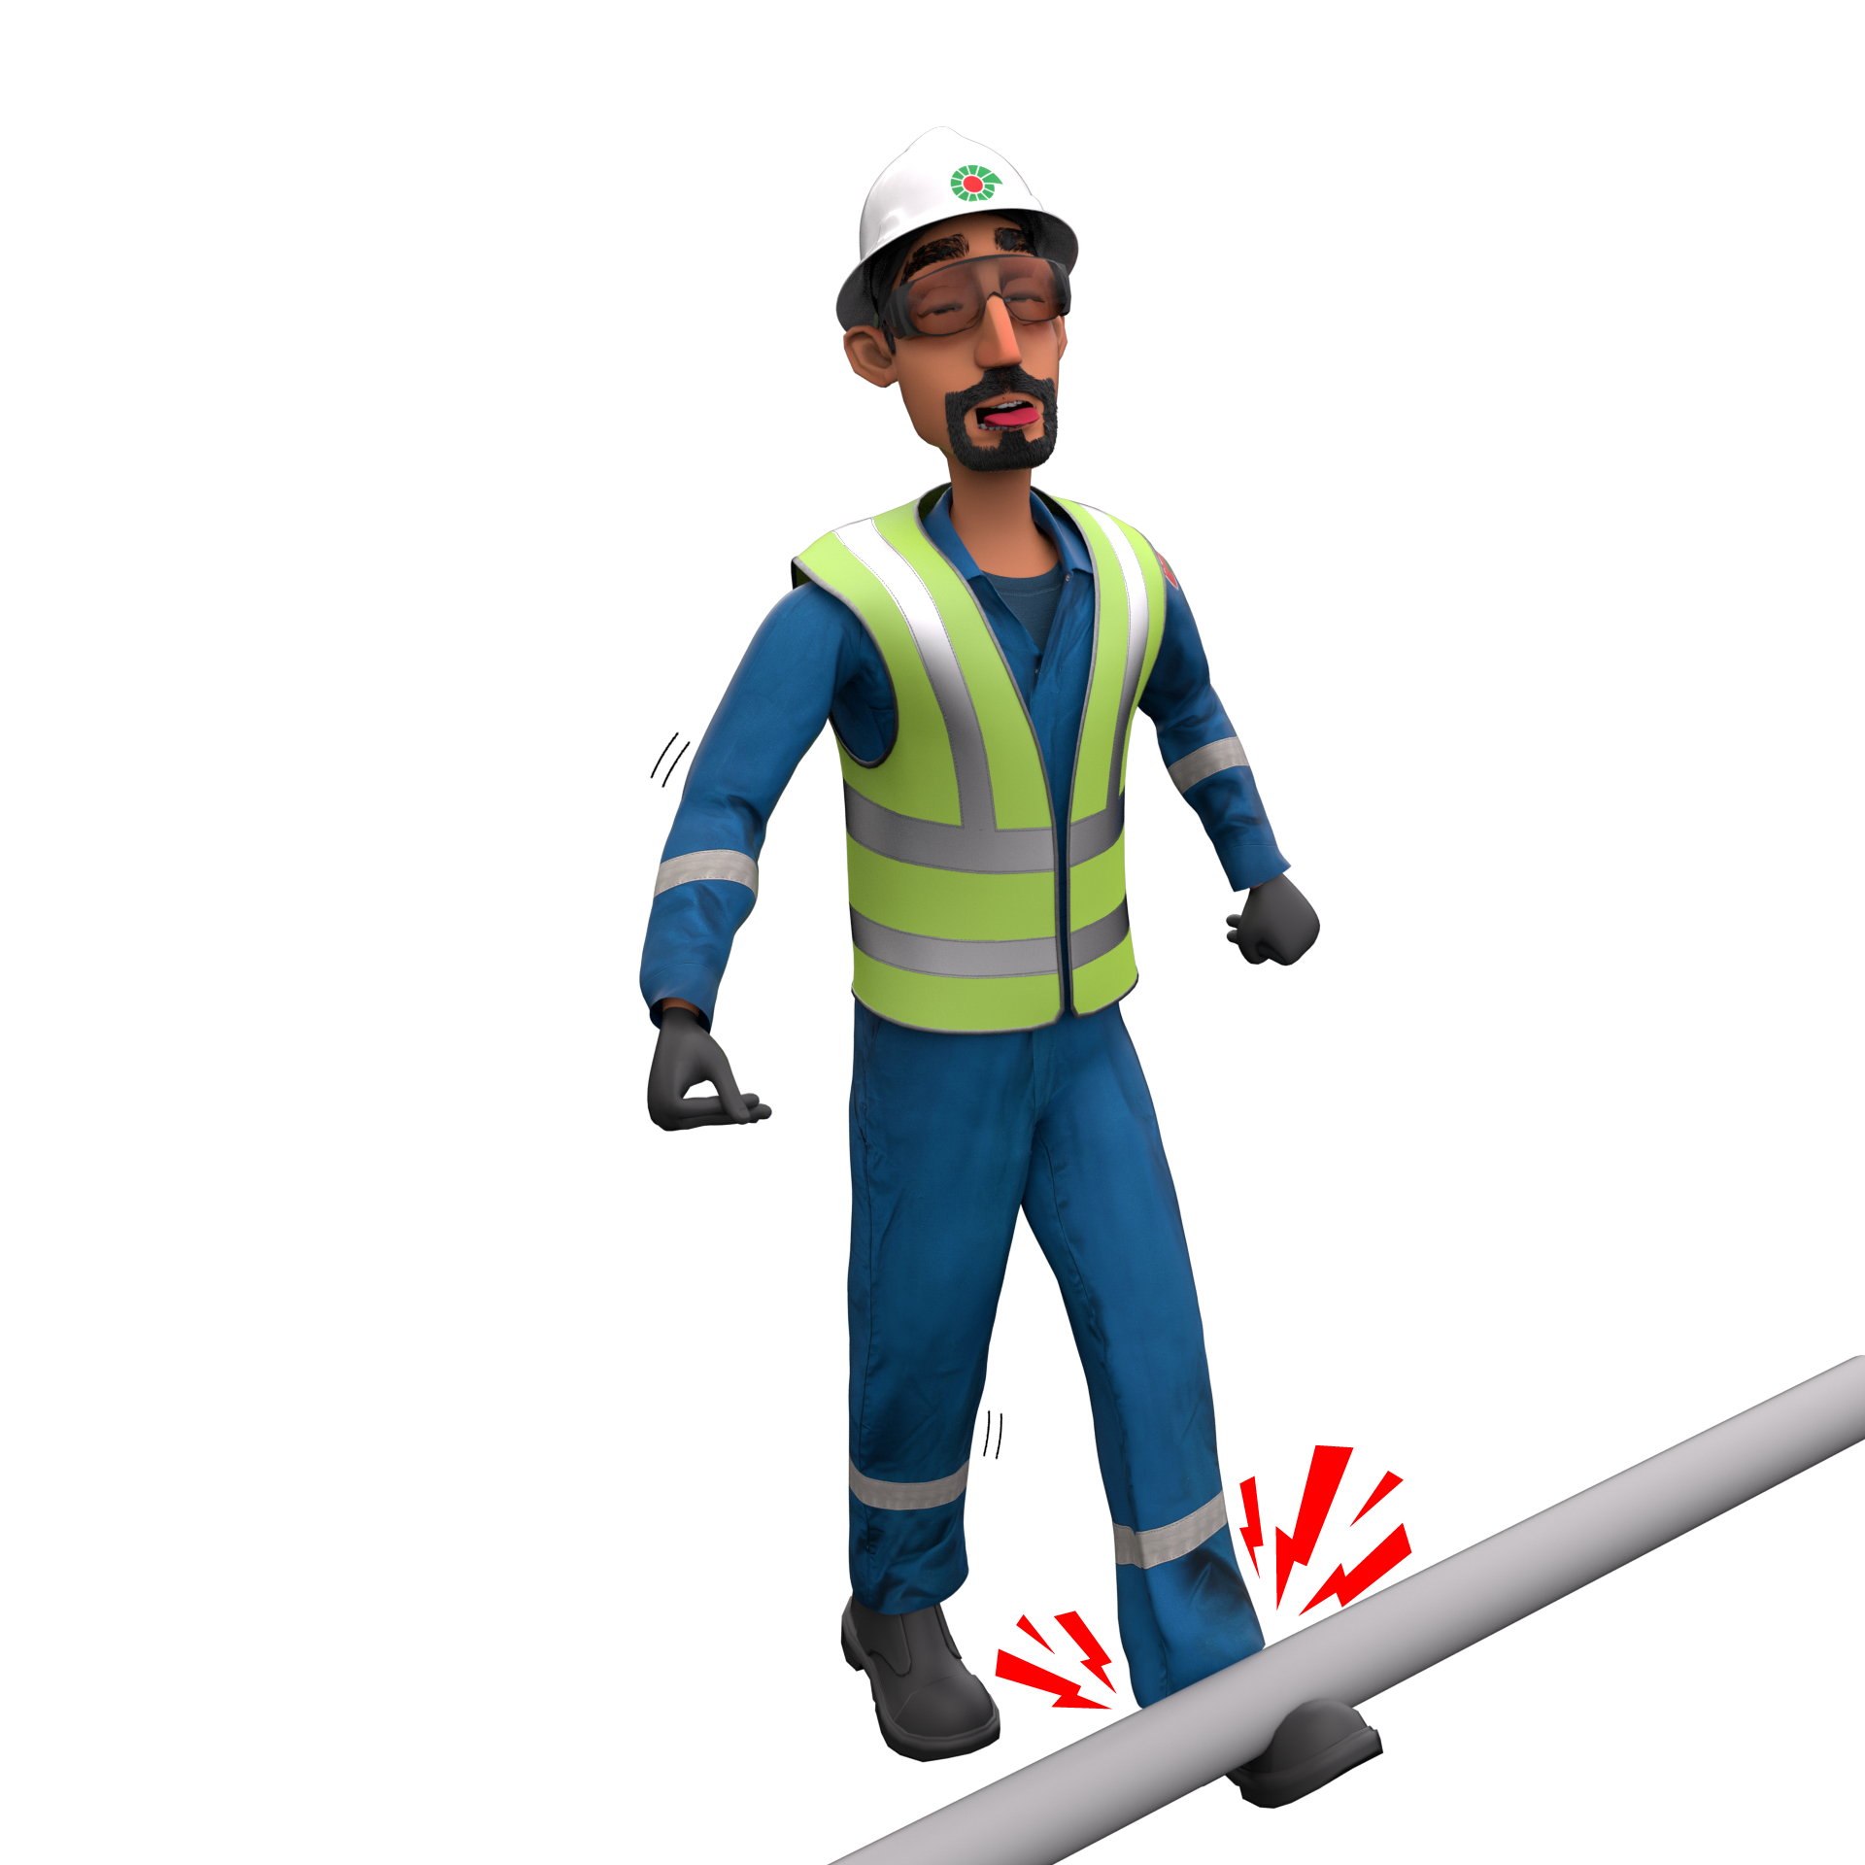
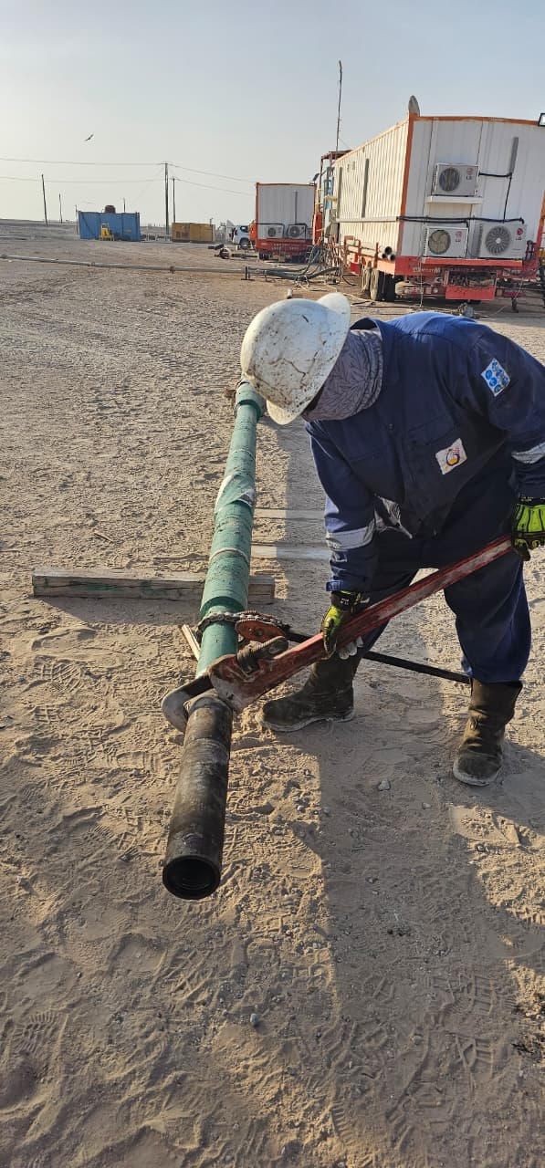
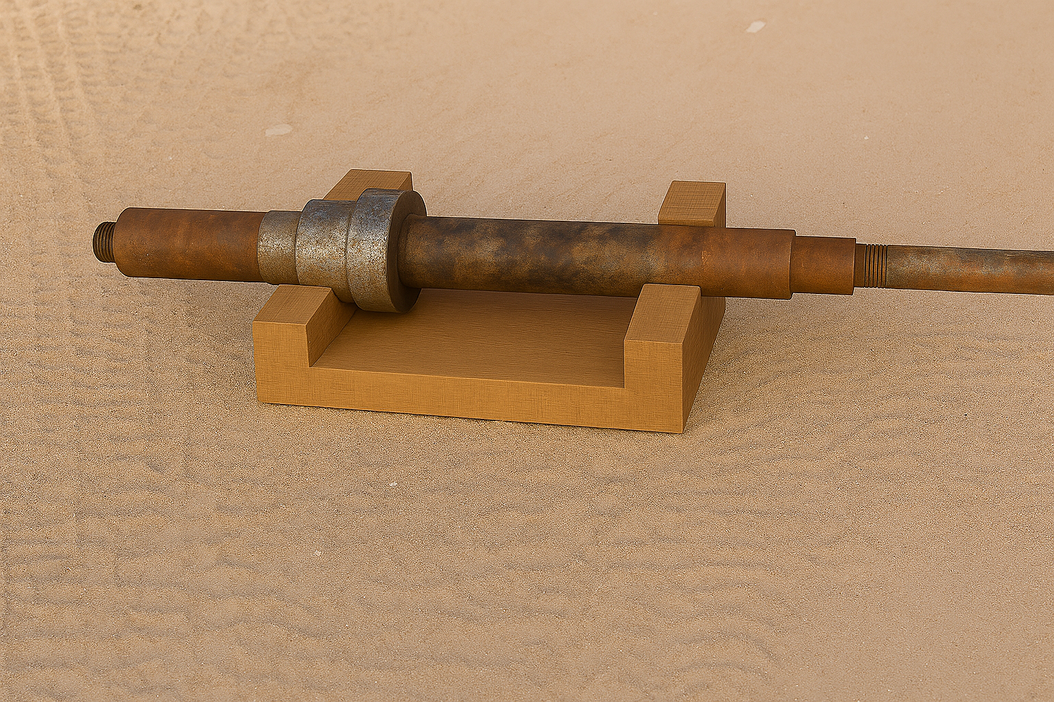
Learning From Incident - First Alert
Event ID # | 25261703 | Date & Time | 16.09.2025 / 16:45 | Location | Qarn Alam
Incident Type | LTI#16 | Category | Struck by | Activity | Makeup BHA
Prevent
Target Audience: ALL
What happened:
During make up of fishing assembly, the crew were using a chain tong and pipe wrench to apply torque to the assembly placed on a piece of wood on the ground. While applying the torque, the chain tong slipped, causing the entire assembly to flip and roll onto the Roustabout’s right leg causing fracture.
Initial Findings:
The BHA assembly was placed on a piece of wood, which did not provide stable support.
Torque was applied using a chain tong and pipe wrench on the ground.
The Roustabout’s leg was in the line of fire and no one intervened before the incident.
The hazard of instability during torque application was not identified in the planning or final check.
Engagement Questions:
Do you ensure BHA make-up is carried out utilizing proper tools on a stable surface?
Are assemblies always secured with proper supports or stoppers before torque is applied?
Do you verify that no crew members are in the line of fire during make up or break out of assemblies?
Are Toolbox Talks (TBTs) consistently highlighting line-of-fire and stability hazards for every assembly operation?
Always secure assemblies and keep clear of the line of fire when torque is applied.
In case of an emergency please call PDO Emergency Number (Toll Free): 2467-5555
Notes:
Mr Musleh image on the top right will change according to incident pattern, MSE3 will provide you with the image as per the pattern
What happened: A short description should be provided without mentioning names of contractors or individuals. You should include, what happened, to who (by job title) and what injuries this resulted in. Nothing more!
Initial Finding: Four to five bullet points highlighting the initial main findings from the investigation. Remember the target audience is the front-line staff so this should be written in simple terms in a way that everyone can understand.
Learnings: Four to five learning message in the form of questionnaires linked with initial findings
The strap line should be the main learning point you want to get across
The images should be self explanatory, what went wrong (if you create a reconstruction please ensure you do not put people at risk) and below how it should be done.

