Slide 1
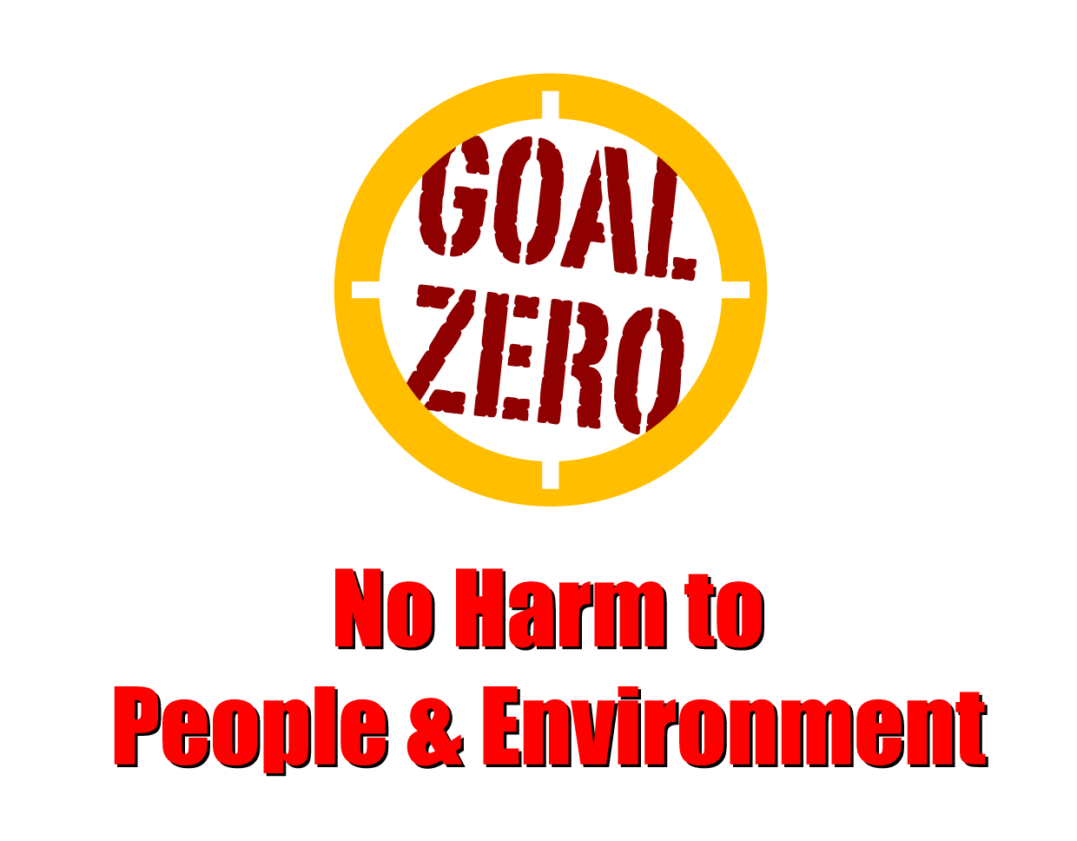
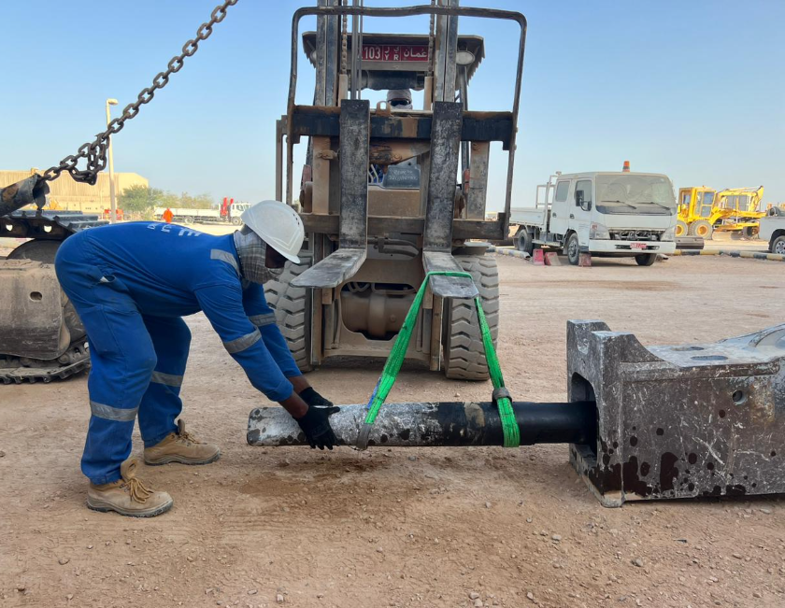
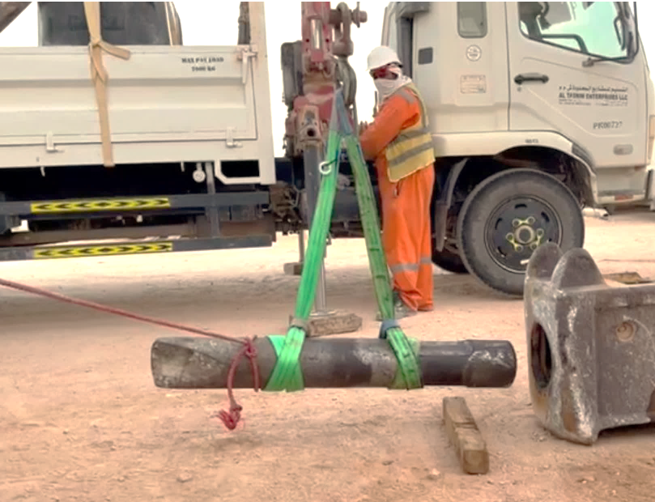
Learning From Incident - First Alert
Prevent
PIM # | 1158474 | Date | 22.07.2023 | Direct / Depart
Incident Type | LTI#16 | Time | 15:45 hrs | Location | ATE Workshop, Nimr
Pattern | Hands & Fingers | Contractor |  | Activity | Fixing RB chisel
Target Audience: All
What happened
At 15:50 pm on the 22nd of July 2023, the workshop crew were fixing a 300kg chisel inside the chisel housing of the breaker. During positioning the chisel using a forklift, the mechanic attempted to align the chisel with the housing, but due to the inclined position, the chisel slipped and trapped two fingers of his left hand between the chisel and the ground resulting in amputation of the fingertips on the middle and ring fingers.
Initial Findings
The chisel was being lifted by the forklift using a sling belt, which does not comply with PDO lifting specification.
Mechanic was using his hands to align the chisel into the chisel housing while wearing cotton hand gloves.
The workshop foreman was operating the forklift in place of the forklift operator who was unavailable.
The event was not reported.
Learnings
Do you ensure TBT engagement is effectively done prior the task ?
How do you ensure all crew members are aware of all the pinch points related hazards?
Do you always ensure that all activities are planned well before starting the task?
Do you ensure to use appropriate tools and equipment for the task?
Do you ensure you comply with PDO lifting specifications?
Always use handsfree option, where there is risk of pinch points
In case of an emergency please call PDO Emergency Number (Toll Free): 2467-5555
Notes:
Mr Musleh image on the top right will change according to incident pattern, MSE3 will provide you with the image as per the pattern
What happened: A short description should be provided without mentioning names of contractors or individuals. You should include, what happened, to who (by job title) and what injuries this resulted in. Nothing more!
Initial Finding: Four to five bullet points highlighting the initial main findings from the investigation. Remember the target audience is the front-line staff so this should be written in simple terms in a way that everyone can understand.
Learnings: Four to five learning message in the form of questionnaires linked with initial findings
The strap line should be the main learning point you want to get across
The images should be self explanatory, what went wrong (if you create a reconstruction please ensure you do not put people at risk) and below how it should be done.

