Slide 1


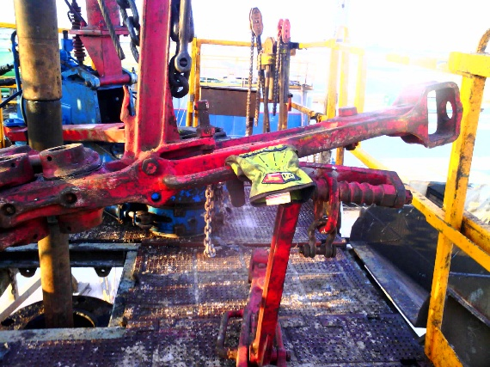
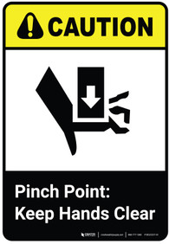
Learning From Incident - First Alert
Event ID # | 25504840 | Date & Time | 19.10.2025 / 11:24 | Location | Yibal
Incident Type | LTI#17 | Category | Hands & Fingers (caught between) | Activity | Rig up power tongs
Prevent
Target Audience: ALL
What happened:
During the rig up of manual tongs on the rig floor. The driller side manual tong was lifted by rig floor air winch to allow crew to connect it to manual tong hanging sling with shackle. After complete connecting hanging line, driller operated the air winch to lower down the manual tong, while the Roustabout was holding the handle, his ring finger was caught between the handle and the lifting arm of the other manual tong which was sitting on the rig floor causing fracture.
Initial Findings:
Lack of Clear Communication: Potential lack of coordination between the driller and floor crew during the lowering operation
Inadequate Hazard Awareness: Crew may not have fully identified or mitigated pinch point hazards during the task planning or toolbox talk.
Hand Placement: Floorman was holding the handle of the suspended tong during lowering, exposing fingers to pinch points
No Use of Taglines or Tools (Handoff method): Manual handling of suspended equipment without taglines or tools to maintain safe distance.
Engagement Questions:
Do you have a process for identifying and discuss pinch point hazards prior to carryout tasks/ pre job meeting?
How can we ensure everyone is stay out of the line of fire?
How can we ensure clear communication during task? What signal communication do we used before moving equipment?
Always ensure your body parts are aware from Line of Fire
In case of an emergency please call PDO Emergency Number (Toll Free): 2467-5555
Notes:
Mr Musleh image on the top right will change according to incident pattern, MSE3 will provide you with the image as per the pattern
What happened: A short description should be provided without mentioning names of contractors or individuals. You should include, what happened, to who (by job title) and what injuries this resulted in. Nothing more!
Initial Finding: Four to five bullet points highlighting the initial main findings from the investigation. Remember the target audience is the front-line staff so this should be written in simple terms in a way that everyone can understand.
Learnings: Four to five learning message in the form of questionnaires linked with initial findings
The strap line should be the main learning point you want to get across
The images should be self explanatory, what went wrong (if you create a reconstruction please ensure you do not put people at risk) and below how it should be done.

