Slide 1
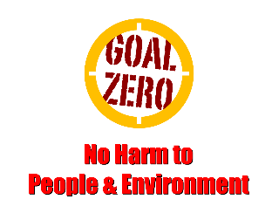
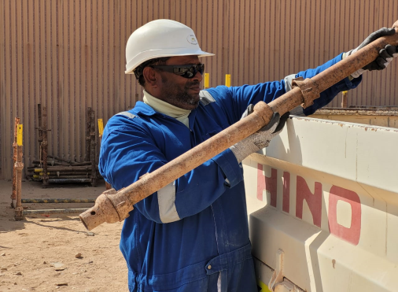
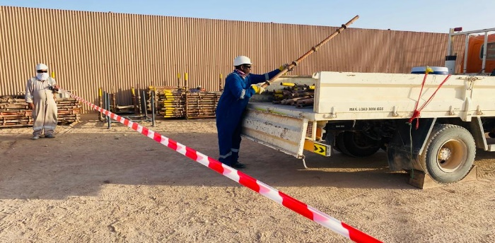
Learning From Incident - First Alert
Prevent
PIM # | 1159481 | Date | 23.09.2023 | Direct /Depart
Incident Type | LTI# 17 | Time | 17:37 Hrs | Location | ATNM Industrial Yard, Marmul
Pattern | Hands & Fingers | Contractor |  | Activity | Loading of scaffold components
Target Audience: All
What happened
While manually transferring scaffolding standards from the storage yard to a 3-ton canter, a rigger right-hand middle finger became trapped between the coupling of the scaffolding standard and the edge of the tailboard of the canter. This resulted in a crush injury (amputation) to the tip of his right-hand middle finger.
Initial Findings
The employee was wearing a poly urethane glove.
The cargo body of the 3ton was kept closed while loading.
The material was dumped into the vehicle instead of arranging it inside the cargo body
Learnings
How do ensure the tasks are risk assessed prior starting the work?
How do you always ensure that all activities are planned well before starting the task?
How do you ensure personnel are aware of the correct PPE for each task and where to obtain it from?
Always be aware of hazards when loading/unloading from vehicles
In case of an emergency please call PDO Emergency Number (Toll Free): 2467-5555
Notes:
Mr Musleh image on the top right will change according to incident pattern, MSE3 will provide you with the image as per the pattern
What happened: A short description should be provided without mentioning names of contractors or individuals. You should include, what happened, to who (by job title) and what injuries this resulted in. Nothing more!
Initial Finding: Four to five bullet points highlighting the initial main findings from the investigation. Remember the target audience is the front-line staff so this should be written in simple terms in a way that everyone can understand.
Learnings: Four to five learning message in the form of questionnaires linked with initial findings
The strap line should be the main learning point you want to get across
The images should be self explanatory, what went wrong (if you create a reconstruction please ensure you do not put people at risk) and below how it should be done.

