Slide 1
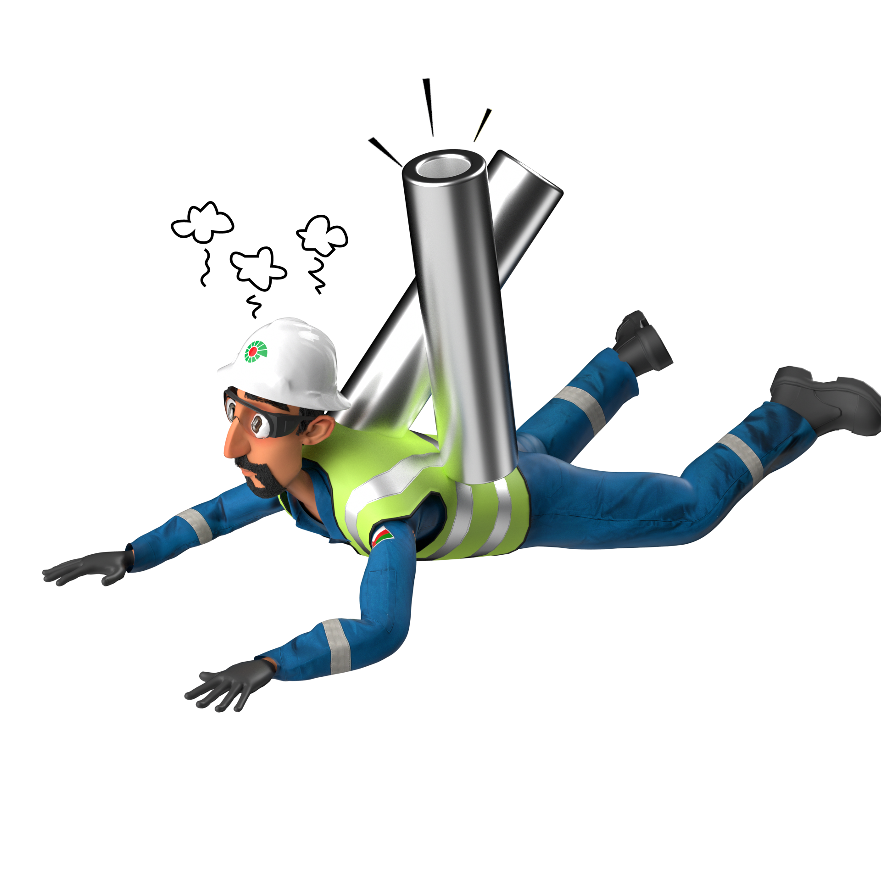
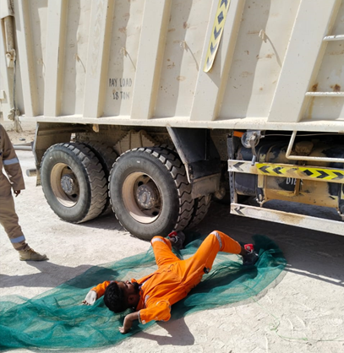
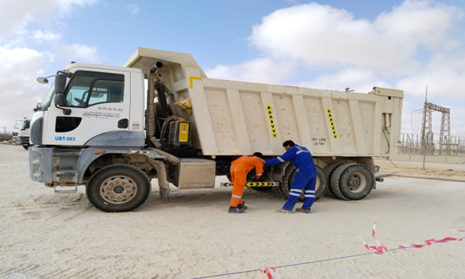
Learning From Incident - First Alert
Prevent
PIM # | 1170739 | Date & Time | 26.09.2024, 06:45 AM | Location | Amal
Incident Type | LTI#18 | Category | Hit/Struck by | Activity | Vehicle Inspection
Target Audience: Drivers
What happened:
On 26 September 2024 at 06:45am, while a Tipper Driver (Driver 2) was assisting his colleague (Driver 1) to inspect the air pressure unit from the right side of the vehicle, Driver 1 started to drive forward, unaware that the Driver 2 was under the vehicle. This caused the Tipper tire to hit Driver 2, injuring his left foot.
He was initially treated at PDO clinic before being transferred to Badr Al Samaa hospital, where x-ray revealed a fracture on his left foot.
Initial Findings:
Driver 1 believed the inspection was complete, so he wanted to drive the vehicle away.
Driver 2 believed that his colleague had followed him to continue the inspection on the other side of the vehicle.
Engagement Questions:
Drivers: Do you ensure to complete a 360º check before moving your vehicle?
How do you ensure HGV Drivers are aware of line of fire risks associate with their vehicles?
How do you ensure the right communication protocol during vehicle inspection?
ALWAYS avoid the line of fire!
In case of an emergency please call PDO Emergency Number (Toll Free): 2467-5555
Notes:
Mr Musleh image on the top right will change according to incident pattern, MSE3 will provide you with the image as per the pattern
What happened: A short description should be provided without mentioning names of contractors or individuals. You should include, what happened, to who (by job title) and what injuries this resulted in. Nothing more!
Initial Finding: Four to five bullet points highlighting the initial main findings from the investigation. Remember the target audience is the front-line staff so this should be written in simple terms in a way that everyone can understand.
Learnings: Four to five learning message in the form of questionnaires linked with initial findings
The strap line should be the main learning point you want to get across
The images should be self explanatory, what went wrong (if you create a reconstruction please ensure you do not put people at risk) and below how it should be done.

