Slide 1
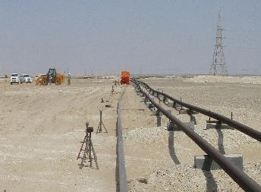
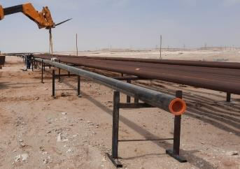
PDO Second Alert
Date: 08.08.2021 Incident type :LTI # 18
What happened?
On 08-08-2021 around 8:50 Hrs, A mechanical crew were shifting the pipes on the wooden skids after completion of welding. After complete shifting of one portion they moved another. While shifting it on the wooden skid, tripod jack got unbalanced and started to fall one by one. Pipe hit left side of the hip of fitter who was doing buffing activity inside welding booth. Resulted fracture injury on his LT pelvis.
Your learning from this incident..
Always adhere with procedures and method statements.
Always ensure to use H Beam support while performing welding activity.
Always ensure the lifting area is free and barricaded.
Always establish proper communication between team members. Ensure to comply to PDO Golden Rules (Comply, Intervene and Respect).
Always ensure not to keep the pipes on jacks for long length.
Don’t do shortcuts, comply with procedures
Notes:
Ensure all dates and titles are input
A short description should be provided without mentioning names of contractors or individuals. You should include, what happened, to who (by job title) and what injuries this resulted in. Nothing more!
Four to five bullet points highlighting the main findings from the investigation. Remember the target audience is the front line staff so this should be written in simple terms in a way that everyone can understand.
The strap line should be the main point you want to get across
The images should be self explanatory, what went wrong (if you create a reconstruction please ensure you do not put people at risk) and below how it should be done.

Slide 2
Management self audit
Date: 08.08.2021 Incident type :LTI # 18
As a learning from this incident and ensure continual improvement all contract
managers must review their HSE HEMP against the questions asked below
Confirm the following:
Do you always ensure work procedure and method statement available and followed?
Do you always ensure daily activities are planned realistic in compliance with safety requirements?
Do you always ensure employees are not in line of fire?
Do you always ensure HEMP, JSP, TRIC covering all your activities?
Do you always ensure TBT is carried out effectively?
Do you ensure that the right equipment are available and used for the task.
* If the answer is NO to any of the above questions please ensure you take action to correct this finding.
Notes:
Ensure all dates and titles are input
Make a list of closed questions (only ‘yes’ or ‘no’ as an answer) to ask others if they have the same issues based on the management or HSE-MS failings or shortfalls identified in the investigation.
Imagine you have to audit other companies to see if they could have the same issues.
These questions should start with: Do you ensure…………………?

