Slide 1
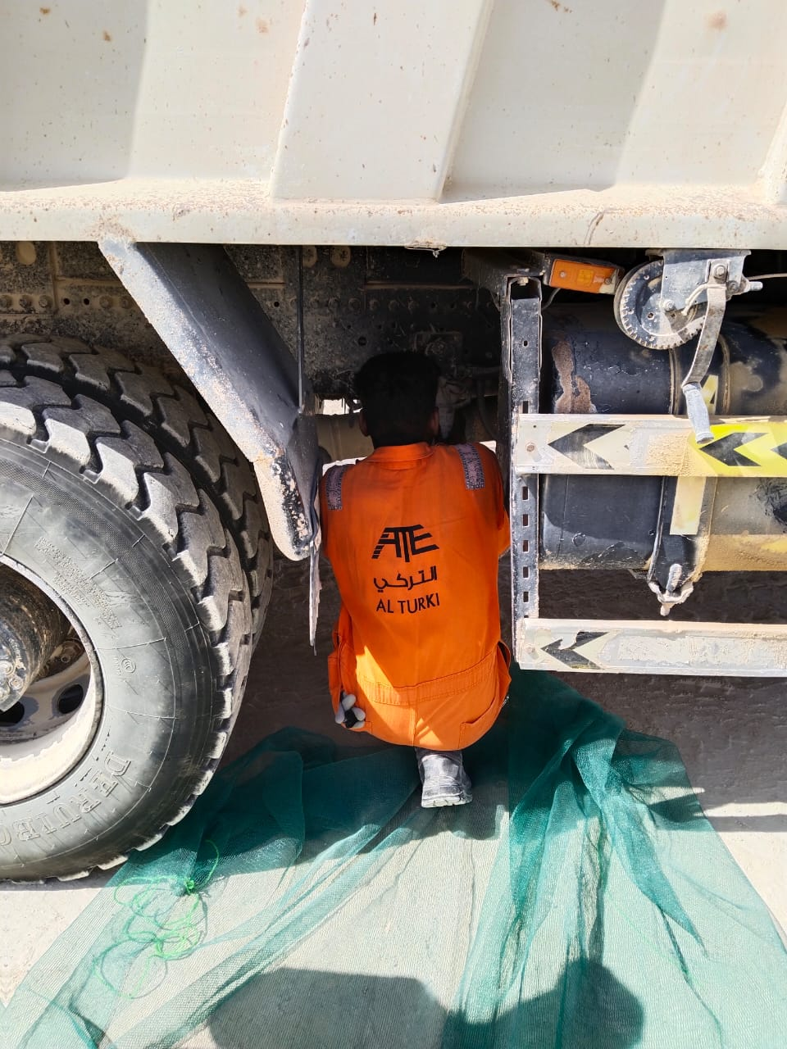
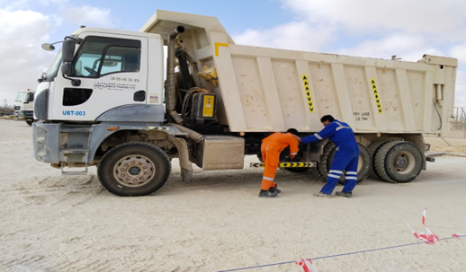
LTI#18 PIM#1170739 ATNM Foot Injury 26/09/2024
Date: Time: | 26/09/2024 06:45 | Incident title: PIM# | LTI#18 1170716 | Risk Category: Injury / Asset Damaged: | Trap in Between Leg Injury | Actual Severity: Potential severity: | 3P 4CP | Activity: Location: | Driving MAF
Target Audience: Drilling, Logistics, Operation & Construction
What happened?
On 26 September 2024 at 06:45am, while a Tipper Driver (Driver 2) was assisting his colleague (Driver 1) to inspect the air pressure unit from the right side of the vehicle, Driver 1 started to drive forward, unaware that the Driver 2 was under the vehicle. This caused the Tipper tire to hit Driver 2, injuring his left foot.
He was initially treated at PDO clinic before being transferred to Badr Al Samaa hospital, where x-ray revealed a fracture on his left foot.
Why it happened/Finding :
Driver 1 believed the inspection was complete, so he wanted to drive the vehicle away.
Driver 2 believed that his colleague had followed him to continue the inspection on the other side of the vehicle.
Verbal communication between both drivers was ineffective due to the noise levels in the area.
Your learning from this incident:
Ensure clear communication between team members, especially in noisy environments, to avoid miscommunication and assumptions
Always verify that no one is near or under the vehicle before moving it, especially during inspections.
Follow strict safety protocols and make sure all individuals are visible and accounted for before operating any machinery or vehicle.
Notes:
Ensure all dates and titles are input
A short description should be provided without mentioning names of contractors or individuals. You should include, what happened, to who (by job title) and what injuries this resulted in. Nothing more!
Four to five bullet points highlighting the main findings from the investigation. Remember the target audience is the front line staff so this should be written in simple terms in a way that everyone can understand.
The strap line should be the main point you want to get across
The images should be self explanatory, what went wrong (if you create a reconstruction please ensure you do not put people at risk) and below how it should be done.

Slide 2
LTI#18 PIM#1170739 ATNM Foot Injury 26/09/2024
Date: Time: | 26/09/2024 06:45 | Incident title: PIM# | LTI#18 1170716 | Risk Category: Injury / Asset Damaged: | Trap in Between Leg Injury | Actual Severity: Potential severity: | 3P 4CP | Activity: Location: | Driving MAF
As a learning from this incident and ensure continual improvement all contract managers must review their HSE risk management against the questions asked below
Confirm the following:
- Do you ensure reporting any defects to the workshop?
- Do you ensure not allowing anyone to go underneath the vehicle?
- Do you ensure a comprehensive pre-start inspection checklist, including a final "all clear" signal ?
- Do you ensure using the proper vehicle checklist?
* If the answer is NO to any of the above questions please ensure you take action to correct this finding
Table of contents
Notes:
Ensure all dates and titles are input
Make a list of closed questions (only ‘yes’ or ‘no’ as an answer) to ask others if they have the same issues based on the management or HSE-MS failings or shortfalls identified in the investigation.
Imagine you have to audit other companies to see if they could have the same issues.
These questions should start with: Do you ensure…………………?

