Slide 1

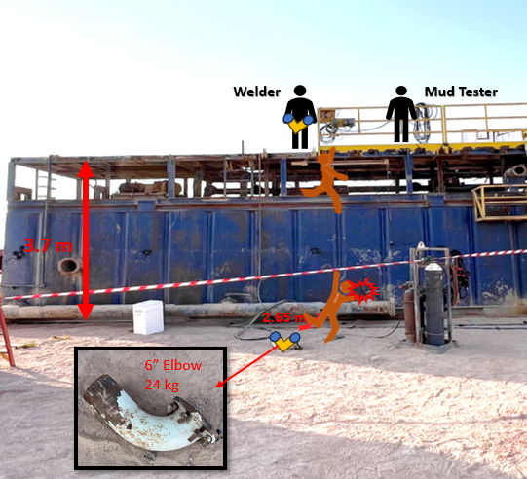
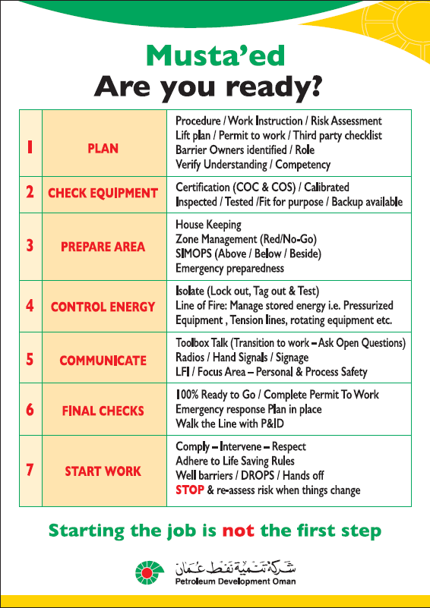
Learning From Incident - First Alert
Event ID # | 25553187 | Date & Time | 23.10.2025 / 17:20 | Location | NIMR
Incident Type | LTI#18 | Category | Fall from height (work at height) | Activity | Rig Move/Tanks Swapping
Prevent
Target Audience: ALL
What happened:
During a rig move operation, as part of the tanks swapping and modification, a welder completed the task of elbow cutting and was conducting housekeeping activities on top of a reserve mud tank located outside the rig boundary. While attempting to discard an elbow fitting, a flange nut snagged on his coverall, causing him to lose balance and fell from the tank resulted to face injury.
Initial Findings:
Plan: PTW, risk assessment, and TBT were implemented; however, they were not specific to the task.
Check Equipment: The tank was only partially equipped and secured with handrails.
Prepare Area: The team did not adequately prepare the area with proper working-at-height controls.
Control Energy: The Welder was wearing a safety harness but disconnected the lanyard while discarding the elbow fitting.
Communication: A pre-tour meeting was held by the Rig Manager, but no TBT was conducted for this specific out-of-sight activity.
Final Check: The team failed to verify that all tank safety controls were in place before starting work.
Start Work: The task was initiated without proper planning.
Engagement Questions:
Do you ensure having proper planning (specific PTW, TBT, Risk Assessment …etc.) and supervision for out of sight activities?
Do you ensure that STOP Work Authority is understood and exercised by all personnel?
Do you ensure that work-at-height and line of fire controls are in place prior to start any activity?
Don’t let out of sight be out of mind
In case of an emergency please call PDO Emergency Number (Toll Free): 2467-5555
Notes:
Mr Musleh image on the top right will change according to incident pattern, MSE3 will provide you with the image as per the pattern
What happened: A short description should be provided without mentioning names of contractors or individuals. You should include, what happened, to who (by job title) and what injuries this resulted in. Nothing more!
Initial Finding: Four to five bullet points highlighting the initial main findings from the investigation. Remember the target audience is the front-line staff so this should be written in simple terms in a way that everyone can understand.
Learnings: Four to five learning message in the form of questionnaires linked with initial findings
The strap line should be the main learning point you want to get across
The images should be self explanatory, what went wrong (if you create a reconstruction please ensure you do not put people at risk) and below how it should be done.

