Slide 1
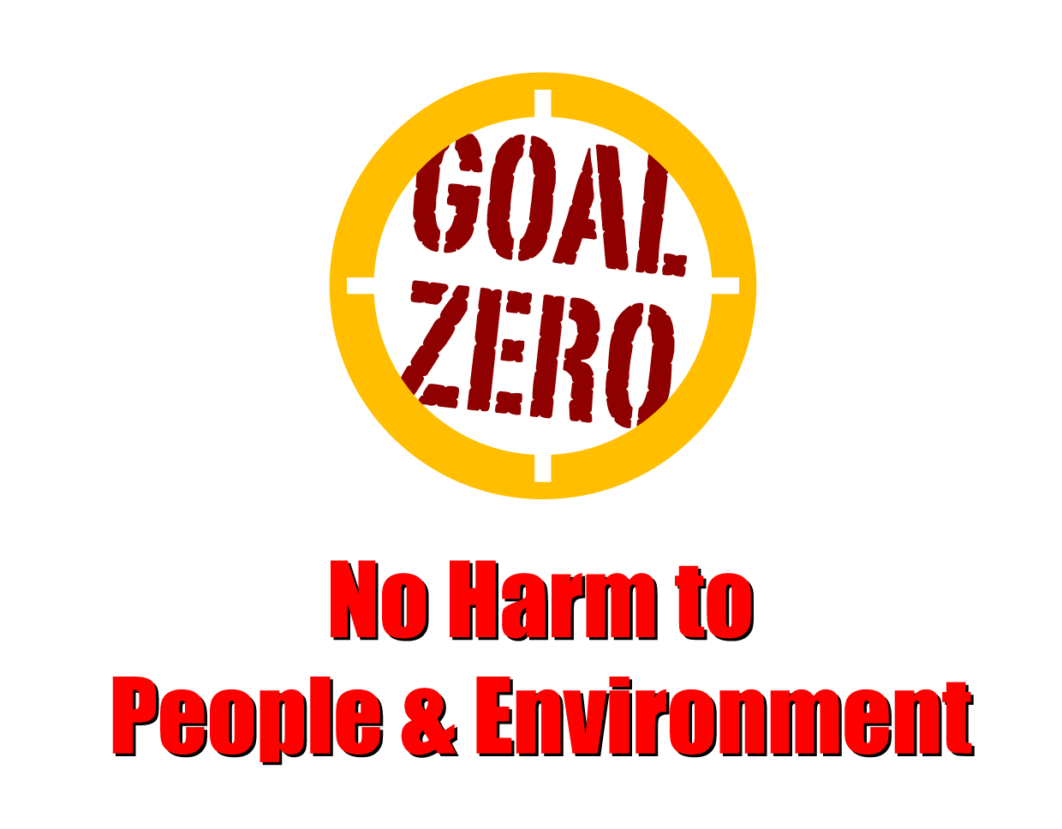
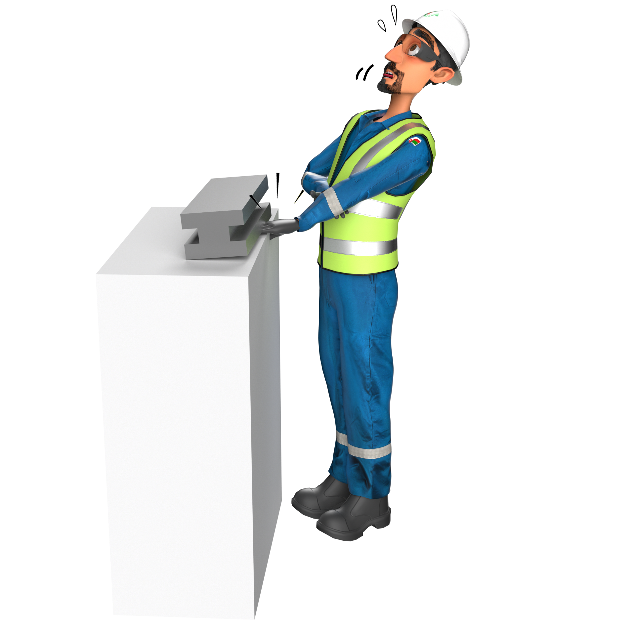
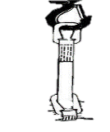
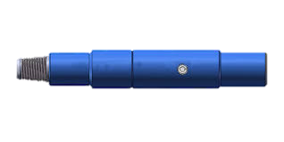
Learning From Incident - First Alert
Prevent
PIM # | 1159702 | Date | 01.10.2023 | Direct / Depart
Incident Type | LTI#18 | Time | 17:35 Hrs | Location | Rima
Pattern | Hands & Fingers | Contractor |  | Activity | Pulling out tubing hanger
Target Audience: Mason, Equipment Operators, Mechanics, Supervisor …
What happened
While pulling out the tubing hanger, the driller and crew installed the landing joint and unbolted the Tie-down Bolts. Floor crew tried to install the Full Open Safety Valve (FOSV) to retrieve the tubing hanger, unfortunately while they picked up the FOSV from rig floor with the webbing sling, the FOSV was not aligned properly on top on the landing joint. It slipped from the double wrapped webbing sling due to its oily condition and it pinched the left middle finger of the Roustabout resulting in partial amputation of fingertip.
Initial Findings
There is no lifting provision to lift the safety valve
Initial Learnings
How do you ensure provision of the correct lifting points available before you start the work?
How do you ensure you to intervene unsafe acts & condition apply empowerment to STOP?
How do you ensure to discuss about hazards & risks associated with the tasks during TBT?
Ensure handoff load during lifting
In case of an emergency please call PDO Emergency Number (Toll Free): 2467-5555
Notes:
Mr Musleh image on the top right will change according to incident pattern, MSE3 will provide you with the image as per the pattern
What happened: A short description should be provided without mentioning names of contractors or individuals. You should include, what happened, to who (by job title) and what injuries this resulted in. Nothing more!
Initial Finding: Four to five bullet points highlighting the initial main findings from the investigation. Remember the target audience is the front-line staff so this should be written in simple terms in a way that everyone can understand.
Learnings: Four to five learning message in the form of questionnaires linked with initial findings
The strap line should be the main learning point you want to get across
The images should be self explanatory, what went wrong (if you create a reconstruction please ensure you do not put people at risk) and below how it should be done.

